Slide 1
The Priesthood of Jesus Christ
Sacrifice, Priest and Victim,
Mediator, Melchizedek

Slide 2
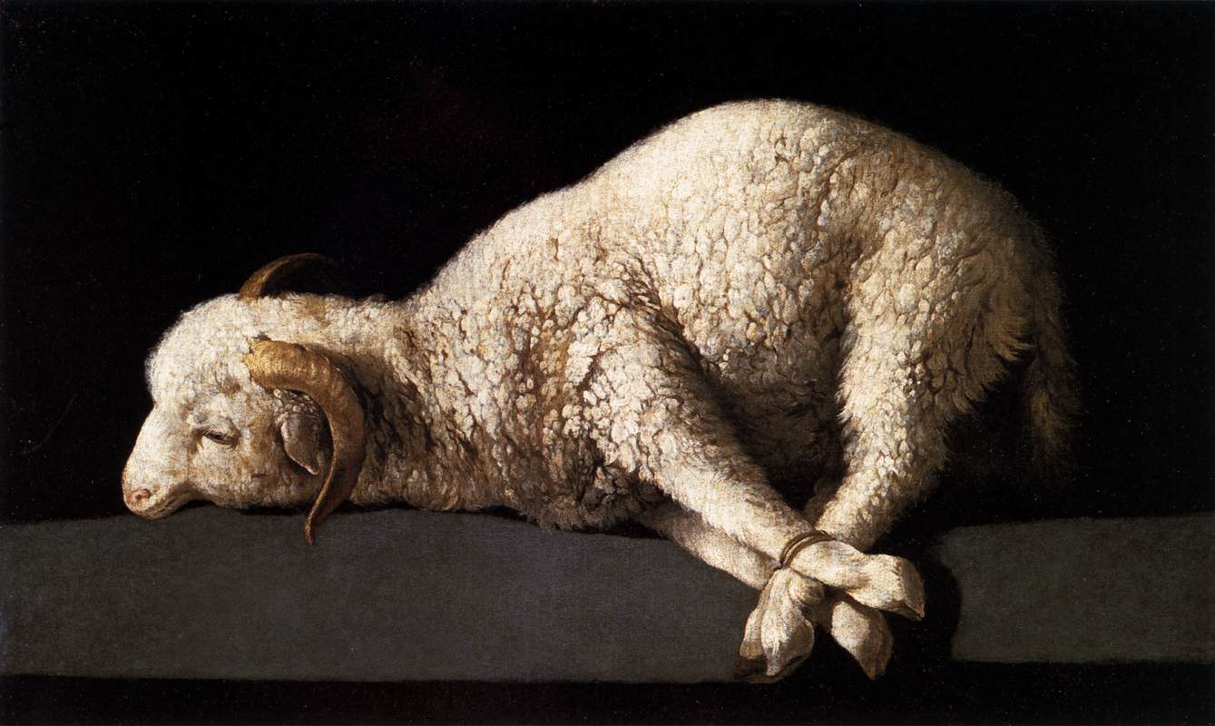
Lesson One: Sacrifice
What is sacrifice?!
Sacrum – Holy
Facere – to make
A Sacrifice is an offering, or gift, made holy by giving it to God

Slide 3
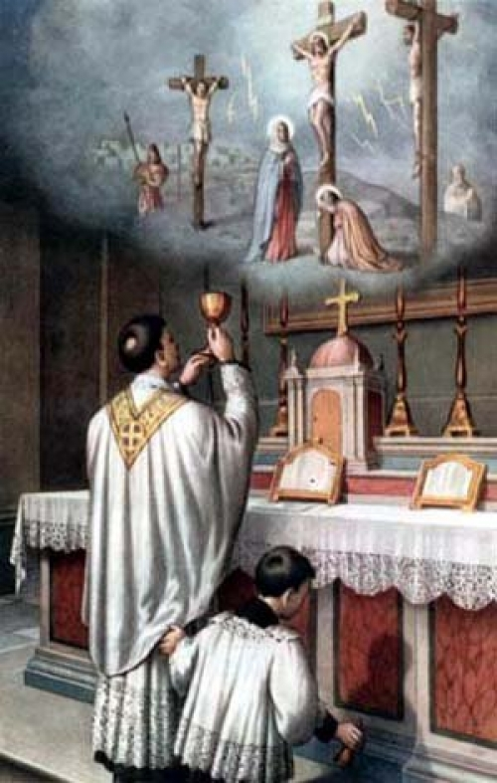
Lesson One: Sacrifice
Sacrifice is an act of worship
Adoration
Contrition
Thanksgiving
Supplication
How do we worship God?
The Mass

Slide 4
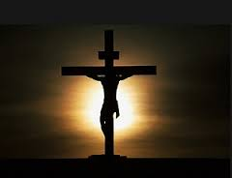
Lesson One: Sacrifice
Essential components for Sacrifice
Priest
Victim
Altar
Offered with a pure and sinless heart
Was Jesus a sacrifice?
He was the priest
He was the victim
The cross was his altar
Offered himself with a pure and sinless heart

Slide 5
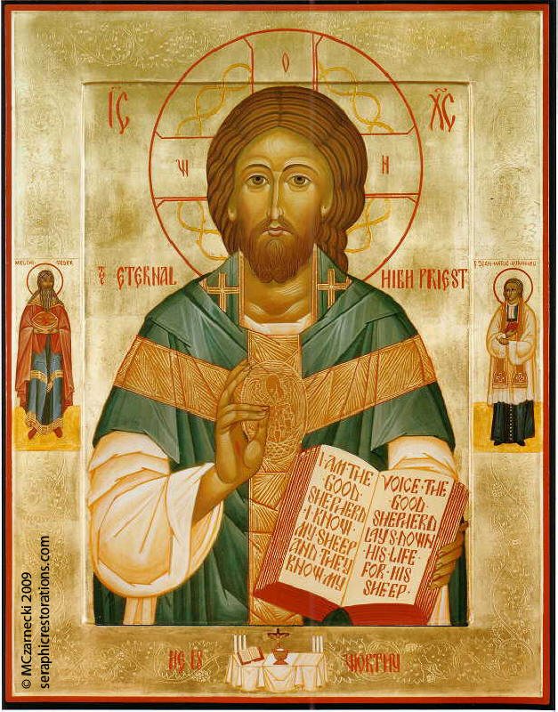
Lesson Two: Priest and Victim
Jesus was a priest… what does that mean?
Jesus was the Christ… what does that mean?
Anointed one
How was Jesus a victim?
“Paschal Lamb who was slain for our
sins”
Offered himself up as the victim
for sins

Slide 6
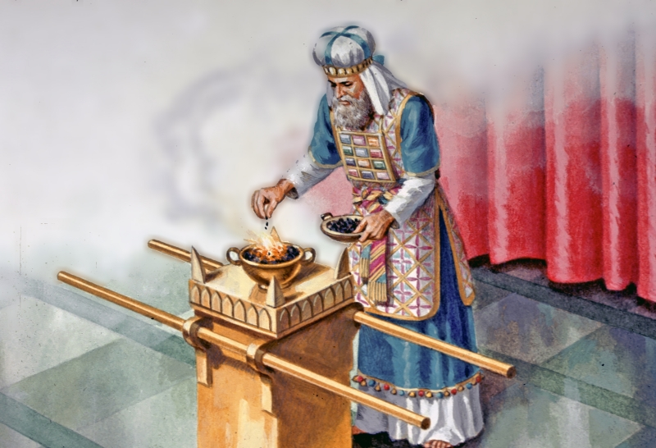
Lesson Two: Priest and Victim
The Old Testament Priesthood
Who were the Levites?
Explain their role and their connection with the priesthood of Christ
Why did Christ form a new priesthood?
Did he?

Slide 7
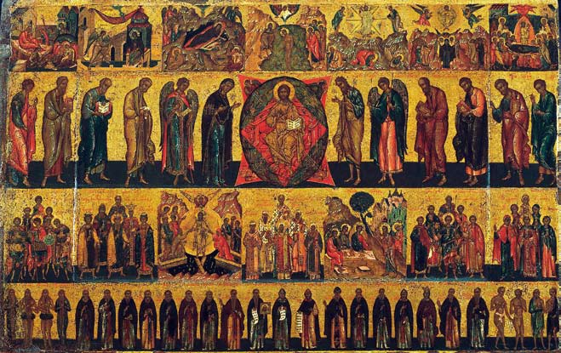
Lesson Three: Mediator
What does mediator mean?
The priest takes our prayers and gives them to God
The priest brings God to us
Eucharist
Confession
All the other sacraments

Slide 8
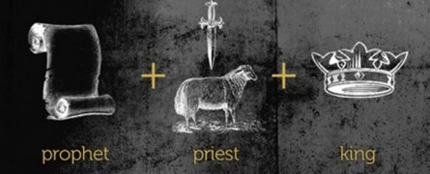
Lesson Three: Mediator
We can pray for others too!
Through our Baptism we become priests, prophets, and kings
We can offer things up
E.g., Lent
Different from the priesthood
Offer the sacrifice of the
Cross

Slide 9
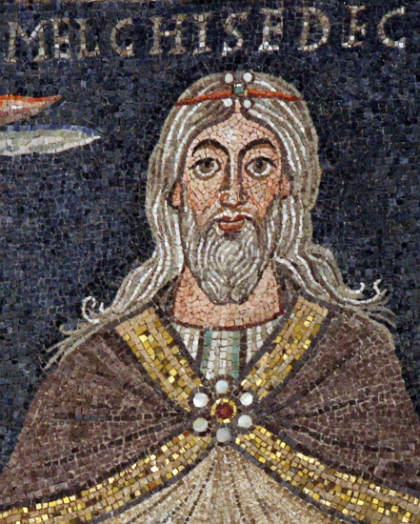
Lesson Four: Melchizedek
Melchizedek is a type of Christ
What is a type?
He offered up Bread and Wine to God
Gen. 14:14-20
Mark 14:22-25
Heb. 7:1-7
Why are our priests like
Melchizedek?

Slide 10
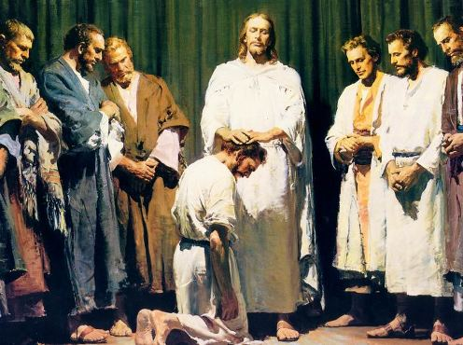
Conclusion
Fishers of Men Video
https://www.youtube.com/watch?v=ZGxWD9Yq73s
Discuss how this video portrays the priest as:
a mediator and a victim

