Slide 1
The Five Themes of Geography

Slide 2
The Five Themes of Geography
Day 1: Location

Slide 3

Geography
Geography – the study of the Earth’s physical and cultural features
It means writing about or describing the earth.

Slide 4
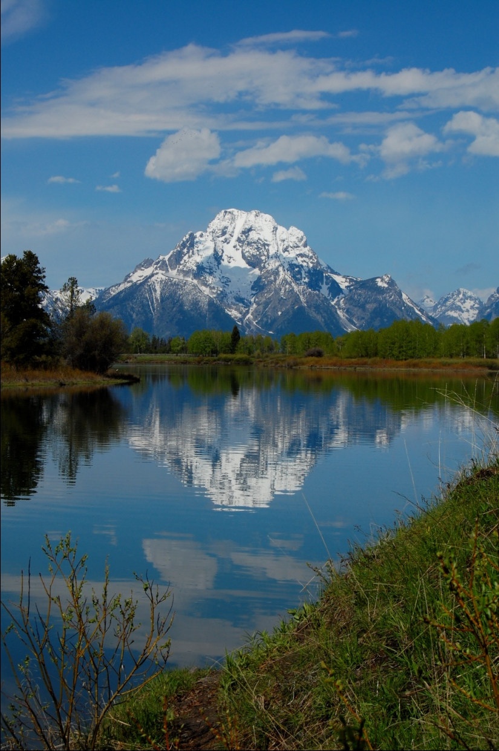
Geography's Five Themes
Location
Place
Regions
Movement
Human-Environment Interaction

Slide 5
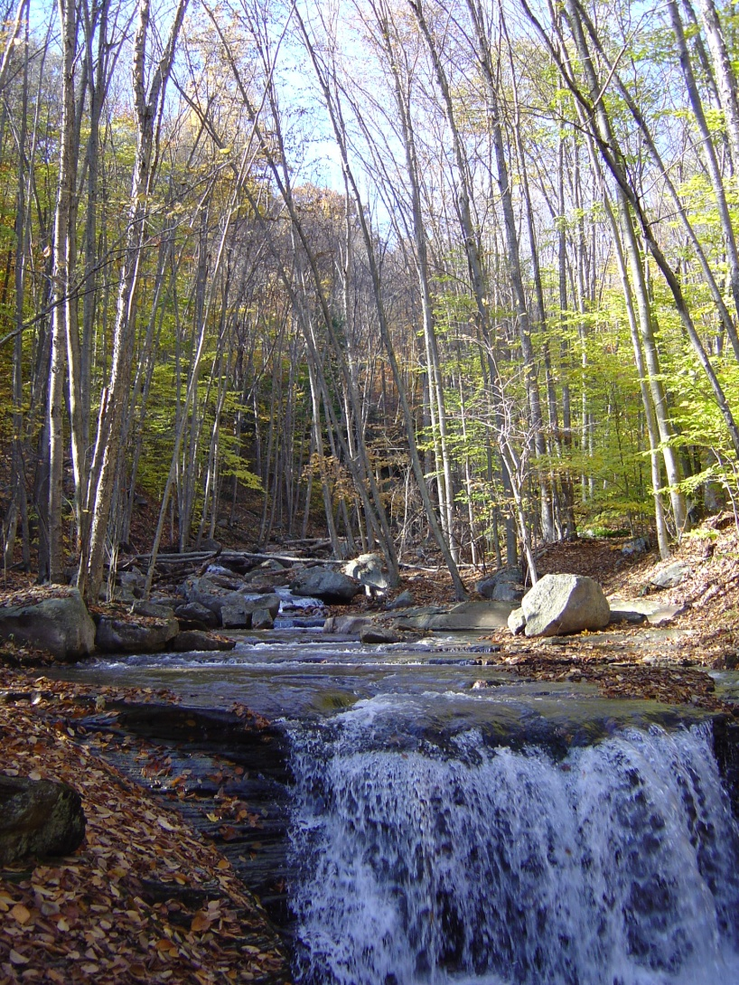
Questions we will answer…
What is the location of a place?
What is the character of a place?
How are places similar to and different from other places?

Slide 6
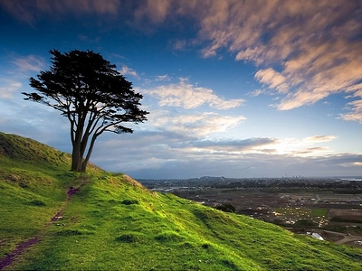
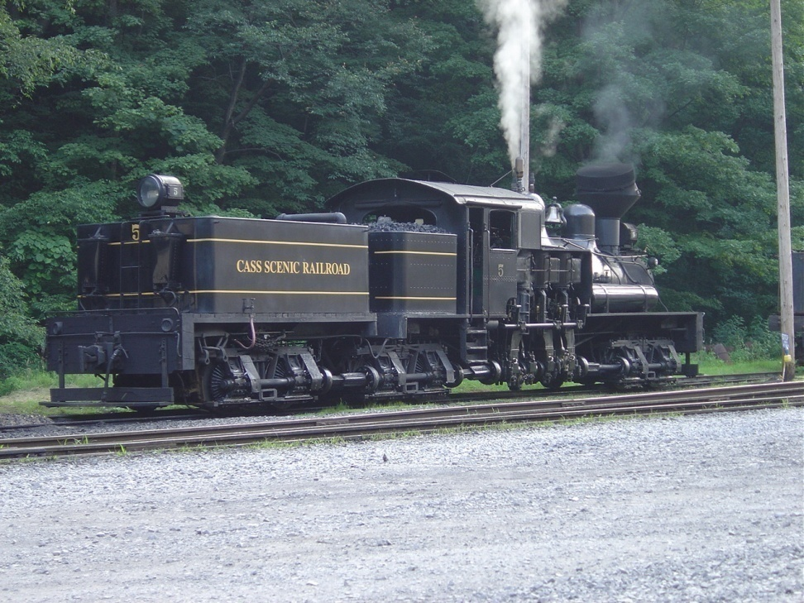
Questions we will answer…
How do people, goods, and ideas move between places?
How do people interact with the natural environment of a place?

Slide 7

Location
Asks the Question: Where is it?

Slide 8

Location
Every point on earth has a specific location.
  Absolute location - the position of a place on the globe using the grid of longitude and latitude lines.
  Relative location - the location of a place compared to other places

Slide 9

Absolute Location
Imagine a single dot on a ping pong ball. How would you describe its location?

Slide 10
Absolute Location
Not easy?
The same is true of locations on the Earth's surface.
Geographers have solved this problem by creating latitude lines and longitude lines.

Slide 11
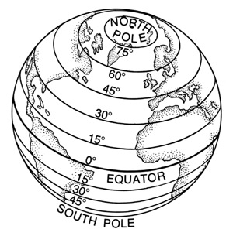
Absolute Location
Latitude: Measures distances north and south of the Equator

Slide 12
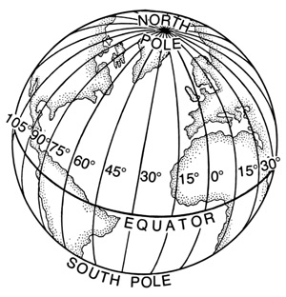
Absolute Location
Longitude – measures distances east or west of the Prime Meridian

Slide 13
Writing Coordinates
  First: Write the Degree of Latitude
    Example: 41°
  Second: Write the direction (North or South)
    Example: 41°N

Slide 14
Writing Coordinates
  Third: Write the Degree of Longitude
    Example: 41°N, 77°
  Last: Write the direction (East or West)
    Example: 41°N, 77°W

Slide 15

Activity
Get out your map of the United States!

Slide 16
I will call out either the name of a city, lake, or coordinates.
Work together
  determine the answer
  write it on your whiteboard.
  Hold it up to be corrected

Slide 17
1. Philadelphia, Pennsylvania
  39°N, 75°W
2. 35°N, 90°W
  Memphis, Tennessee
3. Yellowstone Lake, Wyoming
  44 ° N, 110°W
4. 32 °N, 117 °W
  San Diego, California

Slide 18
Relative Location
Relative location - the location of a place when compared to other places.

Slide 19
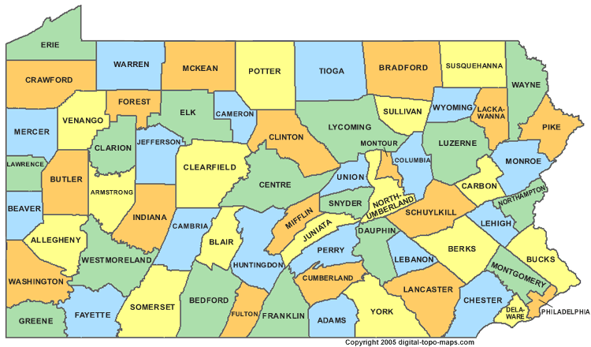
Relative Location
Example - the Relative Location of Pennsylvania is south of south of New York, east of Ohio, and north of Maryland

Slide 20
Relative Location: Activity
Everyone get in to groups and get out your map of Europe

Slide 21
1. Teacher calls a location.
2. Groups determine the relative location.
3. Write the answer on your whiteboard and hold it up
4. Class discusses each location.

Slide 22
Relative Location: Activity
1. Paris, France
2. The Ionian Sea
3. Rome, Italy
4. Athens, Greece
5. Sicily
6. The Strait of Gibraltar

