Slide 1
The Five Themes of Geography

Slide 2
The Five Themes of Geography
Day 5: Human / Environment Interaction

Slide 3
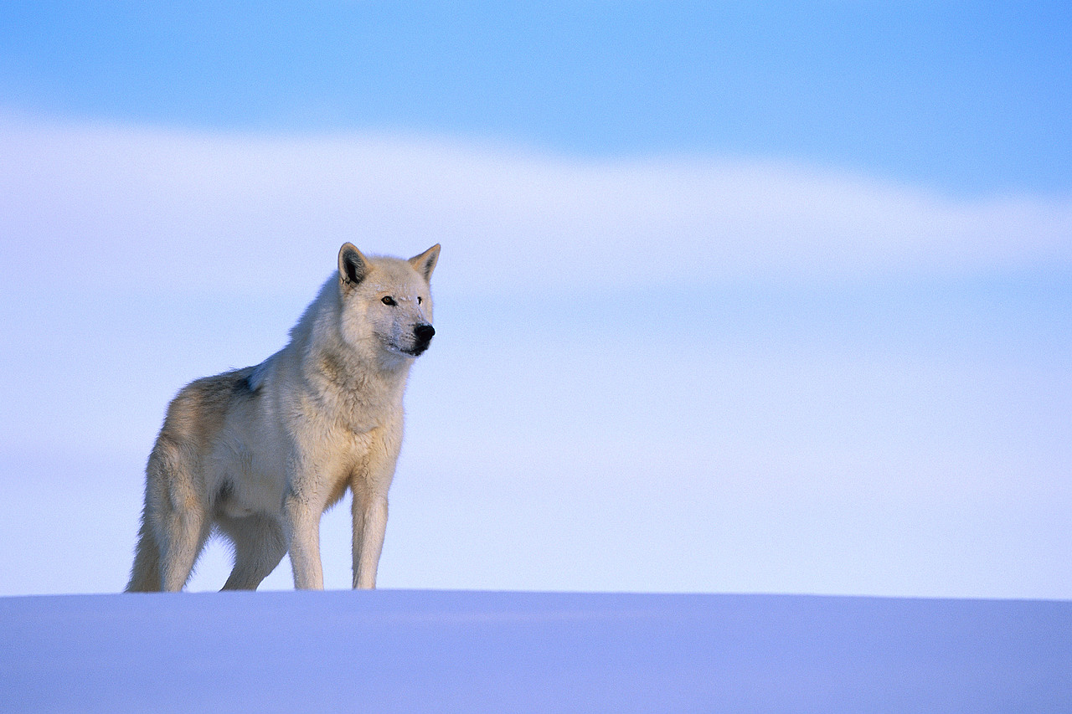
Human-Environment Interaction
How do you affect your environment everyday?
As the seasons change does your impact on the environment change?

Slide 4
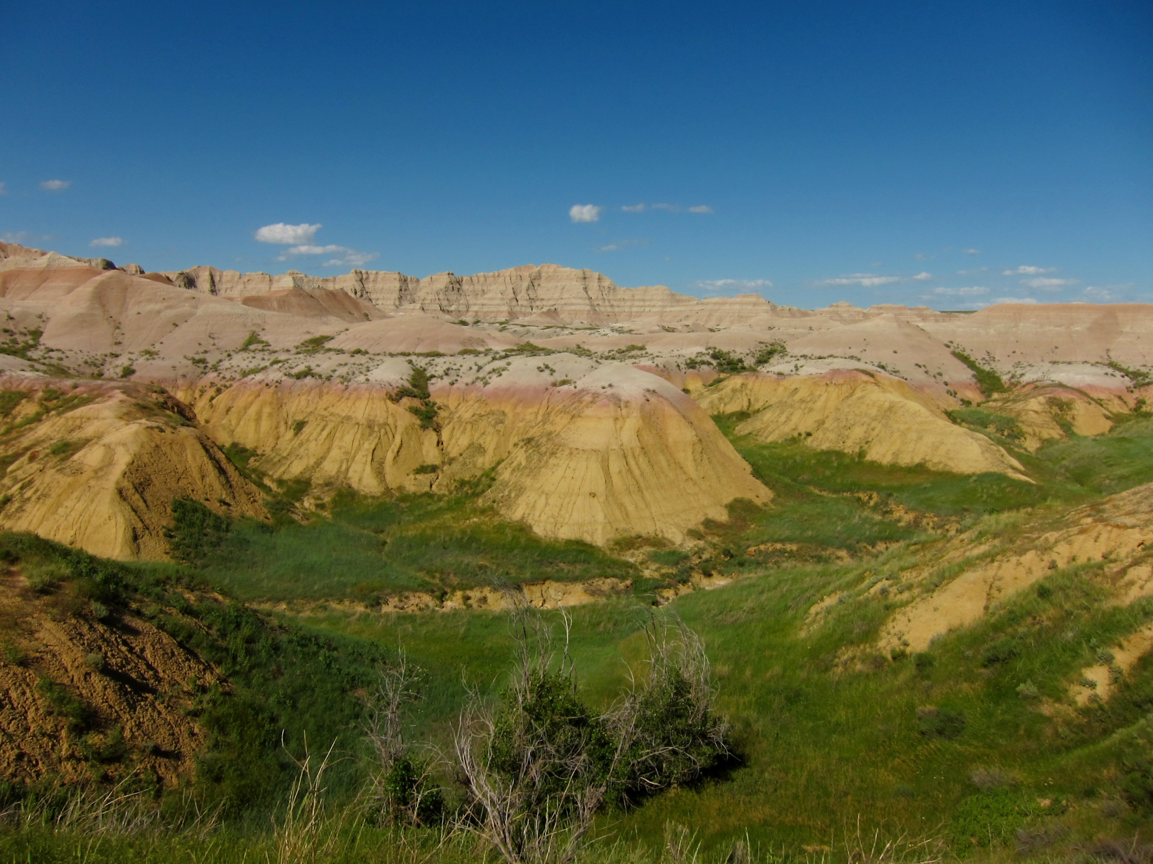
Human-Environment Interaction
How does the environment affect people?

Slide 5

Depending on your cultural background and technological resources the environment means different things to different people

Slide 6

Human-Environment Interaction
When we study Human-Environment Interaction we look at all the effects (both positive and negative) that occur when people interact with their surroundings.

Slide 7
  How can we modify our environment?
    Bringing water to our homes
    Clearing land for farms
    Any other ideas?

Slide 8
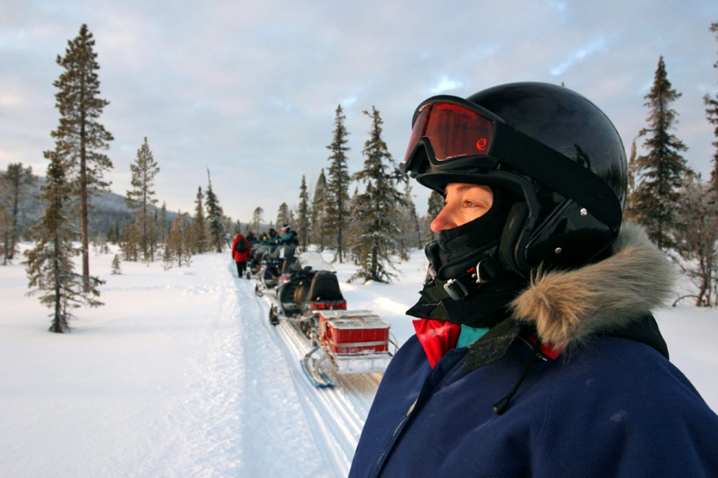
Human Environment Interaction
  How do we adapt to our environment?
    Wearing suitable clothing (summer vs. winter)
    Heating / cooling our homes
    Any other ideas?

Slide 9

How can changes to the environment be favorable?

Slide 10
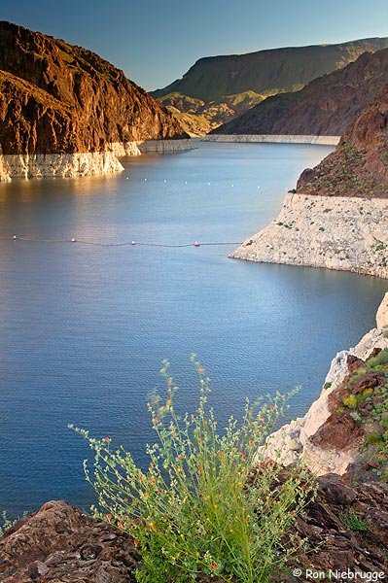
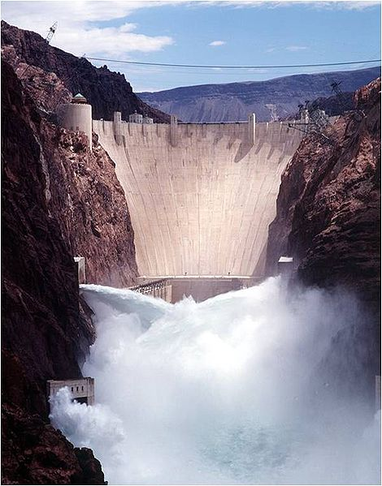
Human-Environment Interaction
The construction of the Hoover Dam on the Colorado River, for example, changed the natural landscape, but it also created a reservoir that helps provide water and electric power for the dry southwest

Slide 11
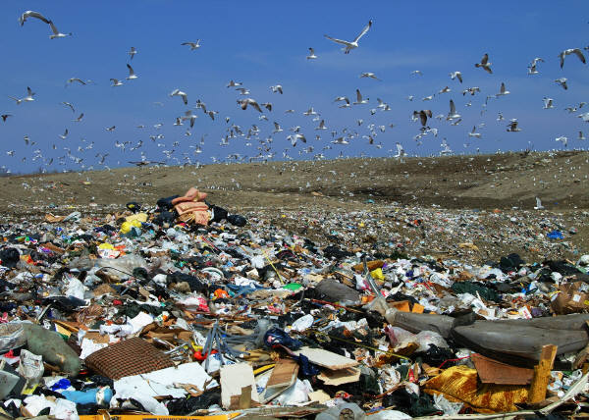
How can changes
also be destructive?

Slide 12

Study the consequences of Human / Environment Interaction helps people plan and manage the environment responsibly

Slide 13
Pack Your Bags
Read about a county to learn about what you would need to travel there. Then, plan a packing list of what you would need to carry in your luggage. Draw the items in your suitcase and explain why all the things you have packed are necessary or desired.

Slide 14
Review
There are three key concepts to human/environmental interaction:
  Humans adapt to the environment.
  Humans modify the environment.
  Humans depend on the environment.

Slide 15
Review
Write five questions – one for each of the five themes. Exchange your questions with a partner.
Let’s share our answers!

Slide 16
The Five Themes of Geography
Day 6: Review of the Five Themes

Slide 17
The Five Themes of Geography
Where does The Way send its strawberries?
How many professional sports teams does New York have?
Is Maryland considered a Northern State or a southern state?
Where is Italy?
How did mountains affect the Ancient Greeks?
Movement
Place
Region
Location
Interaction

Slide 18
Group Activity – Theme Project
Form 5 different groups (one for each theme)
No more than 3 people to one group
You and your group will be assigned one of the Five Themes of Geography. Your task is to create a group poster that shows your theme.
Example: everyone in the location group does a page on location

Slide 19

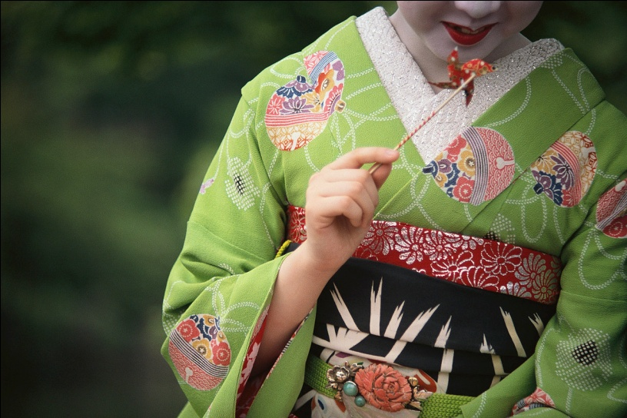
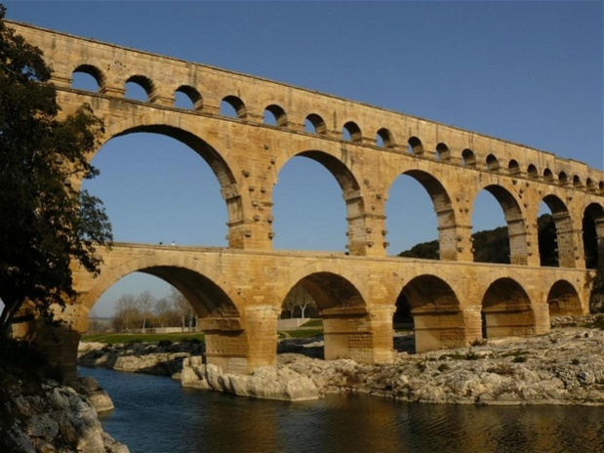
Group Activity – Theme Project
Group 1--- Location
Group 2 --- Place
Group 3 --- Regions
Group 4 --- Movement
Group 5 --- Human-environment interaction

