Slide 1
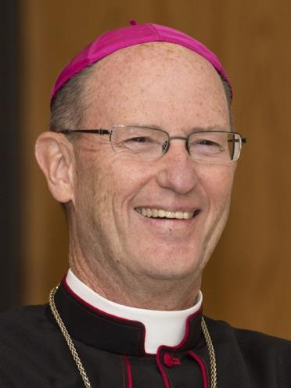
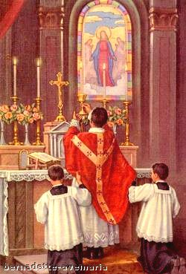
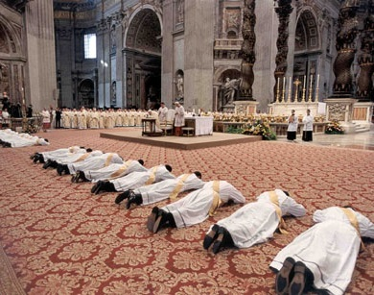
The Sacrament of Holy Orders

Slide 2
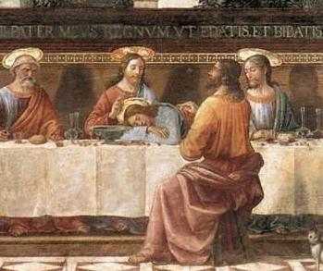
Holy Orders
Jesus instituted the sacrament at the Last Supper when he said to the apostles, “Do this in memory of me.”

Slide 3
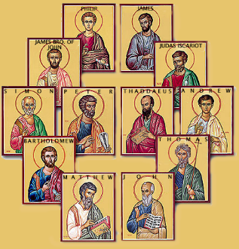
Twelve Apostles
Given power to offer the Holy Sacrifice of the Mass
Also made bishops by Jesus
“Fullness of the priesthood”
Given to bishops
Fullness of Sacrament of Holy Orders
Able to confer Holy Orders on others

Slide 4
Apostolic Succession
Unbroken chain of bishops from the apostles to the present day
Jesus gave Apostles power to become bishops and priests
They passed that power on to others
Our bishops and priests receive their power from that succession

Slide 5
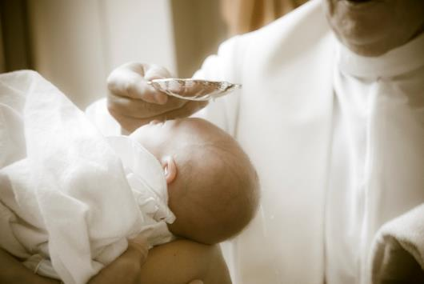
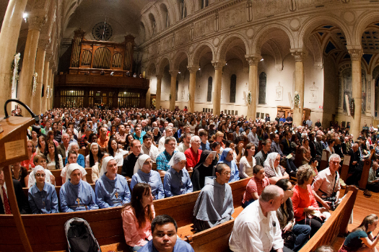
Priesthood of the faithful
Common priesthood of all the baptized
Carried out by attending Mass and praying privately

Slide 6
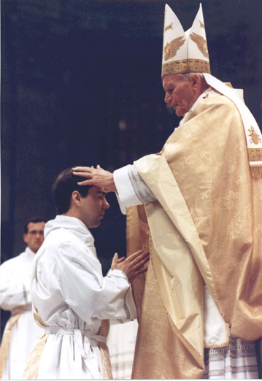
Ministerial (ordained) priesthood
Priesthood of men who have received the Sacrament of Holy Orders
Can celebrate Mass and the other sacraments

Slide 7
Three Levels
Bishops
Official teachers and sanctifiers of the faithful in their diocese
Priests
Help the bishops in preaching the Word of God, teaching the faithful and administering the sacraments
Deacons
Serve the Church by carrying out works of mercy, assisting at Mass and doing other good works

Slide 8
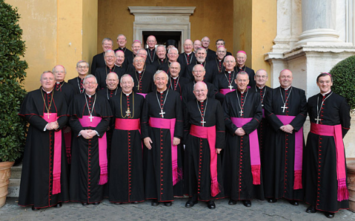
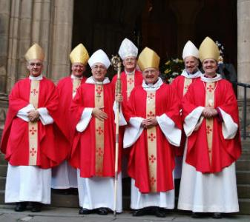
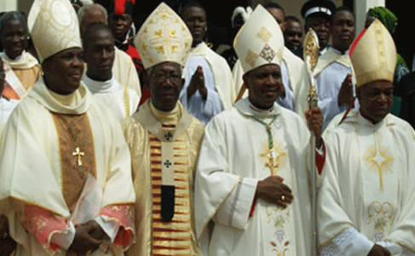
Bishops
Fullness of Holy Orders
Successors of Apostles
Govern, sanctify, teach
Celebrate all seven sacraments
Ordain men to Holy Orders
We owe them obedience and respect

Slide 9
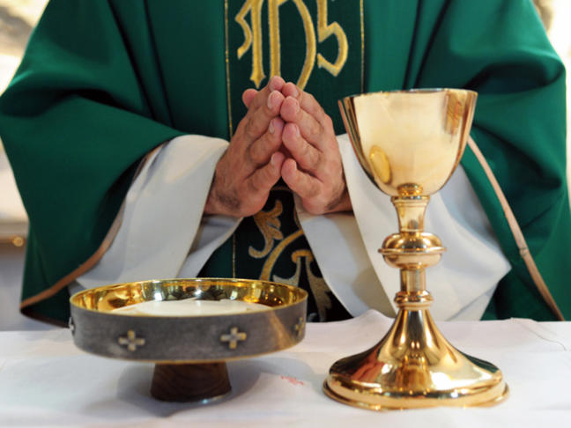
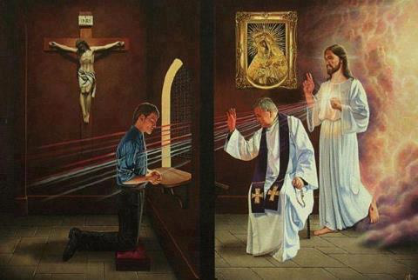
Priests
2nd level of Holy Orders
Help bishops by preaching, teaching, celebrating sacraments
Need bishop’s permission to celebrate Confirmation
Cannot ordain men to Holy Orders

Slide 10
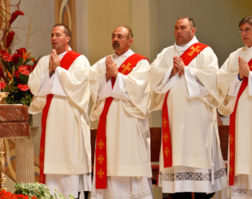
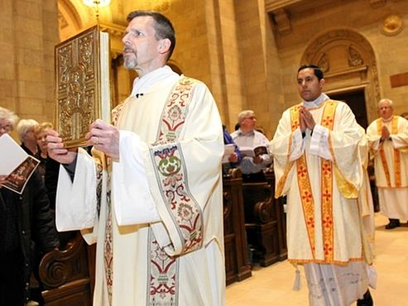
Deacons
Carry out works of mercy
Can read the Gospel at Mass, preach the homily and distribute Holy Communion
Can witness marriages, baptize and officiate at funerals

Slide 11
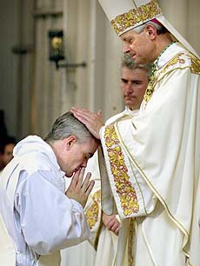
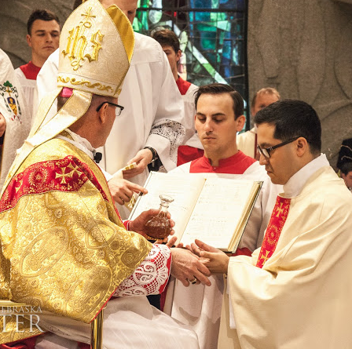
Sign of the sacrament
Matter
Laying on of hands
Shows the passing on of a spiritual gift
Anointing with chrism oil
For priests and bishops
Form
Prayer of the bishop

Slide 12
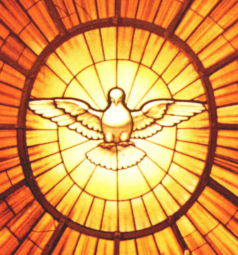
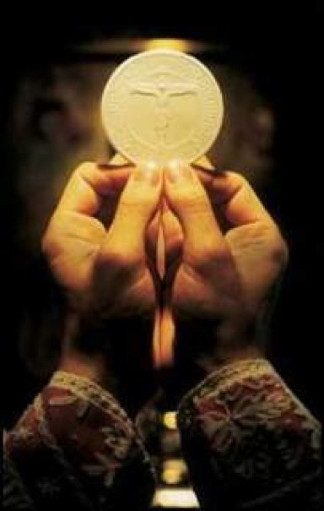
Effects
Increase of the Holy Spirit
Special powers of the priesthood
Graces needed to become good, holy priests
Indelible spiritual seal

Slide 13
Sacramental seal
Spiritual mark on the soul, similar to Baptism and Confirmation
Only one seal for all three levels
Sign of being united to Jesus the High Priest
“A priest forever”

Slide 14
Activities
Option 1: Give students a ball of clay or play-doh. Impress a medal into the clay to visualize the indelible mark the priesthood makes on the soul. If time, first make marks in the clay for indelible marks of baptism and confirmation on the soul. Only priests have all 3 sacraments which leave indelible marks.
Option 2: Attach paperclips to a magnet. Magnet symbolizes Christ, paperclips symbolize priests – priests are “another Christ” or “alter Christus”.
Option 3: Compare a male student to the local priest: what are differences and similarities? (both are boys, priest can forgive sins and celebrate Mass and perform other sacraments efficaciously, both are Cardinals fans, etc).

Slide 15
Videos
All represent the beauty of Christ’s call to the ordained priesthood…lengths vary)
Heroic Priesthood (https://www.youtube.com/watch?v=TaoqdKz4m5E)
Fishers of Men Part 1 of 2 (https://www.youtube.com/watch?v=qqtOvt7d490)
The Catholic Priesthood (https://www.youtube.com/watch?v=3FbL7eFJGdQ)

