Slide 1
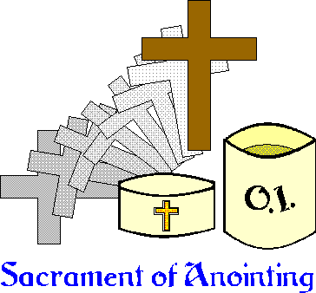
27. The Sacrament of the Anointing of the Sick
The Lord sustains him on his sickbed; in his illness You heal all his infirmities. --Psalm 41:3

Slide 2
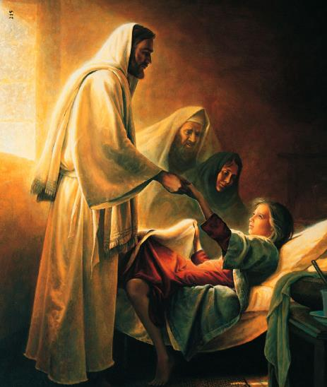
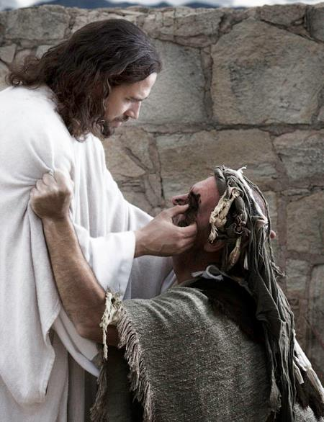
Jesus performed many healing miracles
He shared His healing powers with the Apostles
He gave us this sacrament to show His love for those who suffer

Slide 3
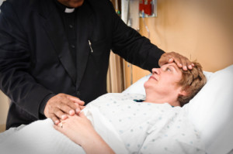
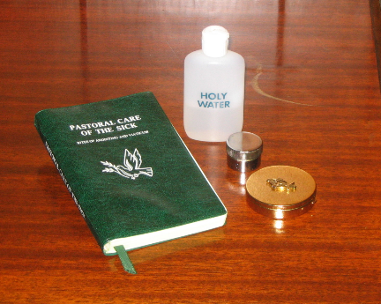
The Sign of the Sacrament
Minister
A Catholic priest
Matter
Anointing with Oil of the Sick
Form
Prayer of the priest…

Slide 4
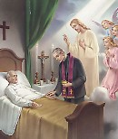
Form
“Through this holy anointing may the Lord in his love and mercy help you with the grace of the Holy Spirit…May the Lord who frees you from sin, save you and raise you up.” Amen.

Slide 5
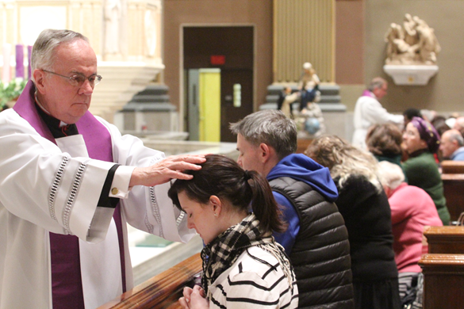
Effects of Anointing of the Sick
Strength to embrace God’s will
Preparation for a holy death
Forgiveness of venial sins (and mortal sins if person is unable to confess)

Slide 6
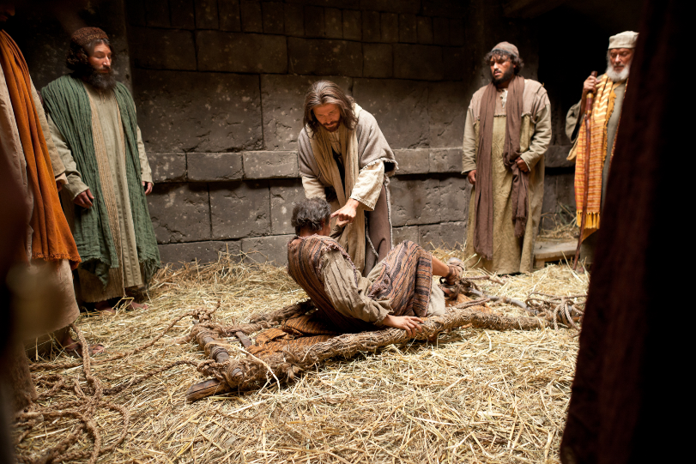
May give bodily healing
Helps us unite our sufferings to Christ’s sufferings

Slide 7
Chrism Oil
Baptism
Holy Orders
Oil of Catechumens
Baptism
Oil of the Sick
Anointing of the Sick
Confirmation

Slide 8
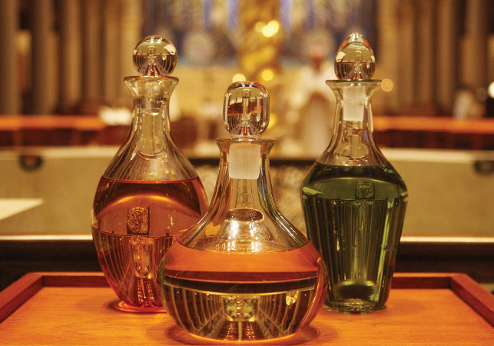
Oil
Sign of strength and power
God’s strength
Holy Spirit’s power
Receiving this sacrament does not mean that we will die soon.

Slide 9
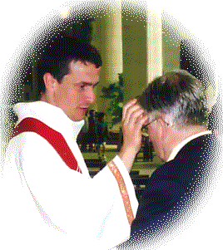
We can be anointed as often as necessary.
Sacrament can be received whenever a person begins to be in danger of death

Slide 10
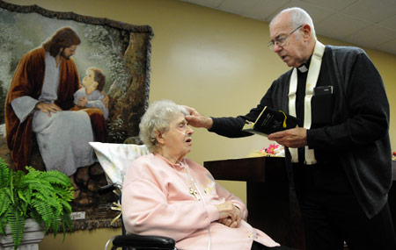
Rite of Anointing
Sacrament can be given anywhere… hospital, home of sick person, scene of accident, in the Church
Priest will bless person’s room with holy water
Penitential rite (or the Sacrament of Penance if they are able)
Scripture reading

Slide 11
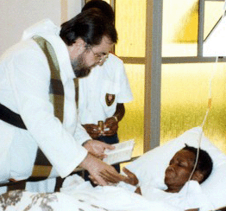
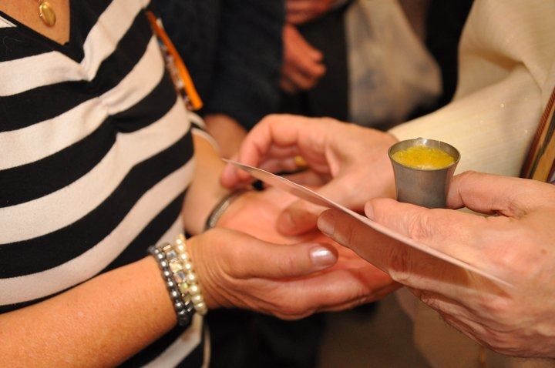
Anointing with oil and prayers for the sick person
Holy Communion (if they can)
Blessing from the priest

Slide 12
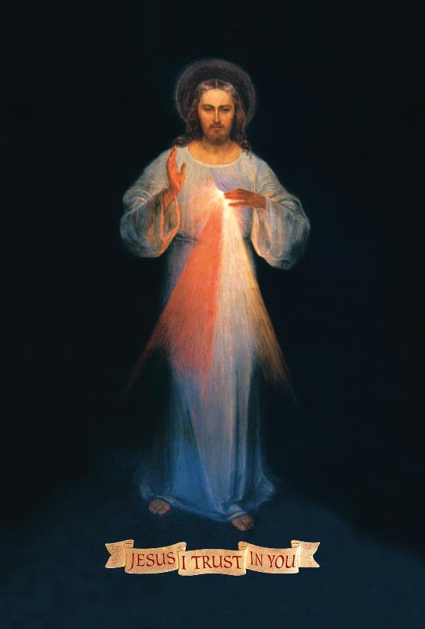
Prepare for a happy death
Pray for that gift
Stay in the state of grace
Receive the sacraments often
Do good works

Slide 13
Activities
Have a volunteer lie on the ground. “Anoint” him/her with ketchup, mustard, mayo, whatever else and have fun with the students in the obvious fact that these things are not used for anointing of the sick. Let students generate “oil” as the substance used – it is chrism (blessed olive oil), not just vegetable oil. Point out that oil is used as a symbol for strength, healing and joy in the Bible.
Tell a story of a time you personally suffered. Explain how you went through the process of accepting your suffering in union with Christ. Explain how you imagined your life without that pain (no broken leg, no headache, no death, no breakup) and how you came to accept that pain with Christ. Point out how the acceptance of the concrete reality of your life with the pain is essential for joy in suffering.
If appropriate, give students chances to talk about their own pain and how they accepted it or how they wished they had accepted it with Christ.

Slide 14
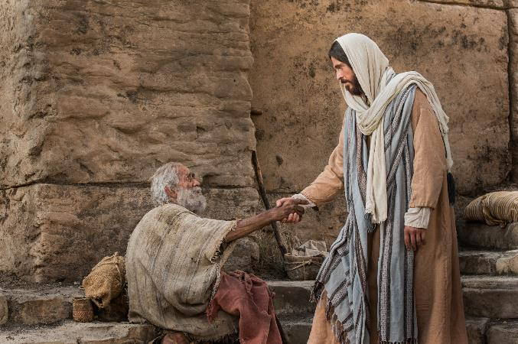
Videos
Suffering and Glorified – Video Catechism (http://vcat.org/may-2014-suffering-glorified/)
Sacraments 101: Anointing of the Sick – Busted Halo (https://www.youtube.com/watch?v=hEppjWNO2y4)

