Slide 1
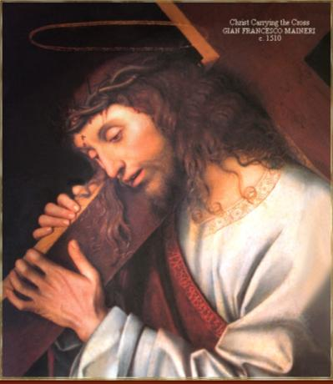
22. The Eucharistic Sacrifice
Christ loved me and gave Himself up for me.

Slide 2
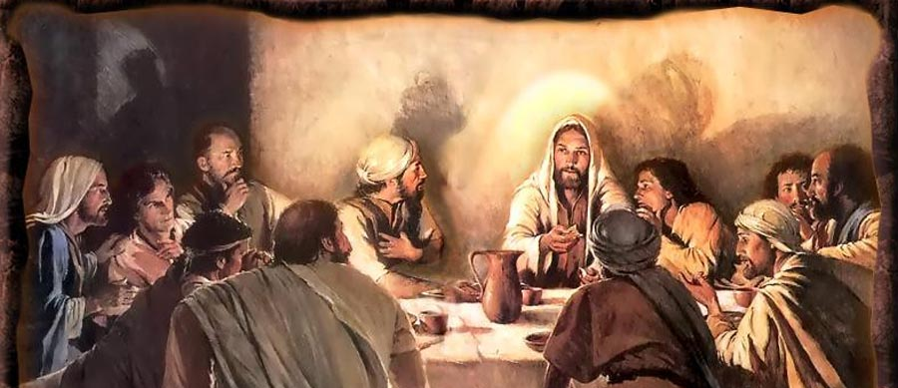
A. Mass as a meal
Table (altar)
Bread and wine
People gathered together

Slide 3
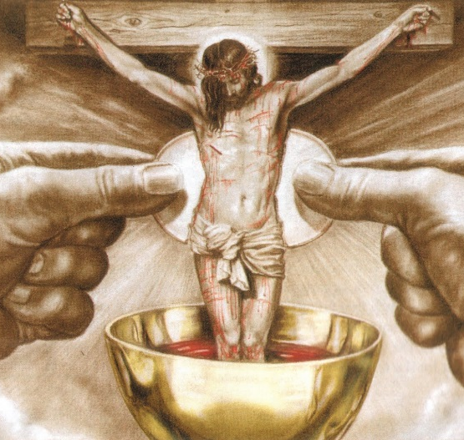
B. Mass as a sacrifice
Altar
Victim
Priest
The one perfect sacrifice of Christ is made present and offered to the Father.

Slide 4
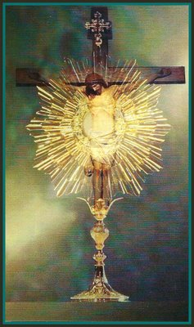
C. Sacrifice of the Cross and Sacrifice of the Mass
In both events
One priest (JESUS)
One sacrifice (HIMSELF)
Offered to the Father

Slide 5
Cross
Jesus offered Himself in a painful and bloody sacrifice
Mass
Jesus offers Himself in an unbloody manner

Slide 6
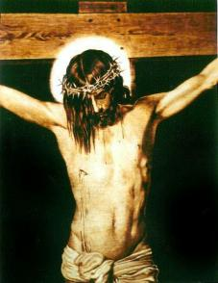
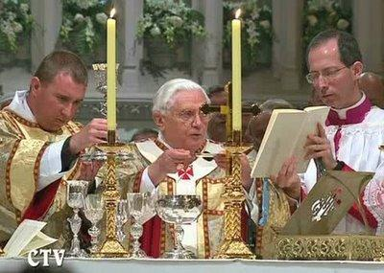
Manner of offering sacrifice is different…but, the sacrifice is the same!

Slide 7
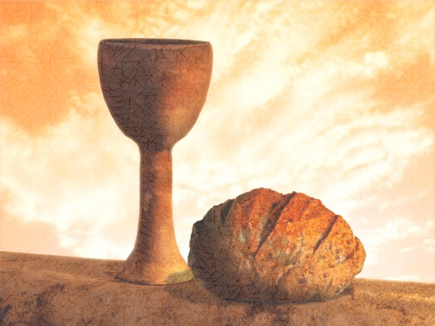
D. Words of consecration
Used by Jesus at the Last Supper
Words said by the priest over the gifts at Mass
Change bread and wine into Jesus’ Body, Blood, Soul and Divinity

Slide 8
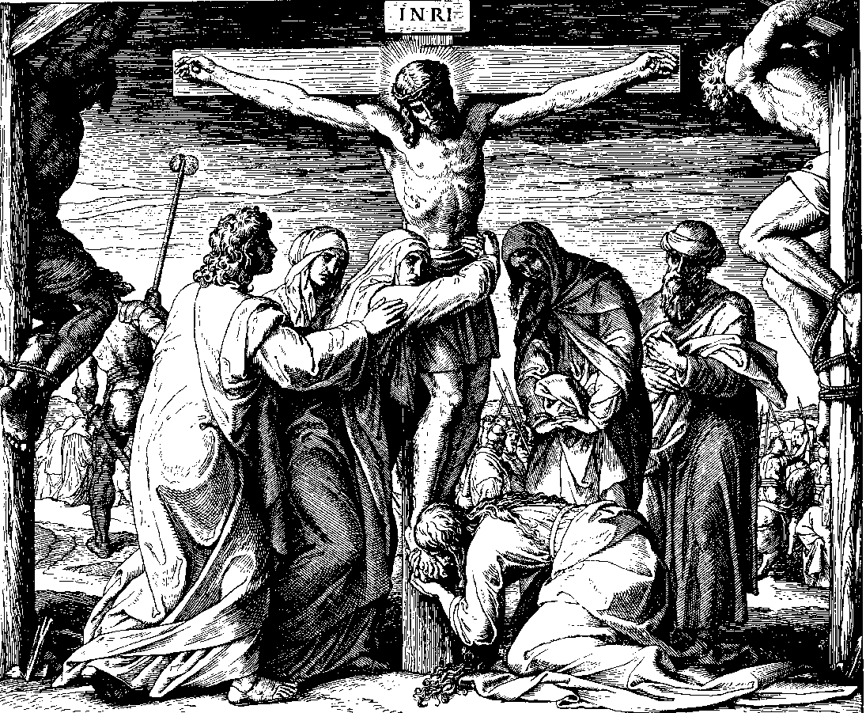
Remind us of Jesus’ sacrifice
“given for you”
“will be shed for you and for all so that sins may be forgiven”

Slide 9
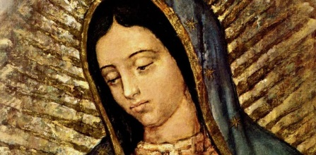
F. Prepare for Mass
Go to confession frequently
Read the Gospel passage that will be used at Mass
Get to church early to pray and prepare
Ask for Mary’s intercession

Slide 10
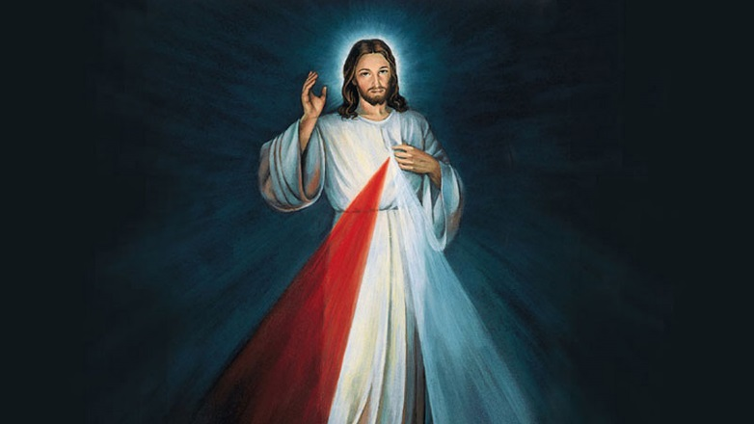
We have an obligation to receive Communion frequently
at least once during Easter season
Every Holy Communion is a tremendous gift.
Don’t take for granted being able to freely worship God at Mass!

Slide 11
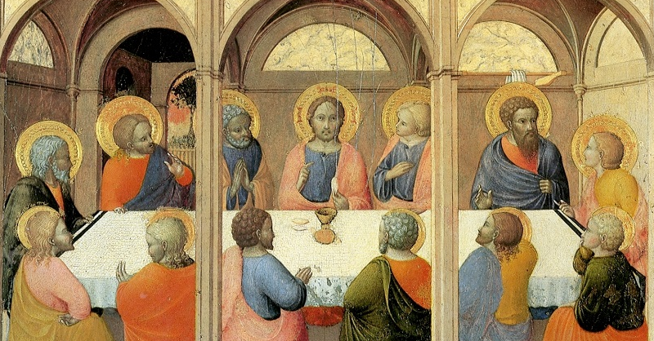
God deserves our worship at Mass.
We may not always feel like going to Mass, but we can ask God to give us the grace to desire it more.
There will always be things in life that we don’t feel like doing, but we should still do them.

Slide 12
Activity
Students make a chart comparing the Mass and the Cross of Calvary

Slide 13
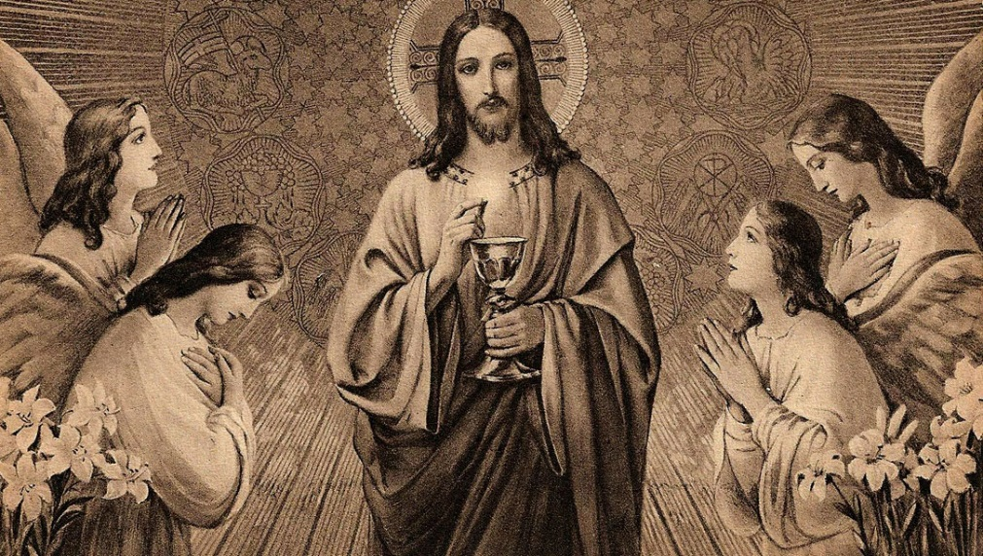
Video
Sacraments 201: Eucharist
https://www.youtube.com/watch?v=TMSiHGTBdGk

