Slide 1
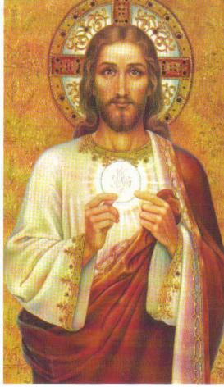
21. The Sacrament of the Holy Eucharist
“For as often as you eat this bread and drink the cup, you proclaim the Lord’s death until he comes.” 1 Corinthians 11:26

Slide 2
Bread of Life (John 6)
Jesus fed 5,000 people with 5 loaves of bread and 2 fish. (Miracle!)
Jesus walked on water. (Miracle!)
Jesus promises to give His disciples His Flesh and Blood to eat. (Miracle!)
He was not speaking of a symbol!

Slide 3
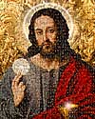
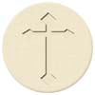
We know that Jesus is the Bread of Life in the Eucharist…
Body, Blood, Soul and Divinity

Slide 4
Titles for the Eucharist
Holy Communion
Breaking of the Bread
Blessed Sacrament
Lord’s Supper
Bread of Life
Bread of Angels
Holy Sacrifice

Slide 5
Institution of the Eucharist
Jesus instituted the Sacrament of the Holy Eucharist at the Last Supper.
This was the first Mass.
Eucharist = thanksgiving
Jesus consecrated the bread and wine after giving thanks to the Father

Slide 6
Sign of the Eucharist
Matter: Bread and wine
Form: “This is my Body. This is the cup of my Blood.”
Minister: an ordained priest
He acts in persona Christi (in the person of Christ), doing exactly what Jesus did.

Slide 7
Bread: made from wheat, which is destroyed and formed into one loaf (we die to sin, united with Jesus)
Wine: made from crushed grapes; used around the world for meals and celebration

Slide 8
Transubstantiation
Bread and wine are changed into the Body, Blood, Soul and Divinity of Jesus Christ.
Appearances of bread and wine remain.

Slide 9
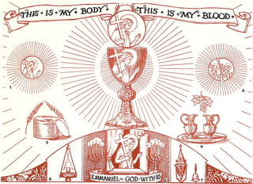
Real Presence
The fact that Jesus is really and truly present in the Holy Eucharist under the appearances of bread and wine.

Slide 10
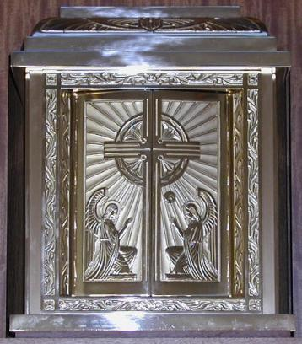
Tabernacle
The special solid and immovable container in which the Blessed Sacrament is kept.
Often adorned with symbols of Jesus

Slide 11
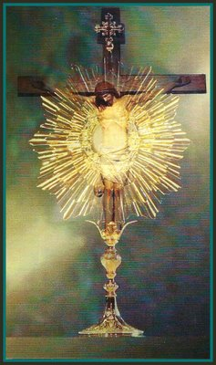
Effects of the Eucharist
We receive sanctifying and sacramental grace.
Venial sins are forgiven.
We are united with Jesus.
We are united with one another.

Slide 12
Sacrilege
A serious mistreatment of people, places, or things that have been consecrated to God.
Example: receiving the Eucharist in a state of mortal sin

Slide 13
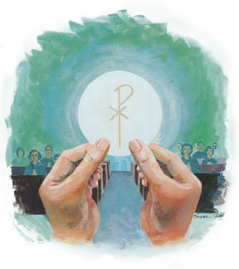
Activity
Write a prayer to Jesus in your own words, something you can really pray to Him after receiving Holy Communion.

Slide 14
Video: We Adore
https://www.youtube.com/watch?v=fru3Nh1UGE8

