Slide 1
Jesus Christ
True God and True Man

Slide 2
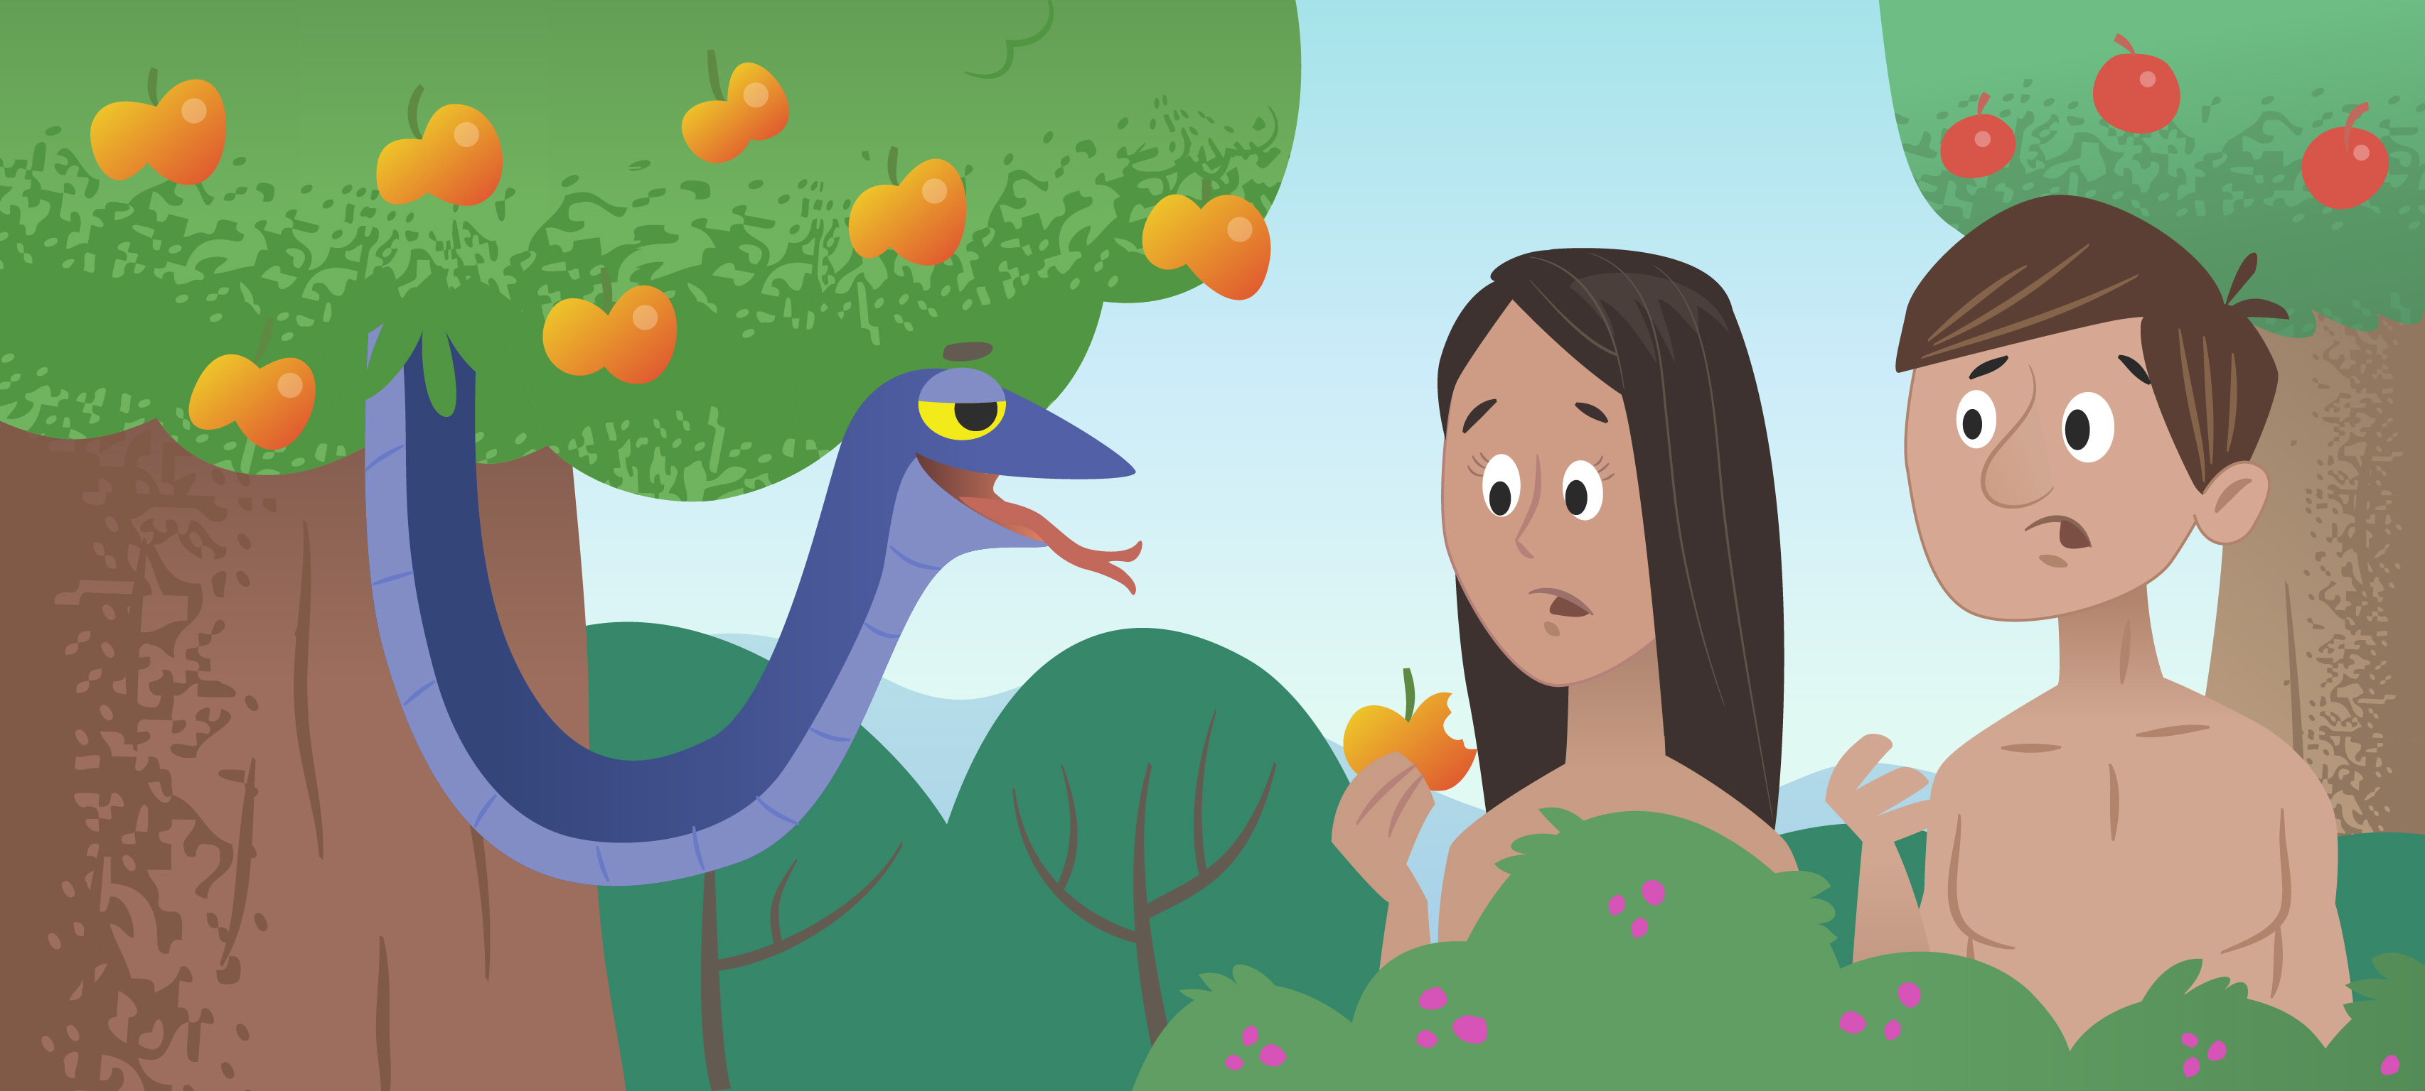
Back to the beginning…
The Fall
Original Sin

Slide 3
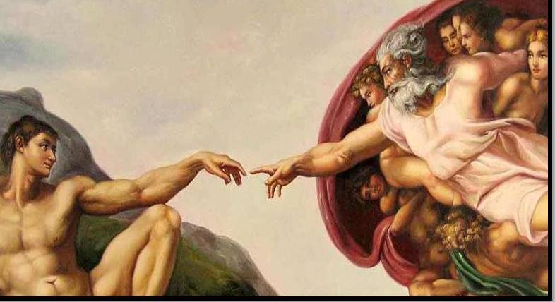
Effects of Original Sin
Division between:
Humans and Creation
Humans and other Humans
Human beings and themselves
Humans and God

Slide 4
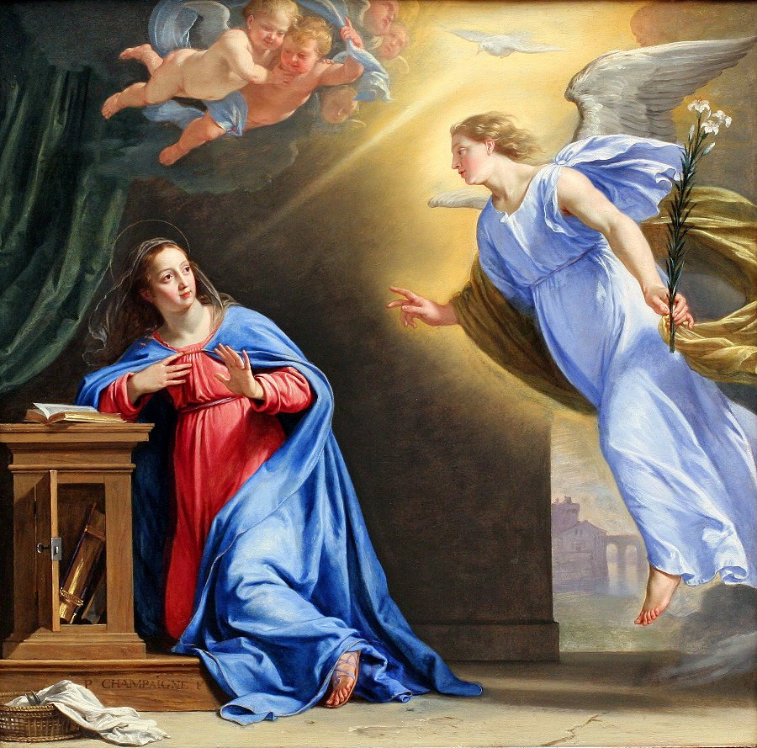
Resolving the Divide
Man has a debt he can’t pay
God works throughout history to fix this
The One Solution:
INCARNATION

Slide 5
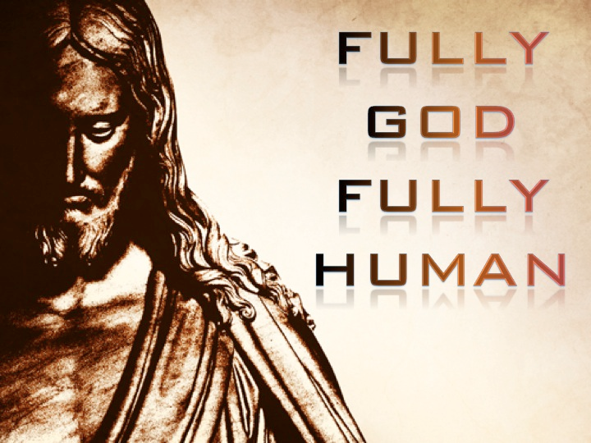
Jesus Christ
Only God can fully give God what He’s due
Love of the Trinity
Has to be man to bridge the gap
Takes on sin and death
Lifts up Humanity

Slide 6
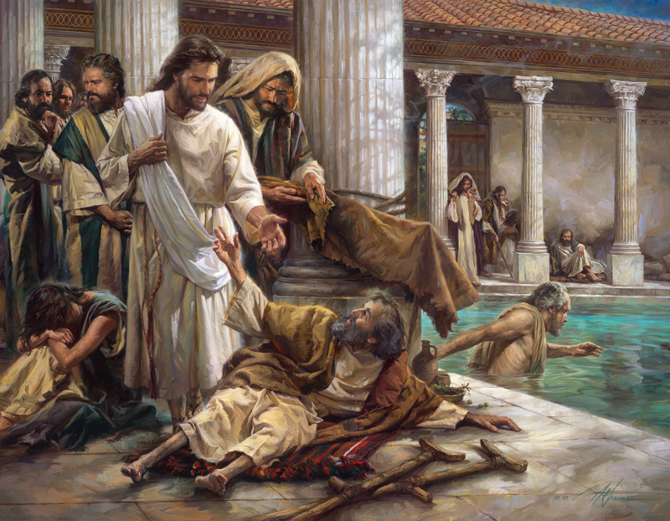
How does Jesus Show He’s God?
Miracles!
Talking with the Father:
Baptism: Matthew 3:17
Matthew 11:25
Luke 23:34
Jesus says so!
John 8:58

Slide 7
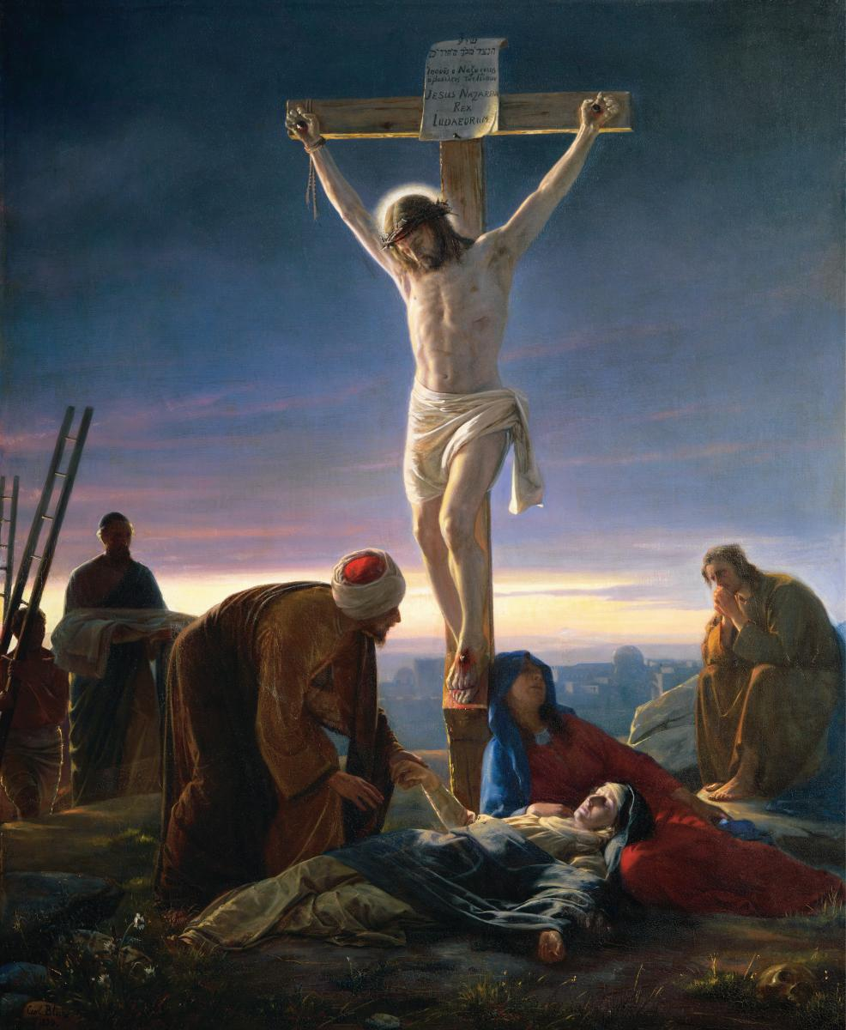
How do we know he’s man?
Has everything that makes someone a human being:
Physical Body – born of Mary!
Immaculate Conception
Immortal Soul – intellect and will
Hunger and thirst – Luke 4:2
Was sad – John 11:32-36
Had friends: Luke 19:1-10
Knew joy – Luke 10:21
Suffered and Died

Slide 8
Fully God Fully Man
Hypostatic Union!
ONE Divine Person
TWO Natures – ONE Divine and ONE Human
JESUS
CHRIST
Human
Nature
Divine
Nature

Slide 9
HERESY!
After Christians stopped worrying about getting martyred for awhile after 313 AD, they started to think about the teachings of the Faith more…
Errors occurred:
Arianism – not fully God
Docetism – not fully man
And the list goes on….
Not an easy thing!

