Slide 1
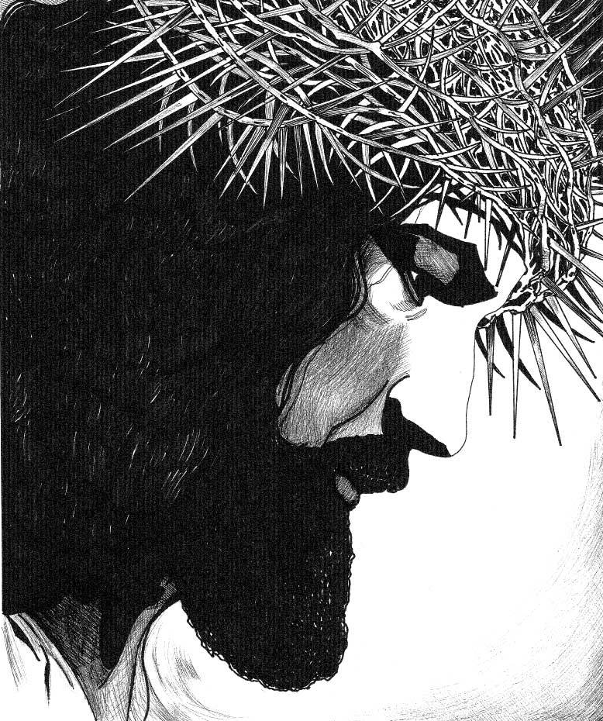
The Saving Mission of Jesus
But when the time had fully come, God sent forth His Son, born of a woman, born under the law, to redeem those who were under the law, so that we might receive adoption as sons. --Galatians 4:4-5

Slide 2
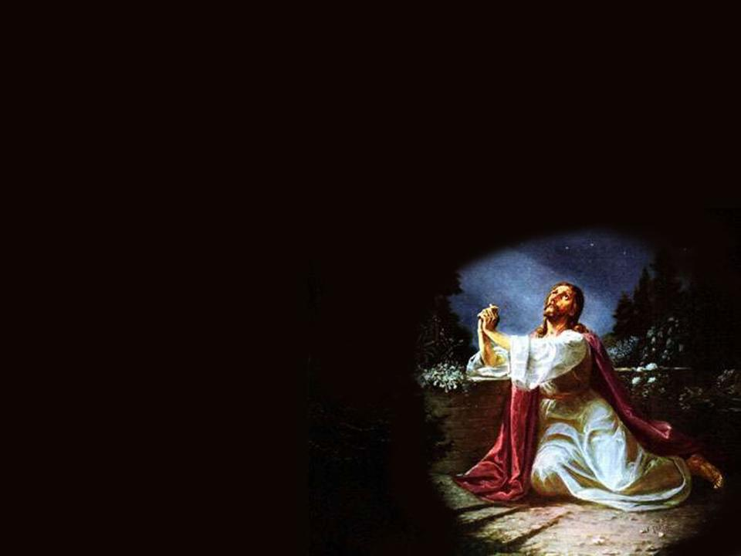
Act of Hope
O my God, relying on Your almighty power and infinite mercy and promises, I hope to obtain pardon of my sins, the help of Your grace, and life everlasting, through the merits of Jesus Christ, my Lord and Redeemer. Amen.

Slide 3
The Saving Mission of Jesus
Mission: a task or duty, being sent somewhere to do something
Missionaries are sent to preach the Gospel
“The Mass is ended, go in peace to love and serve the Lord.”

Slide 4
The Saving Mission of Jesus
Jesus also had a mission: to redeem man.
The Father sent the Son for this mission.
Jesus came to do the Father’s will.
He perfectly reveals the Father’s will and His loving plan.

Slide 5
The Saving Mission of Jesus
Read ¶ 1-6
God is infinitely just, loving and compassionate.
He sent His Son to save the world.
Jesus did everything out of love for His Father.

Slide 7
The Saving Mission of Jesus
God the Son, the Second Person of the Blessed Trinity, became man in the Divine Person of Jesus Christ.
Jesus told man about God, revealing the truth of God as the Trinity and God’s loving plan for us.

Slide 8
The Saving Mission of Jesus
Jesus was sent with a threefold mission:
Priest
Prophet
King
Reread ¶ 6

Slide 9
The Saving Mission of Jesus
Priest: offered Himself in sacrifice to the Father
Prophet: taught God’s truth
King: came to start the Kingdom of God on earth

Slide 10
The Saving Mission of Jesus
Jesus faithfully and obediently did the will of the Father.
His “Yes” to God replaced Adam’s “No.”
As the Redeemer, Jesus is the New Adam.

Slide 11
The Saving Mission of Jesus
Read ¶ 7-9
Jesus taught through parables and sermons.
Parable: a story that uses examples to demonstrate a truth

Slide 12
The Saving Mission of Jesus
Sermon on the Mount: Jesus’ greatest recorded collection of teachings (Beatitudes)
Jesus performed miracles
Proofs of His divinity
Demonstrated His teachings

Slide 13
The Saving Mission of Jesus
Jesus shared His role as teacher with His disciples.
Today He teaches through His Church, especially the Magesterium.
Infallibility

Slide 14
The Saving Mission of Jesus
Because of Baptism and Confirmation, every Christian has a duty to share truths of God.
Our words, good example and apostolic effort help us spread the Faith.

Slide 15
The Saving Mission of Jesus
Read ¶ 12-15
All who are united with Christ are part of the Church.
Angels, saints in Heaven
Poor souls in Purgatory
Faithful on earth
= Communion of Saints

Slide 16
The Saving Mission of Jesus
Church Triumphant
Church Suffering
Church Militant
The Church is God’s Kingdom living under the reign of God with Christ as our King.

Slide 17
The Saving Mission of Jesus
Read Mt 25:31-46
Who is admitted into God’s Kingdom?
Read Mt 13:44-46
Parable of the Treasure and the Pearl
Old Testament Kings
Lead in battle, protect people, uphold covenant

Slide 18
The Saving Mission of Jesus
Jesus our King
Leads us to the triumph of the Cross
Protects us from our enemy (satan and demons)
Instructs us to keep our covenant with God

Slide 19
The Saving Mission of Jesus
In ancient times, prophets, priests and kings were anointed.
We are anointed at Baptism and Confirmation. Some are anointed in Holy Orders.

Slide 20
The Saving Mission of Jesus
Who is a priest?
A man set apart
Consecrated to serve God in his Church
Intercedes for us
Offers worship on behalf of man to God
Brings God and His grace to man in the sacraments

Slide 21
The Saving Mission of Jesus
A priest acts in the person of Christ during the liturgy.
He is to be a Christ-like example, bringing God’s love to all people
Read ¶ 10-11

Slide 22
The Saving Mission of Jesus
Jesus is the one true Priest.
His sacrifice on the Cross gives us sanctifying grace
He is mediator between God and man
Offered perfect sacrifice

Slide 23
The Saving Mission of Jesus
Jesus instituted seven sacraments
Grace won by Christ shared with us through the seven sacraments
His grace is poured into the Church
Through the Apostles, His grace is for all the world

Slide 24
The Saving Mission of Jesus
In the sacraments, Jesus Christ works through the minister of the sacrament.
He pours His grace into our souls
Through outward signs

Slide 25
The Saving Mission of Jesus
By Baptism, we share in the priestly ministry of Christ.
Called to offer worship to the Father, through the Son, in the Holy Spirit
Consecrate our lives and our works to God

