Slide 1
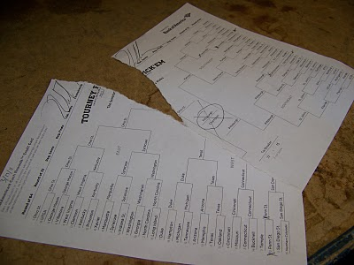

Slide 2
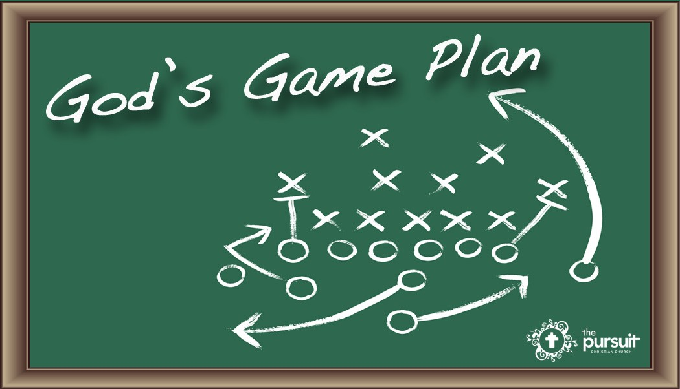
God’s Plan of Salvation

Slide 3
Words to know
Salvation history
All the events in human history by which God prepared the world for the coming of Jesus Christ and the events by which Jesus accomplishes this plan for the redemption of the human race.
Covenant
Prefigurement
To show or represent beforehand
Notes:
Salvation: The forgiveness of sins and restoration of friendship with God, which can be done by God alone.
To be in the state of Salvation: necessities for life (to be in the state of salvation: what are the needs for life –these are temporary and can be taken away)

Slide 4
More Words
Patriarch
a title given to the ancestors or “fathers” of the Jewish peoples, who received God’s promise of election.
Abraham, Isaac and Jacob
Sacrifice
A ritual offering made to God, as a sign of adoration, gratitude, supplication and communion.
Blessing
a prayer invoking God’s power and care upon some person, place, thing or undertaking. – From Man
Grace originally from God, which fulfills a purpose.

Slide 5
Old Testament and New Testament
What do they have in common?
God’s people
Who is the main character?
God (author and subject of all the Scriptures)
Abraham is only important because God talks to him
His relationship with His people/creation
Salvation History
How did he begin this mending?
Notes:
Why did God want to enter into a relationship with us? Out of Love. Out of Love he created us to know him, love him and serve in this life and the next. But what happened to this relationship? Sin entered the World
Why do we have to be saved? Begins with Adam and Eve and the entrance of sin in the World, which breaks relationship with God, man and woman, man and self, and nature.
God was the only one who could fix this broken relationship. Thus, He was the one who initiates the mending (you don’t just heal the bone right away/ set it – I can ask the kids if they have ever had a broken bone.) This was something that occurred gradually over time…He didn’t just snapped his fingers, He didn’t want to force his people to love him but to choose (freely) to enter into a relationship with (HOW DO YOU GET A FRIEND – hold them hostage?)
Typology: the discernment of persons, events, or things in the Old Testament which prefigured, and thus served as a “type” (or prototype) of, the fulfillment of God’s plan for the person of Christ. The typology of the Old Testament which is made clear in the New Testament demonstrates the dynamic unity of the divine plan of salvation.

Slide 6
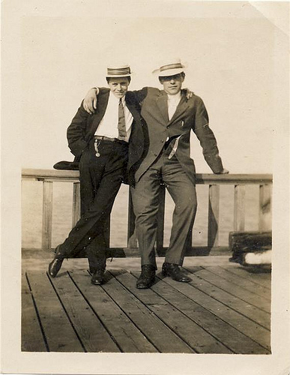
Activity (5-8 minutes)
Notes:
Have them try to make a new friendship
Ask them how many siblings (their names), if they have a pet, what there favorite food is
least favorite subject and why
Something interesting about them
Their favorite thing to do during their free-time
Illustrate the point that a relationship doesn’t happen over night, it takes time – gradual due to mistrust (opening up makes us vulnerable to another). Why is it hard to make a good relationship with others
Do they feel like they truly got to know them?

Slide 7
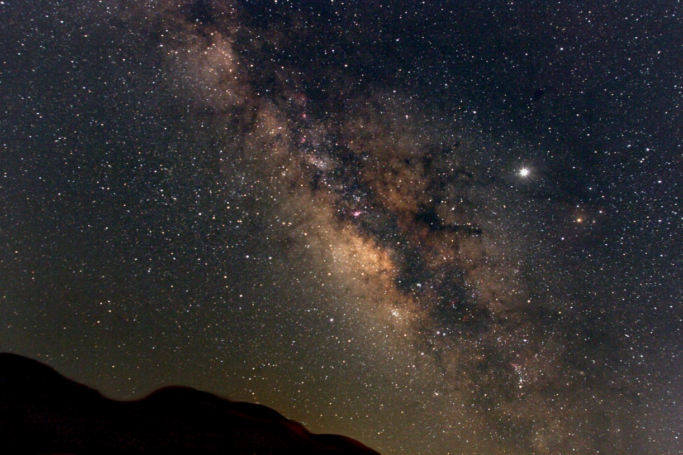
Abraham
Promises to Abraham
Blessing
Land
Descendants
As countless as the stars of the sky and the sand on the sea shore.
Abraham was old and Sarah barren
Change of name:
Abram to Abraham

Slide 8
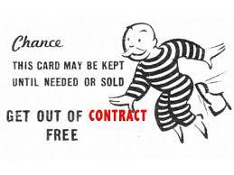
Covenant
An oath binding two parties together as if they were one blood, so that these two are now linked together.
Entering into a relationship – this involves persons.
Not a contract or business arrangement.
Notes:
Genesis 15
So far reaching
So this is now fulfilled and God gives him a son, Isaac (promised descendants and now has a son)

Slide 9
Covenant
For Abraham this is a gift freely given by God and there are no conditions that Abraham needs to do.
This Covenant is forever, b/c God has sworn by Himself that He will do these things for him.
There is no limit to the blessing (as countless as the sand on the sea shore, all people will find blessing in Abraham)

Slide 10
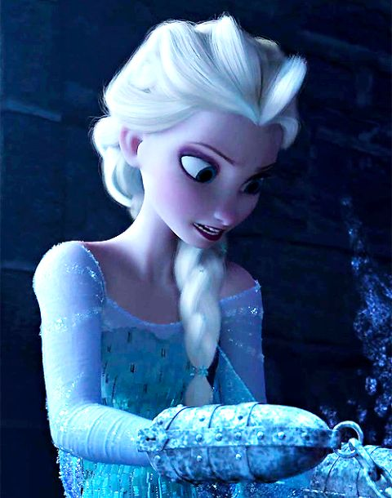
Binding of Isaac
Genesis 22:1
Without the first verse the passage makes no sense
Why? God’s real purpose of testing
Gen 22:5 “We will return”
God will give his son back to him. Lord over life and death.
Notes:
Now that he has Isaac, God comes to him and asks him to offer up Isaac – God is not asking for a sacrifice of Isaac, He is asking for a sacrifice but not of Isaac.
Was Isaac taken against His will? NO
p.177 “The Pentateuch as a narrative”
Gift freely given – not normal for a covenant b/c both parties have to do something. So that when God asks for I
Abraham could have seen that God would take his son from him (odd that God was offering all this without anything in return other than Faith that this would happen)
What does Abraham trust the one who has given the gift or the gift itself.
Abraham’s belief that God will give back his son (Resurrection), b/c God has promised – oath by his very self that it would be through Isaac that his descendants would come and no other.

Slide 11
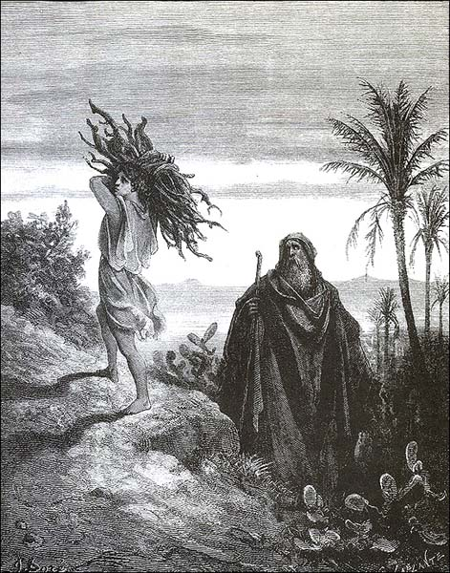
Binding of Isaac
Prefigurement
Only Son
Carrying of the wood

Slide 12
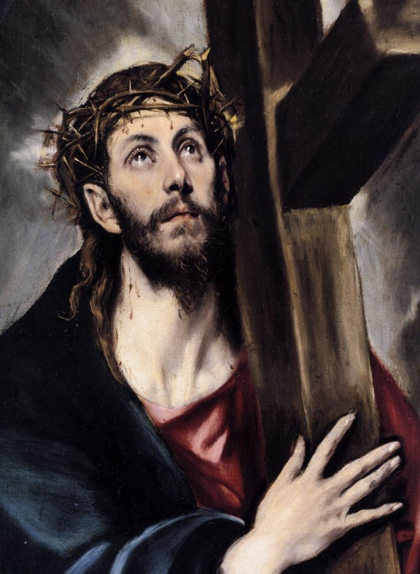
Binding of Isaac
God will provide the lamb
Angel of the Lord stops him
They offer the Ram…
Notes:
There is an incompleteness to the narrative (the lamb is not provided here, but is later)

Slide 13
Jacob
Esau
Gen 28 Dream
Shows that the covenant given to Abraham has gone through Isaac to him.
Vow to the Lord vv. 20-21
12 sons
Wrestling with angel
New name
Israel – “One who contends with God”
Notes:
Blessing of the covenant continues down Abraham’s line to his descendants.
God’s ways are not man’s ways
The Way we see this playing out in salvation history is that the covenant is still being pasted on, even to a man like Jacob beginning parts of his life was a trickster and conniving (to an imperfect man) – the covenant still continued through him to his descendants.
The vow to the Lord and the wrestling with the angel are linked together (struggle with the Lord and himself, unlike Abraham Jacob doesn’t put his full faith in God – so the wrestling with angel shows this struggle and that is what is new name means – “One who contends with God” (sums up his life – to reconciling with his brother)

Slide 14
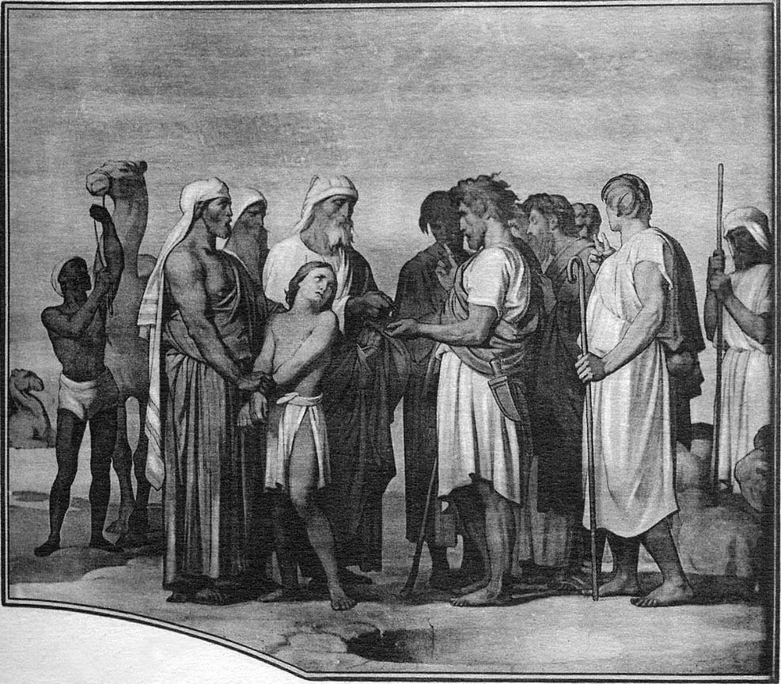
Joseph
Gen 37; 39-49
Brothers sell Joseph
God’s providence
Gen 45
Notes:
Famine in the land
Brothers planned to have him sold into slavery to die as a slave, but God turns this around so that Joseph is made 2nd to pharaoh and placed in charge of the land of Egypt in order to save lives (so instead of losing life are they intended, there is a dramatic reversal of the intended outcome so that life is now saved)
God protects his people

Slide 15
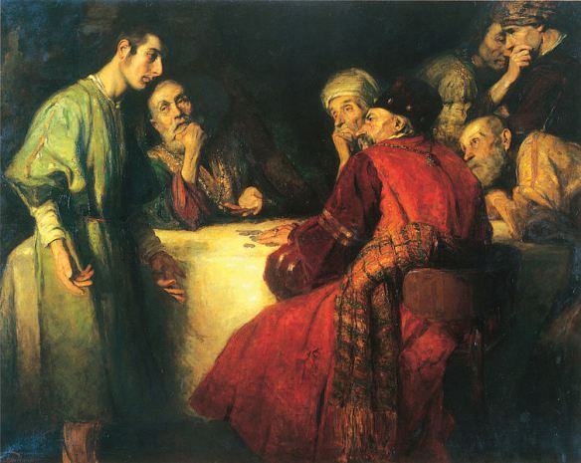
Joseph
Joseph prefiguring Christ
Joseph sold for 20 pieces of silver.
Rejection
Forgiveness
Foreshadowing of Salvation History itself
Part of a bigger plan
Notes:
Part of a bigger plan: Tells his brothers that God sent him ahead to prepare

Slide 16
Complete Fulfillment of Covenant

Slide 17
Anima Christi
Soul of Christ, sanctify me Body of Christ, save me Blood of Christ, inebriate me Water from Christ's side, wash me Passion of Christ, strengthen me O good Jesus, hear me Within Thy wounds hide me Suffer me not to be separated from Thee From the malicious enemy defend me In the hour of my death call me And bid me come unto Thee That I may praise Thee with Thy saints and with Thy angels Forever and ever Amen

