Slide 1
Creation
In the beginning God created the heavens and the earth.
--Genesis 1:1

Slide 2
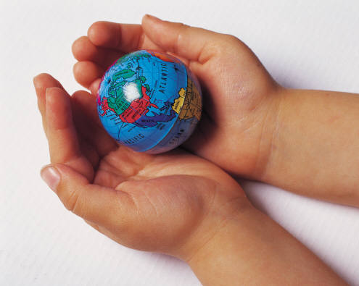
Creation
Why did God create the world?
Was God lonely?
Did God need us?
Did God have to create the world as it is?

Slide 3
Creation
God creates out of nothing
“ex nihilo” in Latin = out of nothing
Out of His goodness and love
Man makes things from other things

Slide 4
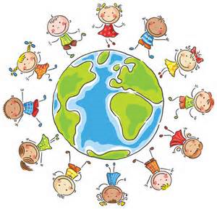
Creation
Read Genesis 1:26-29
(in Bible or on p. 24)
“Let us make man in our image, after our likeness.”
After God finished all of His creation, He created mankind in His image and likeness.
Nothing else on earth was made in God’s image.
Creation Sequence Video

Slide 5
Creation
God gave us a human nature
We are made of a body and a soul (natural gifts)
Body is made of matter – it will die and corrupt
Soul is spiritual (invisible, but real) – it is immortal and will live forever
Our human souls has …
Intellect: ability to think and reason
Will: ability to choose

Slide 6
Creation
Gifts Adam and Eve had before original sin
Preternatural Gifts
Immortality – body and soul would live forever
Infused knowledge of God – didn’t need to study (no school)
Integrity – harmonious relationships with oneself, with others and with nature
Supernatural Gift
Sanctifying Grace – a share in God’s life

Slide 7
Man is on top. Why?
Animals
Plants
Inanimate Creation
(rocks, water, etc.)

Slide 8
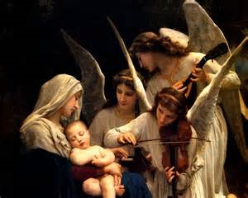
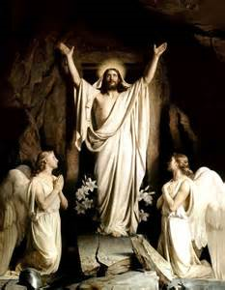
Creation
Angels
Pure spirits with intellect and will
Do not have bodies, but shown with bodies in art.
Often shown with wings because they move as quickly as they can think.

Slide 9
Creation
The Fall of the Angels
All angels were created good.
Satan (Lucifer) was created good.
God tested the angels to give them a chance to love and obey Him freely.
Lucifer led some angels to rebel against God.

Slide 10
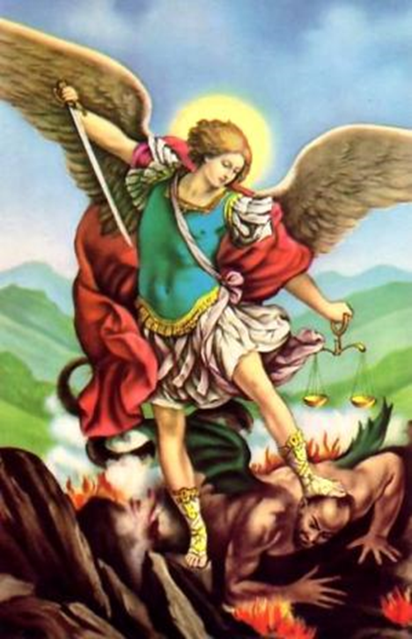
Creation
The Fall of the Angels
Satan and the angels who followed
him were sent to hell.
Hell—place for those who do not want to be
with God; never-ending separation from God.
Fallen angels are called demons.
Demons try to turn all creation away from God.
The good angels who resisted Satan’s temptations were allowed into heaven.
Read Revelation 12:7-10: Battle between St. Michael and the good angels and the demons.

Slide 11
Creation
The Fall of Man
Read Genesis 3:1-13
Adam and Eve believed the lies of the Devil and doubted God’s love for them.
Original Sin – committed by our first parents and inherited by all humanity.
Effects of Original Sin
Death (sickness, corruption of the body)
Ignorance of divine things
Concupiscence (temptation to sin)
Disharmony in nature and among men
Loss of grace and union with God

Slide 12
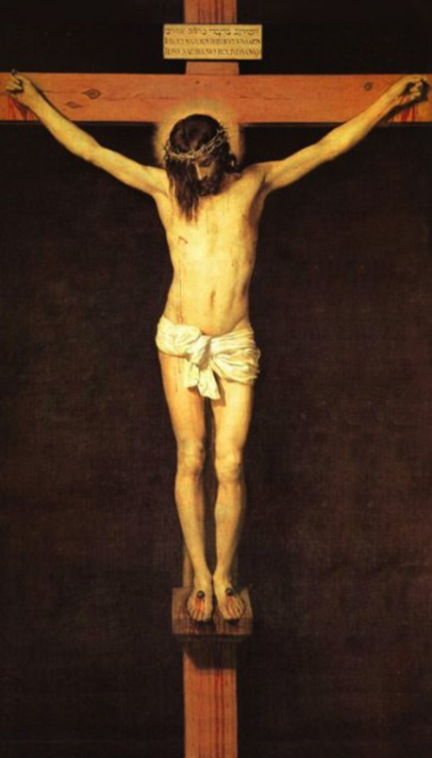
Genesis 3:15
(God speaking to the Devil) “I will put enmity between you and the woman, and between your offspring and hers; he will strike at your head while you strike at his heel.” (Gen. 3:15)
God’s promise to send a Savior!
Who is the woman?
Who is the Savior (her offspring)?

