Slide 1
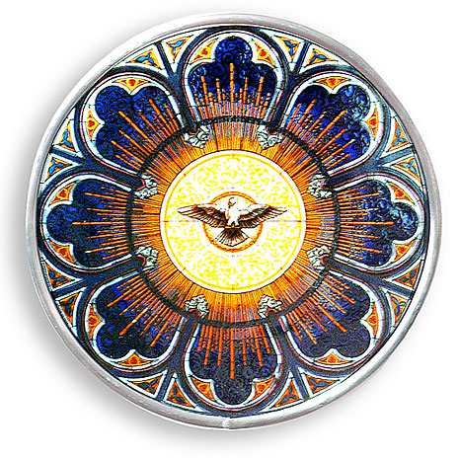
Ch. 20: The Gifts of the Holy Spirit
Send your Holy Spirit upon them to be their helper and guide.
Fill them with the spirit of wonder and awe in your presence.

Slide 2
Indwelling of the Trinity
At the Last Supper Jesus said, “If a man loves me, he will keep my word, and my Father will love him, and we will come to him and make our home with him.” (John 14:23)
At Baptism, God (Father, Son and Holy Spirit) comes to live in us!
At Baptism the Holy Spirit brings seven gifts.
In Confirmation these gifts are stirred up and fully activated.

Slide 3
What are the Seven Gifts? A brief overview video link
Help me know God’s will
Wisdom
Knowledge
Help me do God’s will
Piety
Fortitude
Understanding
Counsel
Fear of the Lord

Slide 4
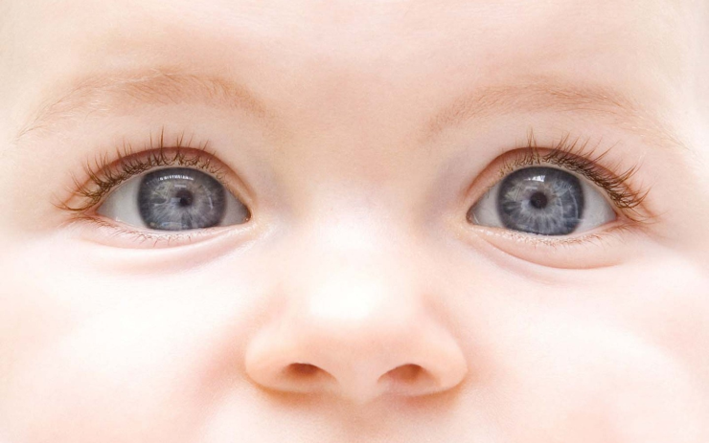
What are the Seven Gifts?
Wisdom (Latin – Sapientia)
To see things as God sees them.
See what is truly valuable in life.
Judge according to God’s standards.

Slide 5
What are the Seven Gifts?
Understanding (Latin – Intellectus)
Insight into the mysteries of faith.
Helps us explain the Faith to other people.

Slide 6
What are the Seven Gifts?
Knowledge (Latin – Scientia)
To see everything in relation to God and eternity.
Knowing the spiritual value and use of created things.

Slide 7
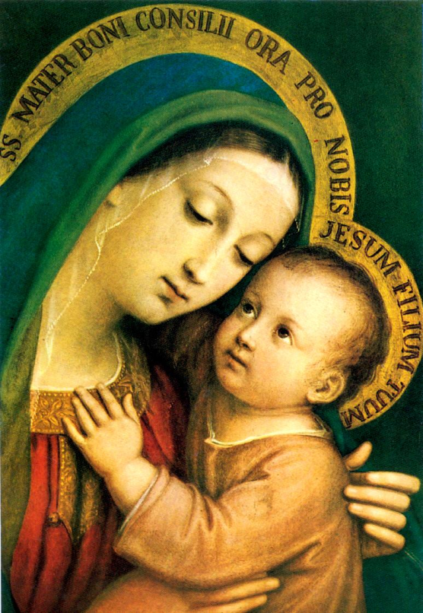
What are the Seven Gifts?
Counsel (Latin – Consilium)
To make correct decisions about God’s will for our lives.
Seeing what is best for others in relationship to God.

Slide 8
What are the Seven Gifts?
Fortitude (Latin – Fortitudo)
The strength to be faithful to Christ when it is difficult.
Strength for God.

Slide 9
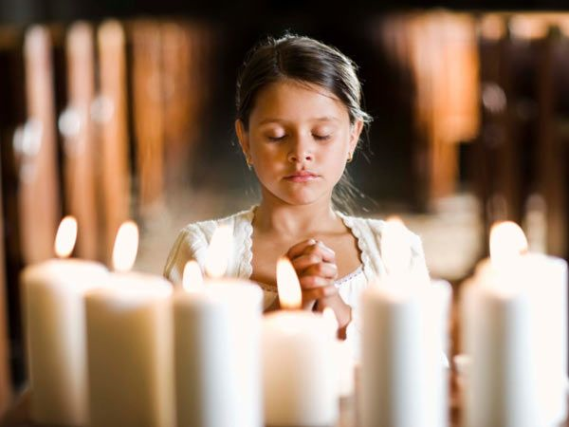
What are the Seven Gifts?
Piety (Latin – Pietas)
To worship God and love Him as our Father.
Affection for God as our Father who loves us and who is worthy of worship.

Slide 10
What are the Seven Gifts?
Fear of the Lord (Latin – Timor Domini)
To see the evil of sin and the goodness of God.
Fearing the judgment of God.
Having a healthy respect for Almighty God.

Slide 11
When a gift is given to us …
We can accept it or decline it.
We can open it right away or wait until later.
We may open it right away, but not use it until later.

Slide 12
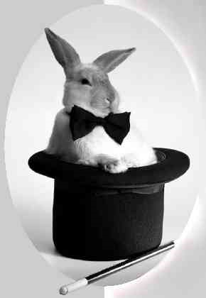
The Gifts of the Holy Spirit really are gifts!
They are truly given to us in
Baptism and Confirmation.
These gifts are not a sort of magic.
They don’t suddenly make us perfect Christians.
We must exercise the gifts by using them in different situations.
Pray to the Holy Spirit to teach us how to use these gifts well.

Slide 13
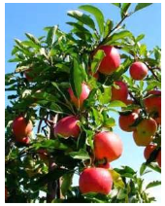
“You will know a tree by its fruit.”
We know an apple tree because it bears apples.
If you think of yourself as a “Christian tree,” what kind of fruits will you bear?

Slide 14
Fruits of the Holy Spirit
The fruits of the Holy Spirit are ways of acting that show others that we have the gifts of the Holy Spirit.
As we grow in the gifts of the Holy Spirit, we will see certain effects in our lives—the fruits of the Holy Spirit.

Slide 15
The Fruits of the Spirit are:
joy
patience
charity
gentleness
generosity
kindness
chastity
faithfulness
self-control
modesty
peace
goodness

Slide 16
Prayer to the Holy Spirit
Come, Holy Spirit, fill the hearts of Your faithful, and kindle in them the fire of Your love. Send forth Your Spirit, and they shall be created. And you shall renew the face of the earth.
Let us pray, O God, Who has taught the hearts of the faithful by the light of the Holy Spirit, grant in the same Spirit we may always be truly wise and ever rejoice in His consolation. Through Christ our Lord. Amen.

