Slide 1
Ch. 16
The Seven Sacraments
For the grace of God has appeared for the salvation of all men.
Titus 2:11

Slide 2
What is a Sacrament?
A sacrament is a visible sign that confers grace.
Who started the Sacraments?
  Jesus Christ!
  Bible Workout activity – find them in the Bible.

Slide 3
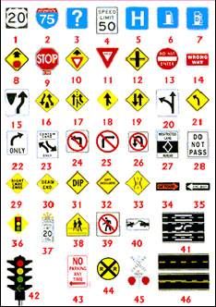
Signs
Signs
Signs

Slide 4
Sacraments are signs…
A sign points to a reality.
Think about …
  signs in our school.
  signs in the world.

Slide 5





Sacraments are signs…
Country
A sign points to a reality.
Poison
Love
Red Cross
Hot
CAR

Slide 6

Efficacious Signs
Efficacious sign
  It causes to happen what it signifies.
  This is different than a stop sign.

Slide 7
Efficacious Signs
Jesus works in the Sacraments.
  We don’t know exactly how they work (it’s a mystery!), but Jesus makes them effective.
  Example: Although we see a priest consecrate the Eucharist, it is Jesus who works through the priest to consecrate the Eucharist.

Slide 8
Efficacious Signs
If the minister has the right intention and uses the proper natural signs, the Sacrament will give grace.
  The power of the Sacraments comes from Jesus, not the minister.
  The power of the Sacraments don’t depend on the holiness of the minster.

Slide 9
The Sacraments Give Grace
Every sacrament confers sanctifying grace upon the person’s soul.
Every sacrament also confers a specific sacramental grace.

Slide 10
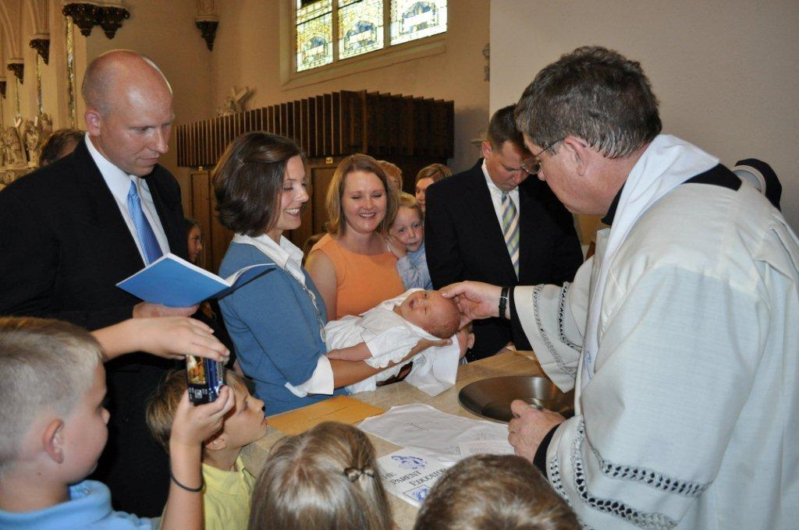
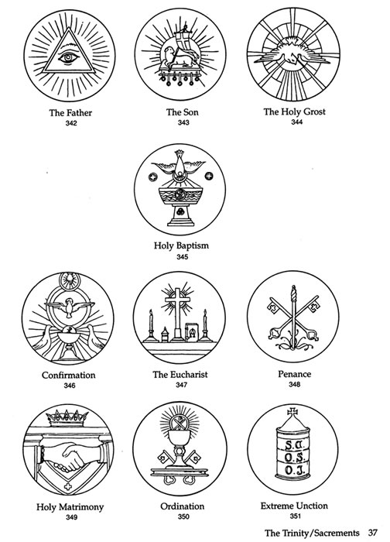
Sacramental Grace
Baptism
  Gives the grace to live a holy life.

Slide 11
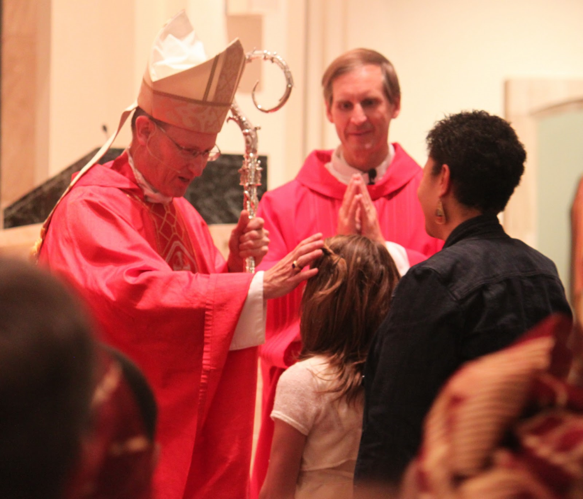
Sacramental Grace
Confirmation
  Gives the grace to be strong in faith.

Slide 12
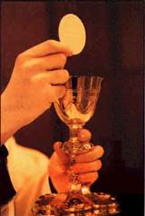
Sacramental Grace
Eucharist
  Gives the grace to love Jesus and our neighbor.

Slide 13
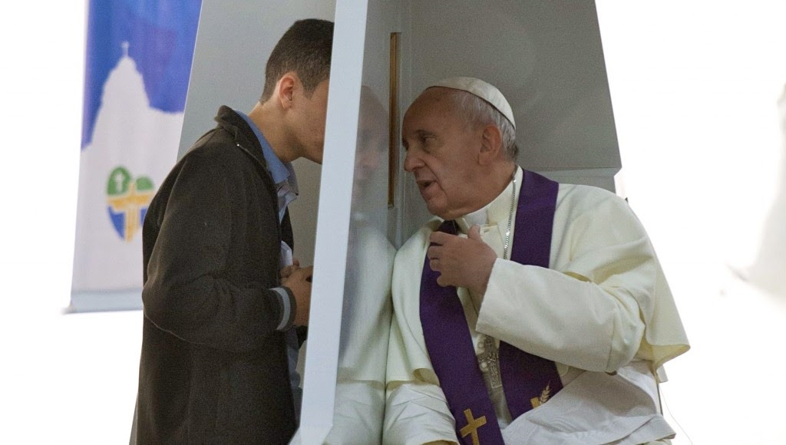

Sacramental Grace
Penance
  Gives the grace to overcome our sins.

Slide 14
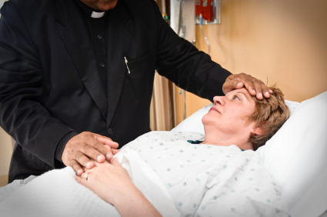

Sacramental Grace
Anointing of the Sick
  Gives the grace of healing in body, soul or both
  Gives the grace to accept suffering and death.

Slide 15
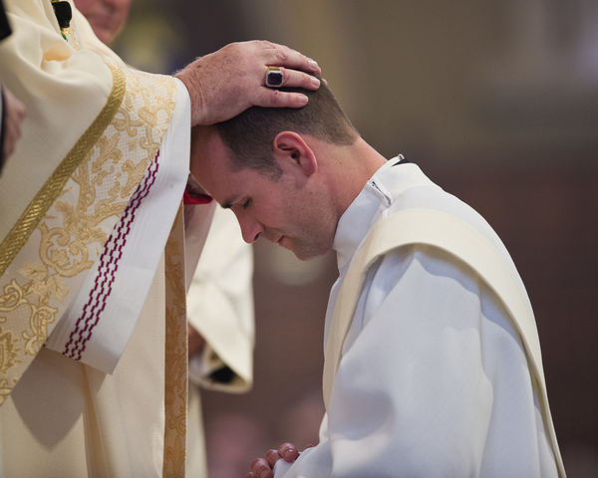
Sacramental Grace
Holy Orders
  Priests are given grace to live holy lives and administer the sacraments.

Slide 16
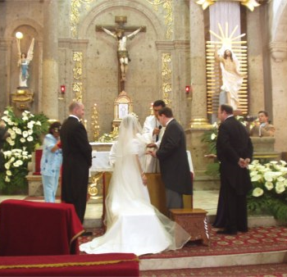
Sacramental Grace
Matrimony
  Gives the grace for the couple to love one another and be good parents.

