Slide 1
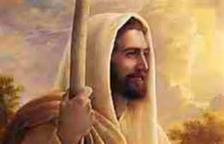
Jesus Founds His Church
Chapter 11

Slide 2
Discussion: Let’s say you are staring a club …
What’s the name of your club?
What must you do to have a successful club?
You need a goal.
You need a leader.
You need people to help
the leader.
You need to recruit new
members.

Slide 3
Jesus Calls His Twelve Apostles
At the age of 30, Jesus called his 12 Apostles.
He started the Catholic Church.
To save people and lead them to heaven
Since Jesus knew he would be going to heaven soon, he chose Peter to lead the Church.
The Apostles carried on his message and teachings after his death.

Slide 4
Memorize the Apostles’ Names: Sung to the tune of Yankee Doodle
Peter, Andrew, James and John,
(“Yankee Doodle went to town”)
Philip and Bartholomew
(“riding on a pony,”)
Matthew, Simon, Thomas, Jude
(“stuck a feather in his hat”)
James the Less and Judas, too.
(“and called it macaroni.”)

Slide 5
Church Leadership
Jesus chose Peter to be the first Pope and visible head of the Church on earth.
Gives him new name: Peter, which means rock, to show his new mission.
What are the qualities we think of with the word “Rock”?
Strength, firm, solid, consistent
Jesus gave him the “keys to the Kingdom of Heaven”. What does that mean?
Key=power
Peter (& any pope) can open & close the gates.

Slide 6
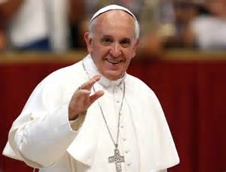
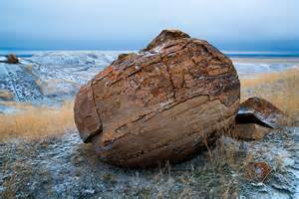
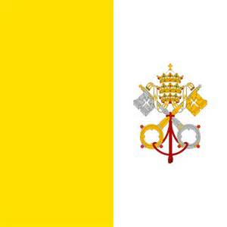
Our Current Pope
Pope Francis.
He is the “rock”.
He holds the keys.

Slide 7
“… and the gates of hell will not prevail against it.” (Mt. 16:18)
Jesus spoke these words to Peter.
Indefectibility: The Church will exist as Jesus founded her, until the end of time.
The Church is essentially the same as She was 2,000 years ago!
Same structure (Popes and Bishops)
Same Holy Book - Bible
Same Sacraments & Same Mass
Same goal/purpose: for all to be holy and get to heaven

Slide 8
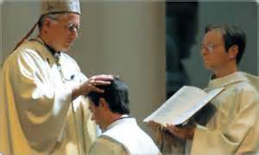
Apostolic Succession
An unbroken chain.
Beginning with the apostles and carried on through bishops.
Passed on through laying of hands.
Essential for Holy Orders and Sacraments to be valid.

Slide 9
Prayer for the Pope
O God, the Shepherd and Ruler of all Your faithful people, mercifully look upon Your servant [name of Pope], whom You have chosen as the chief Shepherd to preside over Your Church. We beg You to help him edify, both by word and example, those over whom he has charge, that he may reach everlasting life together with the flock entrusted to him. Through Christ our Lord. Amen.

