Slide 1
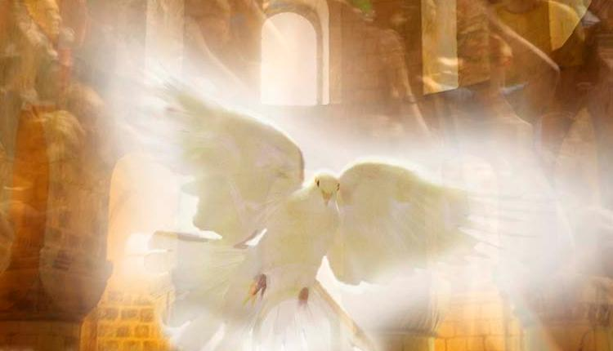
The Church in Our Time
“…teaching them to observe all that I have commanded you; and lo, I am with you always, to the close of the age.” Matthew 28:20

Slide 2
What would you say?
Imagine that you are meeting someone who is not Catholic. How would you respond to them if they said the following?
How do you know the Pope is right on statements of the Faith?
I thought there was only one Catholic Church. How are there other Churches that claim they’re Catholic?
Sure, I know you have what you call “truth” but I have my truth—you can keep your truth to yourself. I don’t have to believe it.
We’ll try to answer some of these today!

Slide 3
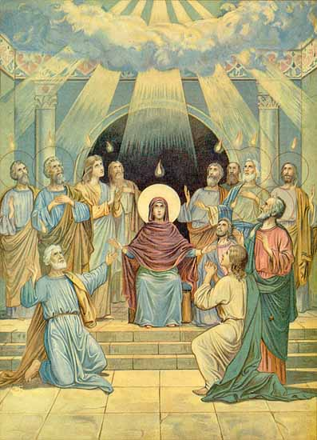
Pentecost –Birthday of the Church
50 days after Jesus’ Resurrection
10th day after the Ascension of Christ
The Holy Spirit descended upon them as tongues of fire in the Upper Room.
Gave the Apostles the gift of tongues.
They could be heard in every language.
Gave the Apostles the ability to preach the Good News and go on missionary trips around the world.
On that day 3000 were converted to Christian/Catholic Faith.

Slide 4
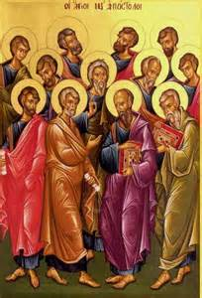
Spreading the Church
Simon Peter
Served as the first Pope in Rome.
Martyred: crucified upside down.
Andrew (Peter’s brother)
Missionary in Greece & Russia.
Martyred: in Greece on a X-shaped cross.
James the Greater
Served in Spain and Jerusalem
Martyred: in Jerusalem; first Apostle to die for the Faith.
John (James the Greater’s brother)
Took care of Mary, the Mother of God.
Traveled to Asia & Turkey.
Died a natural death: the last Apostle to die.

Slide 5
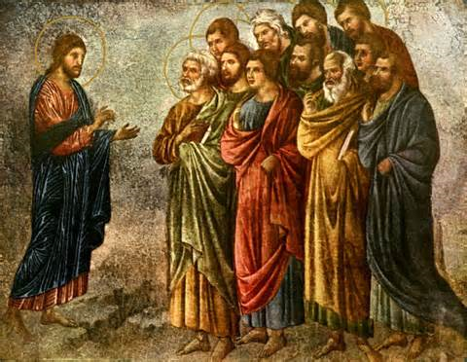
Spreading the Church
Phillip
Preached in Asia Minor.
Martyred: in Greece.
Bartholomew
Preached the Good News in Armenia (Northeastern Turkey).
Martyred: beheaded.
Doubting Thomas
Taught in India.
Martyred: in India.
Matthew (Levi)
Traveled to Palestine.
Martyred: in Iran.
James the Less
First Bishop of Jerusalem.
Martyred: in Jerusalem.

Slide 6
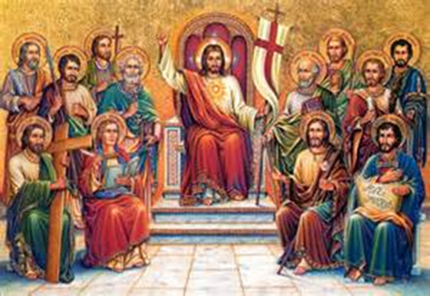
Spreading the Church
Jude Thaddaeus (James Less’ brother)
Missionary in Iran & surrounding countries.
Martyred: in Iran.
Simon
Missionary in Iran & surrounding countries.
Martyred: in Iran with St. Jude.
Judas Iscariot
After betraying Jesus, he despaired of God’s love and killed himself.
St. Matthias (took Judas’ place)
Preached in Ethiopia.
Martyred.

Slide 7
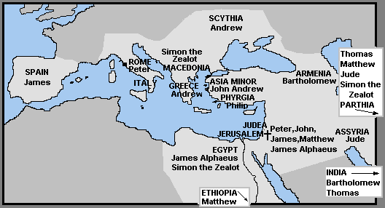
Twelve Apostles’ Travels

Slide 8
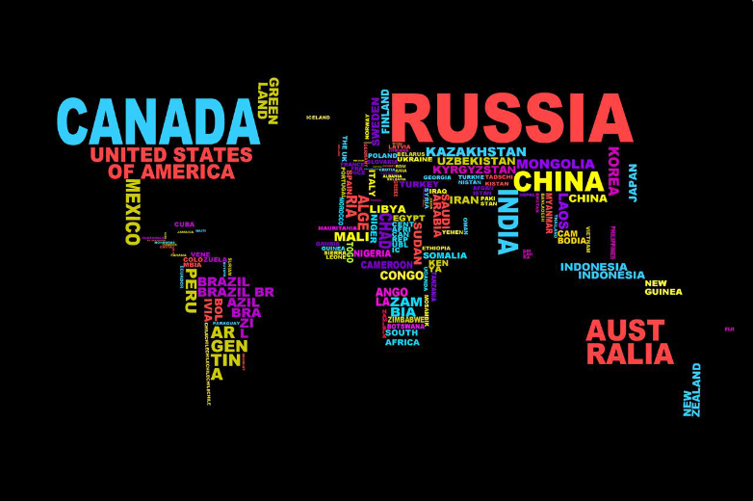
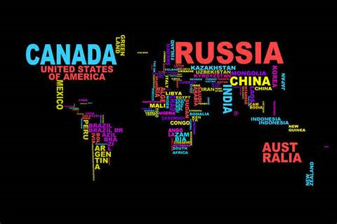
If you were a missionary, where would you want to serve?

Slide 9
You are a missionary! Who is God calling you to serve?

Slide 10
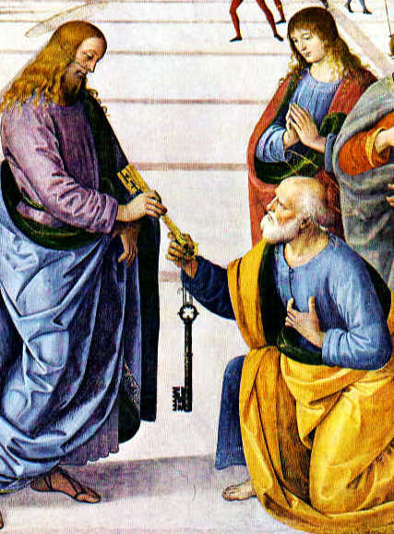
Infallibility
There is absolute truth.
The Holy Spirit protects the Church from errors in teaching matters of faith and morals.
“The Holy Spirit, whom the Father will send in my name, will teach you all things and will remind you of everything I have said to you.” Jn. 14:26
In essence, it is the Church’s ability to know the truth of God and to teach it without error.

Slide 11
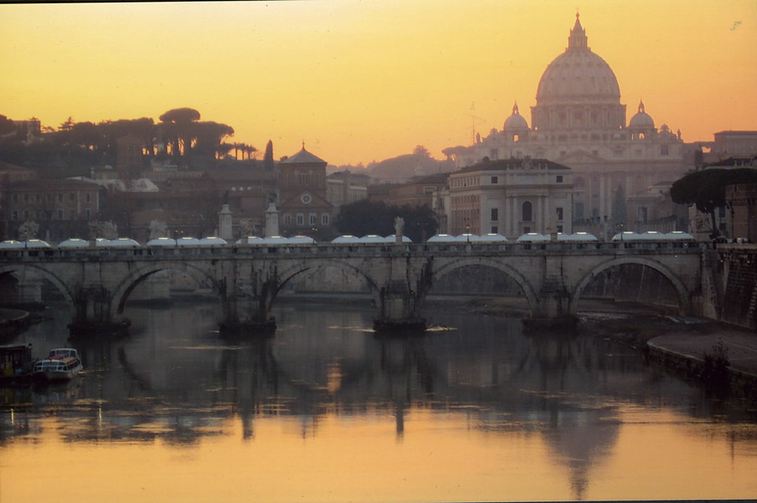
Indefectibility
The Catholic Church will exist on earth until the end of the world – indestructible and unchanging.
Christ’s truth will always be taught by the Church.
The Church will have the same structure (Pope, bishops, etc.), Sacraments, and goal.
Christ’s mission continues, despite many persecutions!

Slide 12
Change
The truths of God will never change (Commandments, teachings necessary for salvation).
Some Church disciplines (how we do things) may change.
Examples…
The Communion fast has been shortened to one our before receiving Communion, instead of fasting from midnight before receiving Communion.
Until recent years it was forbidden to eat meat on Fridays. The faithful are allowed to eat meat on Fridays provided some other act of mortification is performed.

Slide 13
The Church in different cultures and areas
celebrates the Faith in different ways.
All Catholics share:
in the true Faith.
in Liturgical symbols…
in the institution (Pope, bishops).
in their understanding of God’s mysteries.
in various forms of holiness.
Rites: different ways of celebrating Mass and other liturgies.

