Slide 1
The Five Themes of Geography

Slide 2
The Five Themes of Geography
Day 3: Regions

Slide 3

Place: Review
Let’s play a quick review game to see if you understand the Theme of Place! I’ll say a place and you write down first three characteristics that come to mind.
Forest
Beach
Pittsburgh, PA

Slide 4
Regions
Region - an area on the Earth that is defined by certain similar characteristics.
These similar characteristics may be physical, human, or cultural.

Slide 5
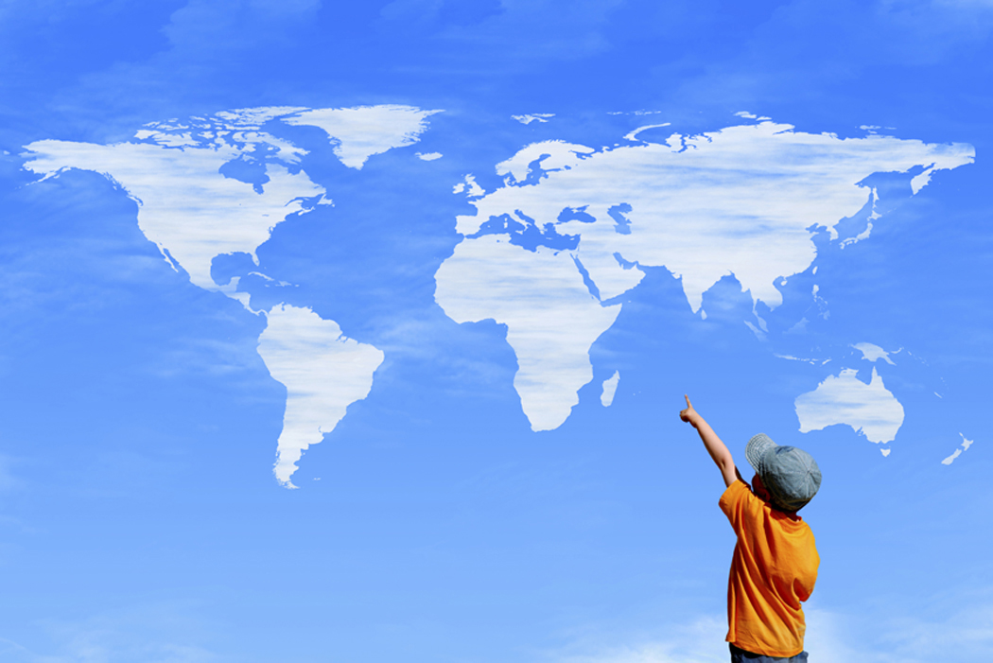
How do Regions help geographers?
Regions help divide the
world to make it easier to study.

Slide 6
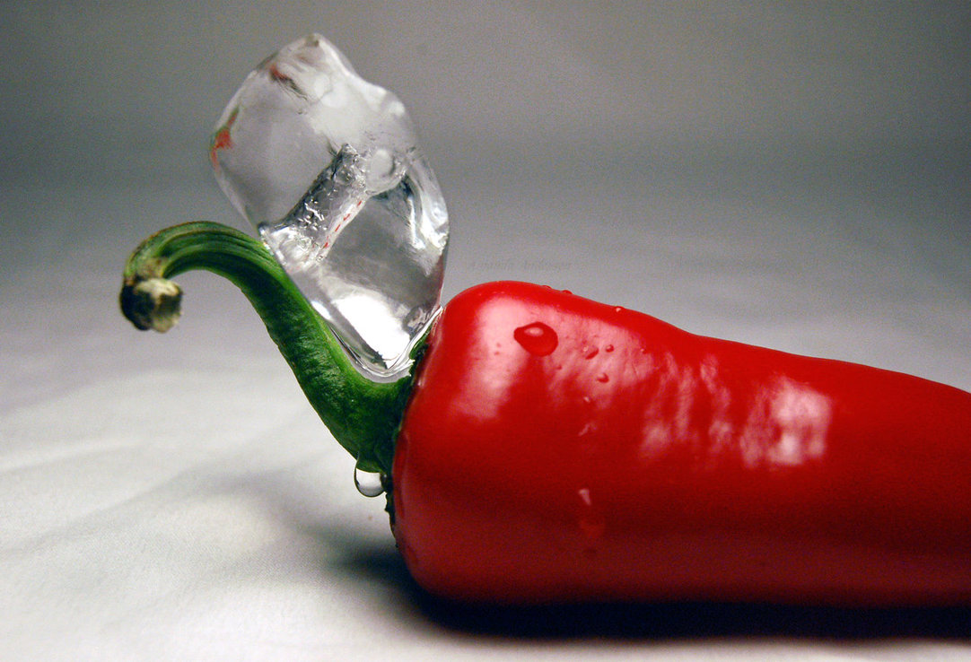
How do Regions help geographers?
Regions help us to learn about the differences and similarities that help our world function as a unit.

Slide 7
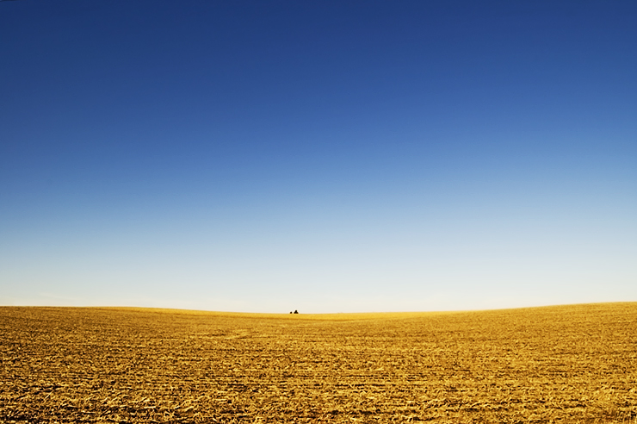
Types of Regions
Region - a group of places with at least one common physical or human characteristic, and may be determined by people’s opinion, influenced by one’s culture and experiences.
You can think of regions as having both human (Centre County) and physical (Great Plains) characteristics

Slide 8
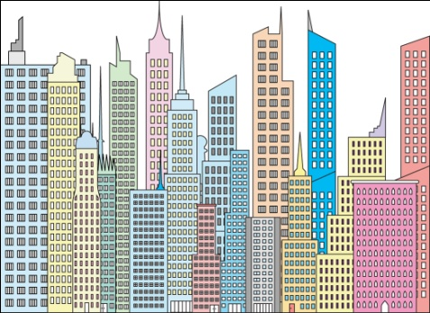
Types of Regions
Formal regions - areas in which a certain characteristic is found throughout them.
  Example: States, countries, cities

Slide 9
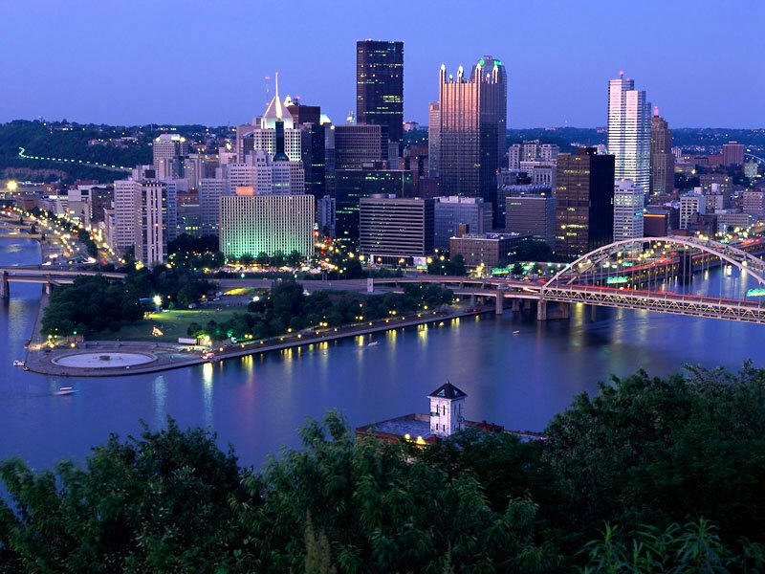

Types of Regions
Functional regions - consist of a central place and the surrounding places affected by it.
  Example: Amazon drainage basin, Greater Pittsburgh Area

Slide 10
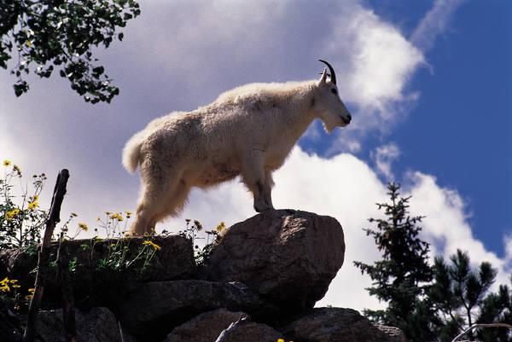
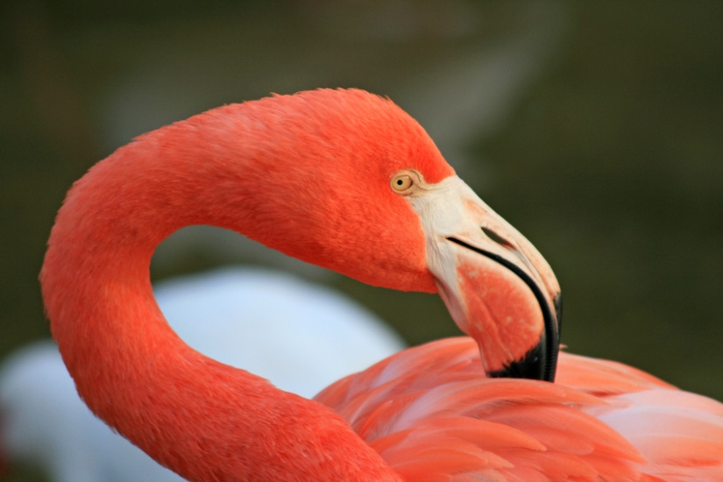
Types of Regions
Perceptual regions - defined by people’s attitudes and feelings about areas. They don’t have defined boundaries
  Example: The West, the Middle East, the South

Slide 11
Regions – Geo Poem
You will be working in groups to create a poem on one country
Use the country books from the library to discover information about your country
Write the poem with your group and draw some pictures that describe your country
We will share our poems when everyone is done

