Slide 1
The Five Themes of Geography

Slide 2

Geography
Geography – the study of the Earth’s physical and cultural features
It means writing about or describing the earth.

Slide 3
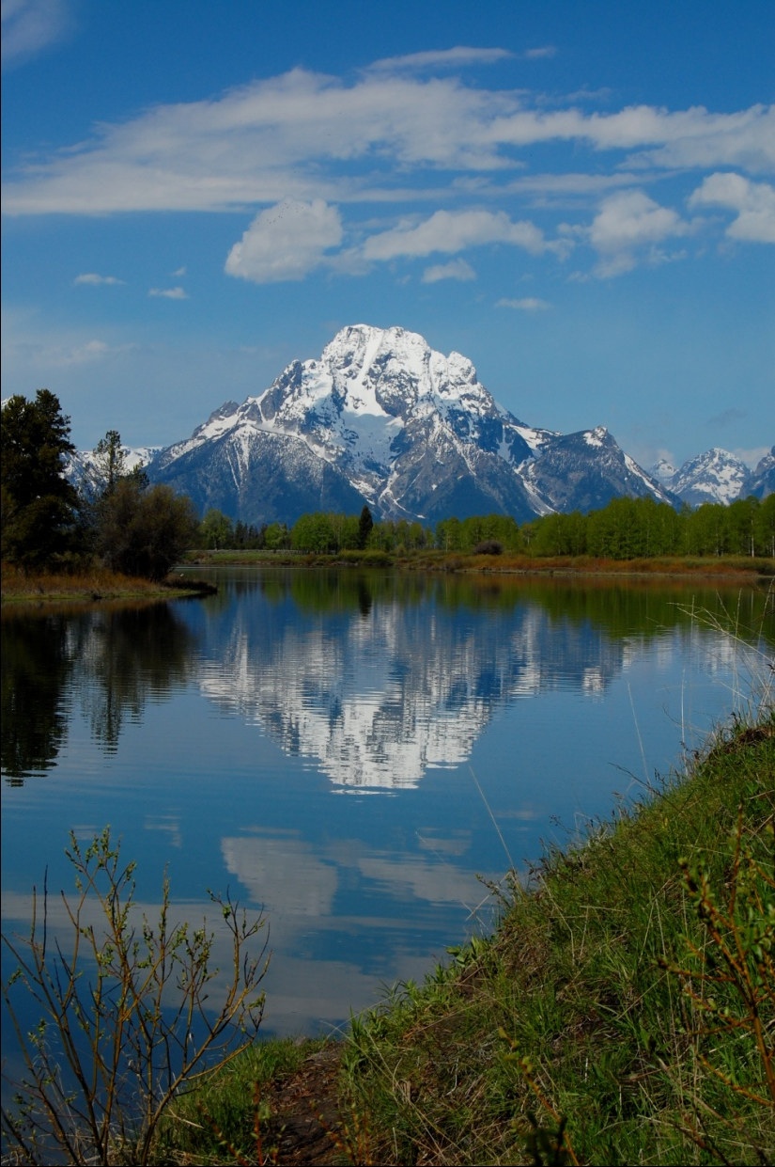
Geography's Five Themes
Location
Place
Regions
Movement
Human-Environment Interaction

Slide 4
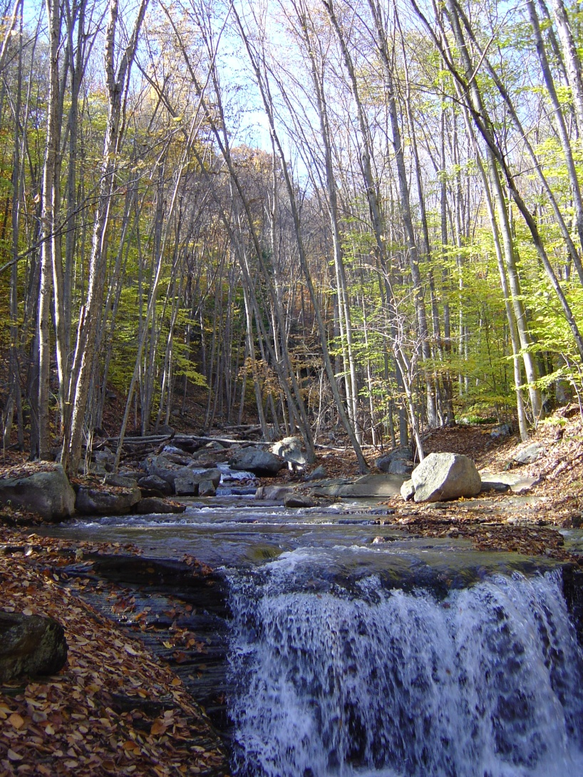
Questions we will answer…
What is the location of a place?
What is the character of a place?
How are places similar to and different from other places?

Slide 5
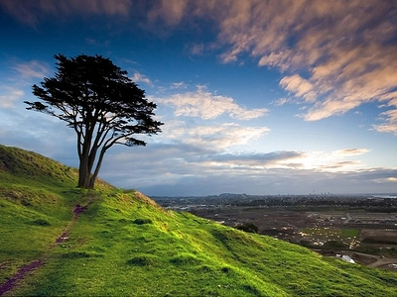
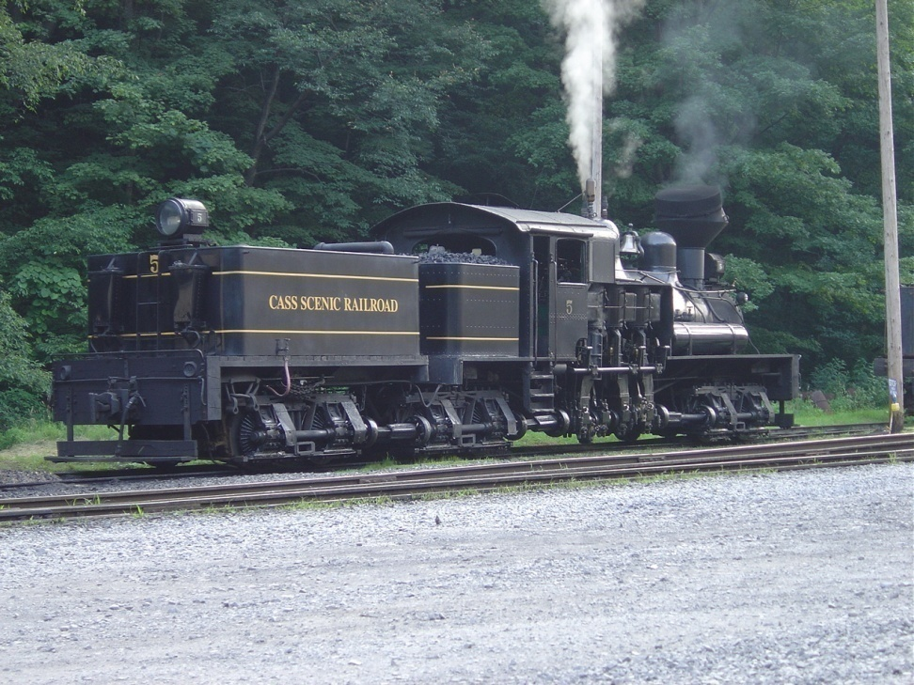
Questions we will answer…
How do people, goods, and ideas move between places?
How do people interact with the natural environment of a place?

Slide 6
The Five Themes of Geography
Day 1: Place

Slide 7

Place
All places have characteristics that set them apart from other places.
Geographers describe places by both their physical and human characteristics

Slide 8
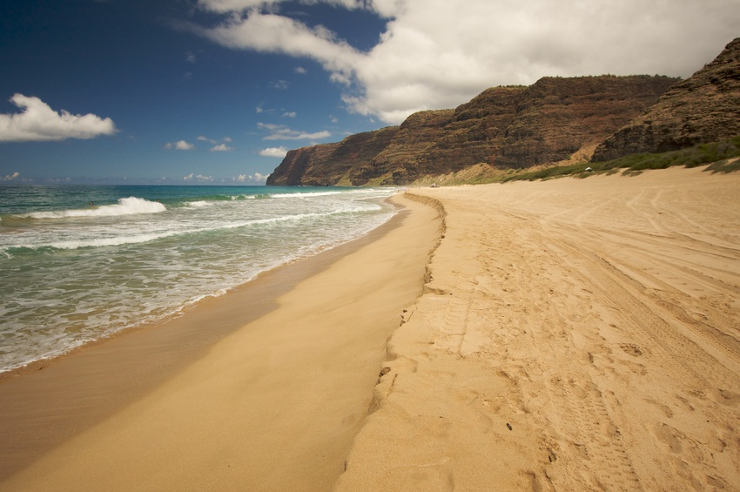
Place
Physical Features – landforms, ecosystems, climate, animal life, other geographic features

Slide 9
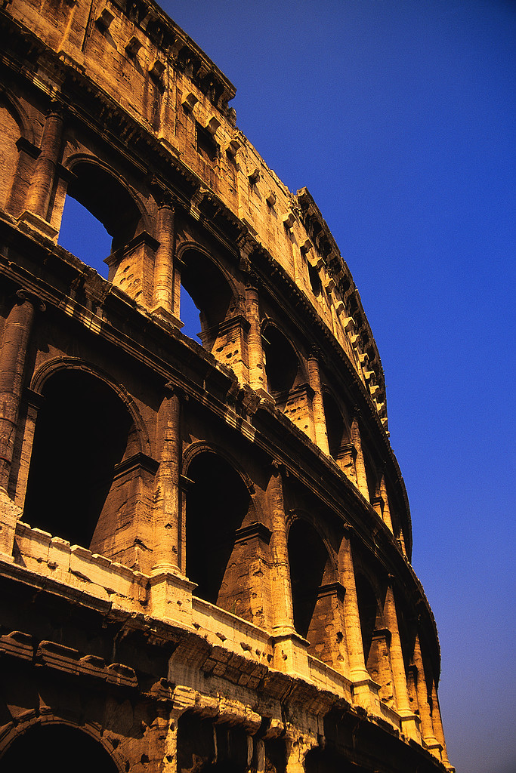
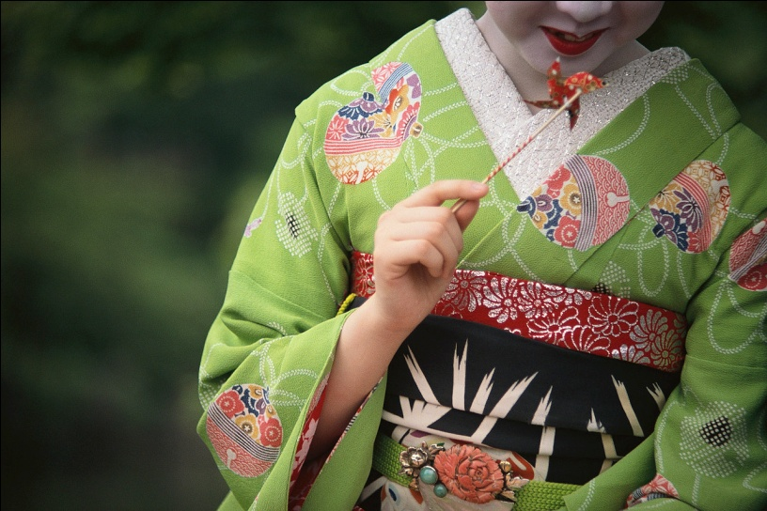
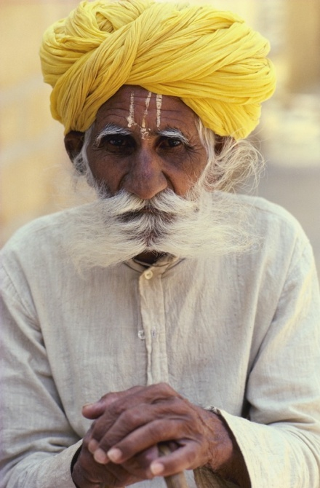


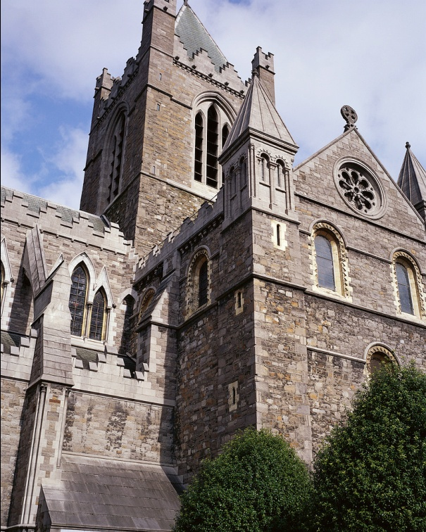
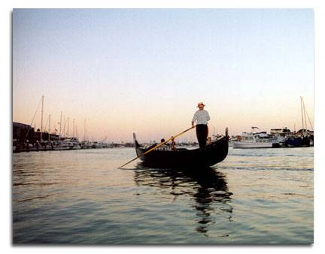
Human Characteristics
languages, art, customs, economy, government, architecture, religion, and so on…

Slide 10
So…Place is the personality of Geography

Slide 11

Place…Check for Understanding
What are the physical and human characteristics of BEA Middle High School? How is BEA different from other schools?

Slide 12
Place: ABC Book
You will create part of an ABC book to describe your township or Borough. You can describe the unique physical features, the buildings, the weather, traditions, people, or so on. When you are finished the book should tell people unfamiliar with your community what it is like to live there.

Slide 13
Requirements for each letter:
Choose a topic for each letter
Example: B is for Blue and Gold
Create a four line rhyme the describes your word (the last word of the second and fourth line should rhyme)
Write a paragraph describing more about your topic – the paragraph needs to be at least five sentences
Draw and color a picture to go with each letter

Slide 14

B is for Blue and Gold
True colors never falter
Fight, Fight for Victory
Our pride will never alter

