Slide 1
The Five Themes of Geography

Slide 2
The Five Themes of Geography
Day 4: Movement

Slide 3
What culture did I come from?
China
Germany
Germany
Hindu-Arab
Canada
Greece
Celtic
Aztec

Slide 4
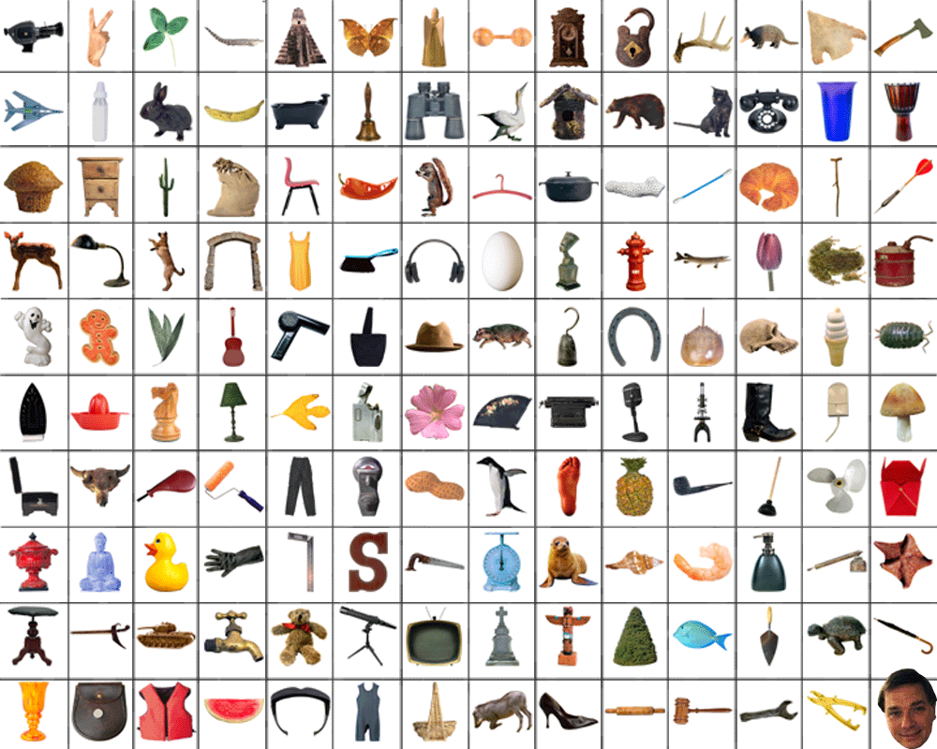
During a common day what different objects or people do you interact with?

Slide 5




Movement
What are some of the different ways you communicate with other people?

Slide 6
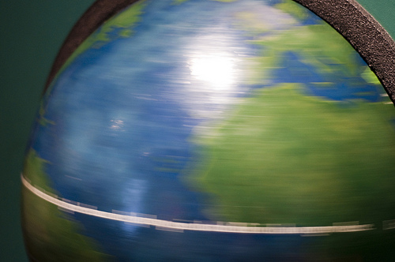
Movement
We interact with many different people, places and things everyday of our lives. We travel from place to place, rely upon different products, information, and ideas from sources beyond our immediate environment. This all explains the theme of Movement.

Slide 7
Movement
Question to ask to understand Movement:
  Who …
  What…
  Where …
  When…
  … and why do things, people and information move?
  How do things move?

Slide 8
Movement
How do ideas travel from place to place?
  In ancient times?
  Today?

Slide 9

The theme of movement helps us understand how we are connected with, and dependent upon, other regions, cultures, and people in the world.

Slide 10
Movement: Look at the Label Activity
Items in the classroom can easily represent a miniature version of the world economy. You will be surprised how many countries are represented on the “Made in….” labels of products in our classroom.

Slide 11
Movement: Look at the Label Activity
Take a tour of our classroom and look at the labels on items to see where they are made.
Write down the brand names and Fill out your chart to show what type of movement we can see here in Room 80.

Slide 12
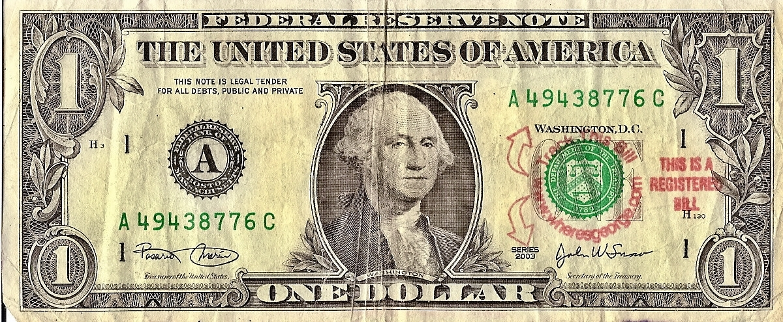
Movement
Currency travels all over the place. This particular bill has been marked to show where it has been.

Slide 13
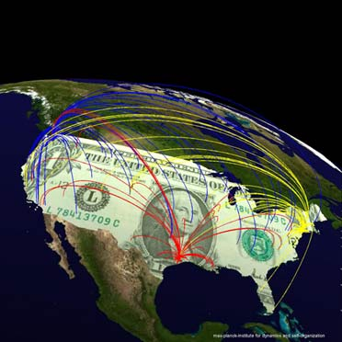
Movement
Tracking Paper Money

