Slide 1
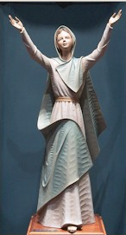
Mary
Mediatrix of Grace

Slide 2
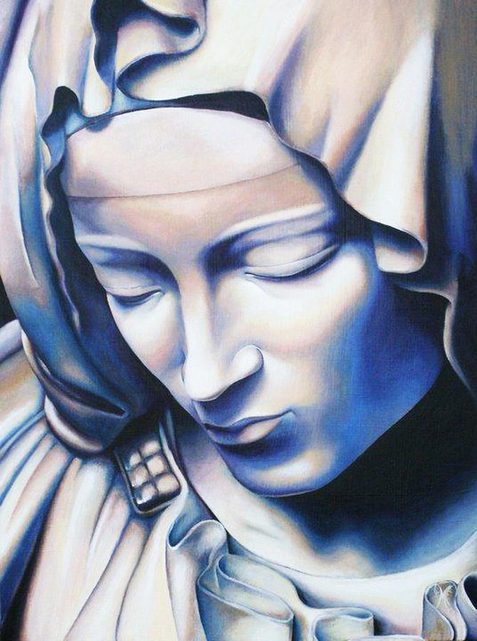
Mary’s Motherhood
POINTS
Jesus gave Mary to be the mother of the Church and our mother.
Mary’s special privileges:
Mediatrix of grace
Immaculate Conception
Perpetual virginity
Assumption
Consecration to Mary

Slide 3
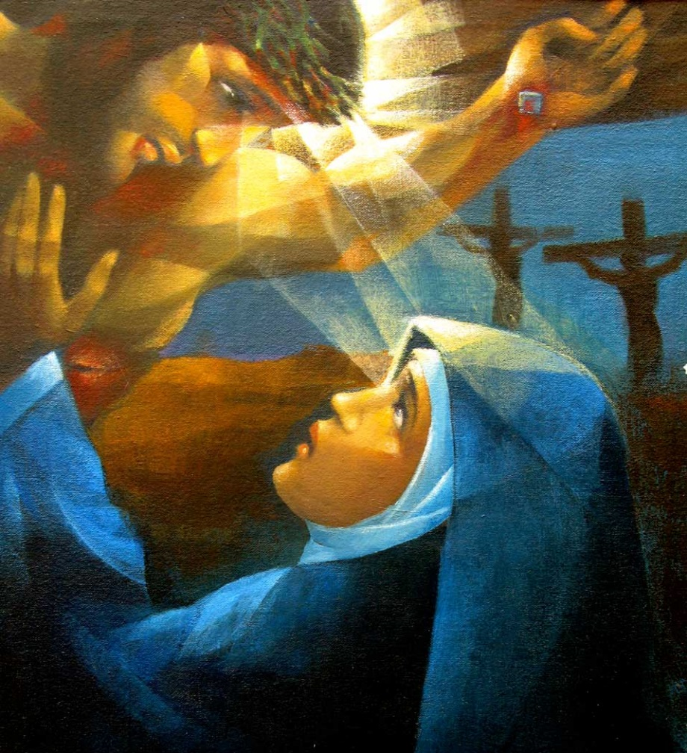
Jesus gives Mary to us to be our Mother
Read John 19:16-27
Mary is at the foot of the Cross with John the Apostle
“Woman, behold your son…
…behold your Mother.”
John represents all of us
Mary is given to each of us

Slide 4
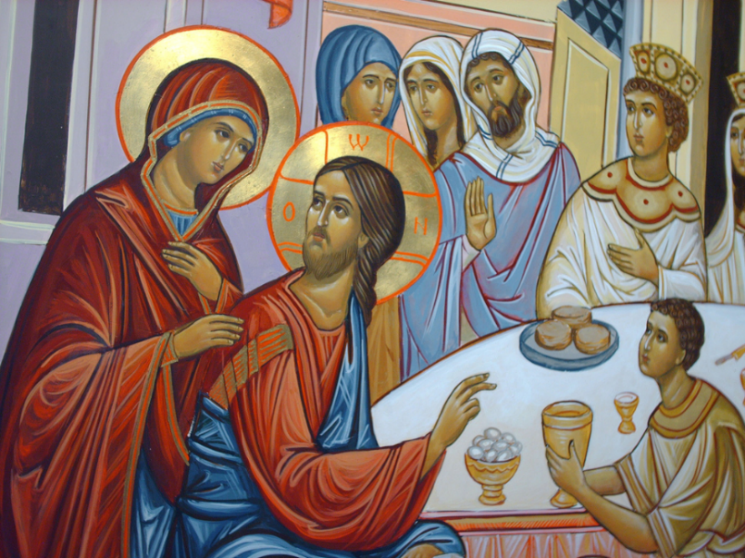
“Woman, behold your son.”
Why did Jesus call Mary, “Woman”?
He did this another time…at the wedding at Cana (John 2:1-11).
This reminds us of Eve, who is also identified as “woman.”
Jesus is the New Adam, who by his act of obedience restores the grace lost by Adam’s disobedience.
Mary, as the New Eve, is united with the New Adam.
Her yes (fiat) allowed Christ to be born of her to restore grace to the world.
Mary is Mother of us all by the order of grace, just as Eve is the mother of all by the order of nature.

Slide 5
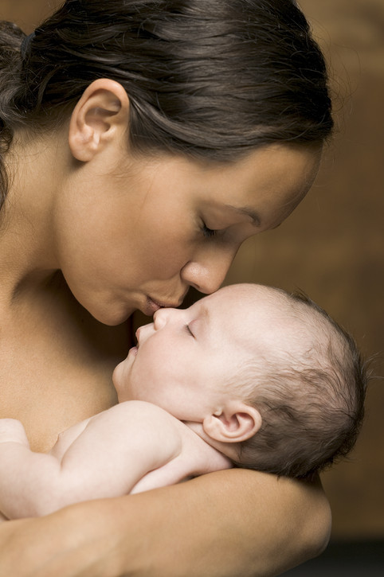
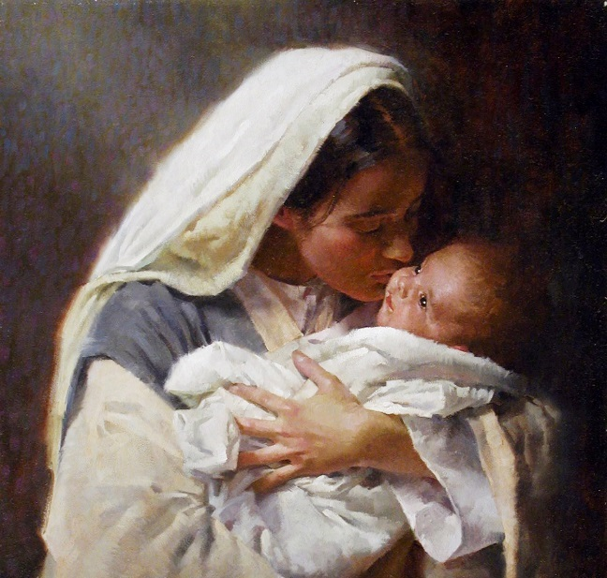
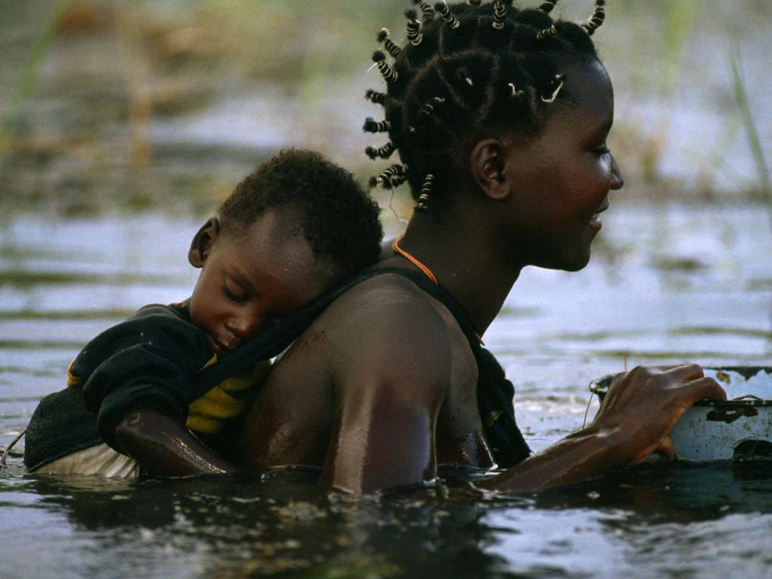
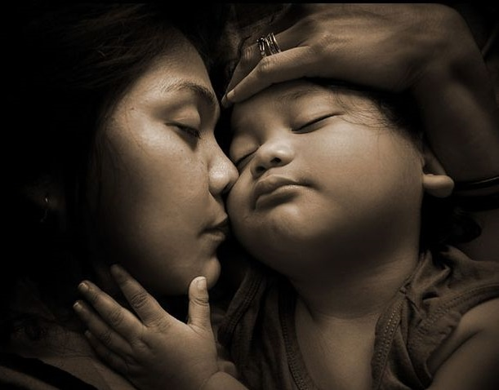
Mary’s Motherhood
We all have mothers who give us the gift of human life.
Mary is a spiritual mother who gives us access to divine life through grace.
John took Mary into his home.
How can we take Mary into our homes?
How can we take Mary into our hearts?

Slide 6
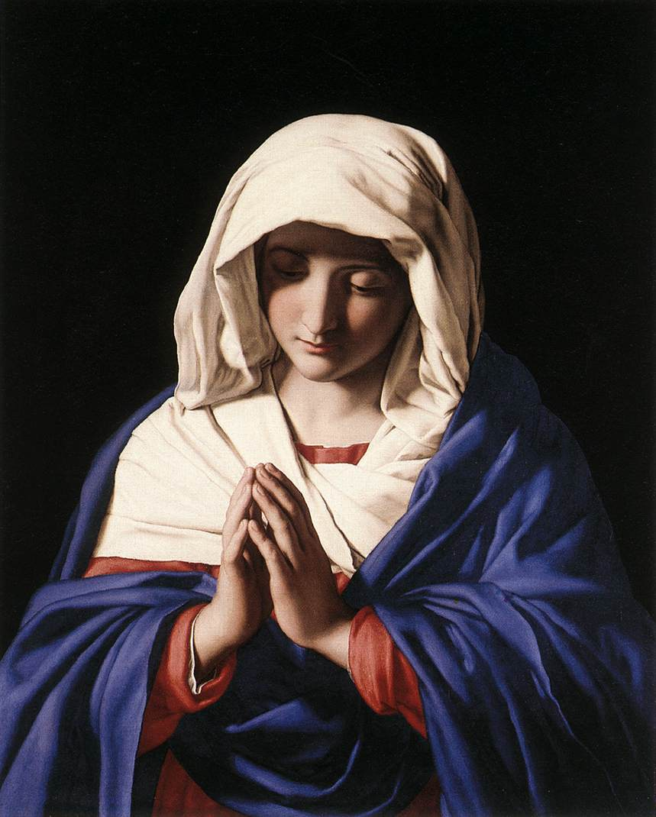
Mary’s Motherhood
When we love someone, we strive to share his loves, interests, experiences, etc.
We love God and know that he loves Mary.
Thus, we, too, should strive to know and love his Mother.
Love and devotion to Mary is truly Christian.
Mary is not worshipped, but is given the highest devotion or veneration among the saints.
Mary is honored because of her faithfulness to God!
Mary is an example and guide for us on our journey to heaven.

Slide 7
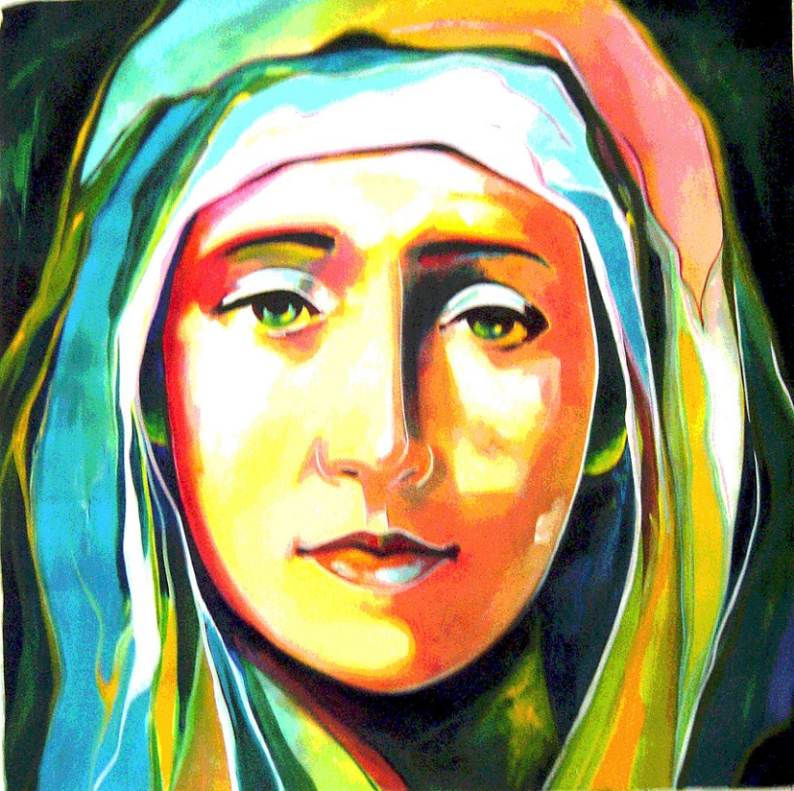
Mary’s privileges
Mediatrix of grace
Immaculate Conception
Perpetual virginity
Assumption

Slide 8
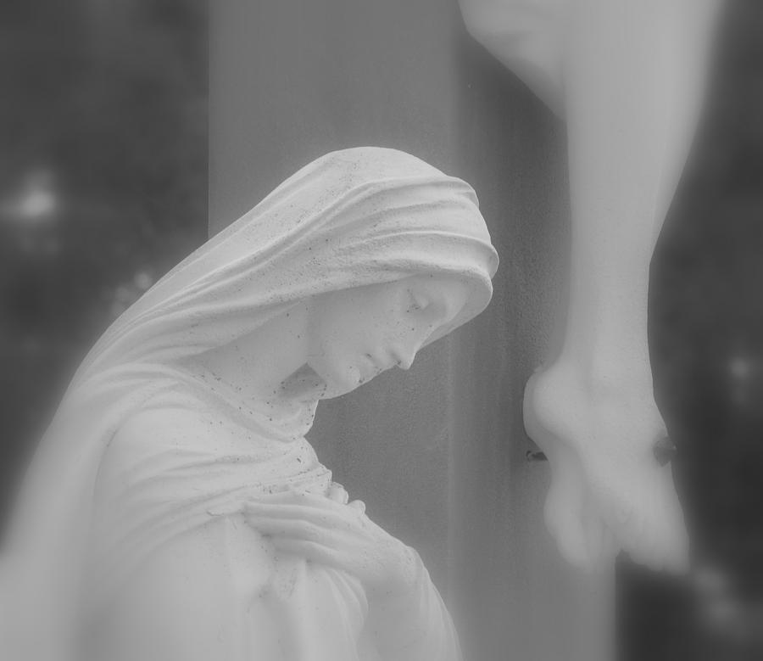
Mediatrix of grace
This means she is the channel of grace.
She does this in two ways:
Through Mary, Christ, the source of all grace, came into the world.
Mary prays for us and asks Jesus to give us all that we need.
Jesus gives graces to us through Mary.
Mary has a special ability to intercede for us.

Slide 9
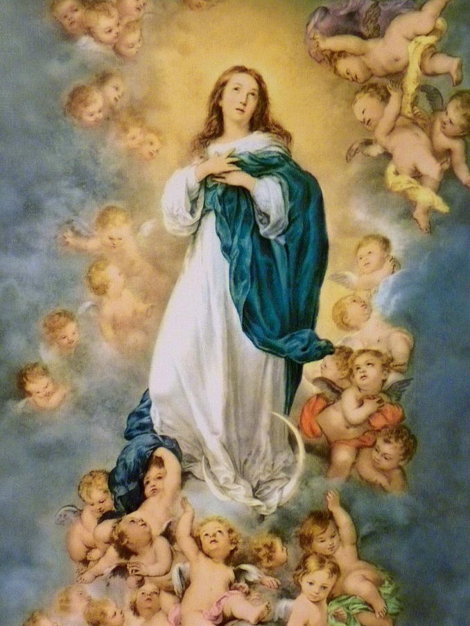
Immaculate Conception
Mary was full of grace and free from the stain of Original Sin from the first moment of her life (at conception).
Gabriel greeted her by saying: “Hail, full of grace” (Lk. 1:28).
Jesus is the source of all grace, which he won on the Cross.
God applied the grace won by Christ on the cross to Mary in anticipation of her yes (or fiat)
With God, there is no time!
Mary was not only immaculately conceived, she never once committed an actual/personal sin.
She was always free from the stain of sin.

Slide 10
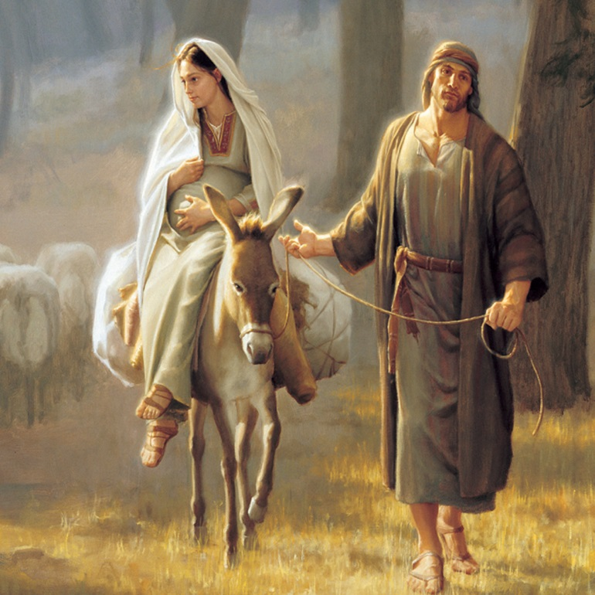
Perpetual Virginity
Mary was a virgin before, during, and after the birth of Jesus.
Jesus was conceived by the power of the Holy Spirit.
Mary is the only woman who can say she is both a virgin and a mother!
This is a beautiful sign of purity and total self-gift.

Slide 11
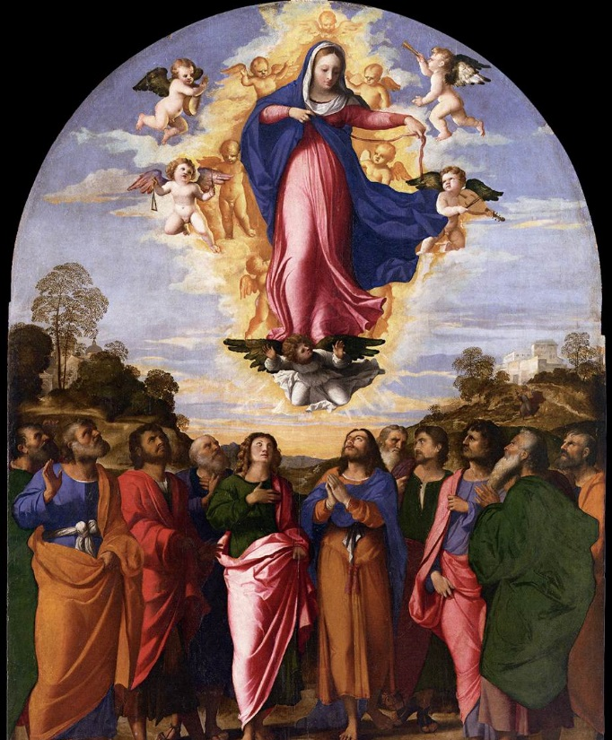
Assumption into Heaven
At the end of her earthly life, Mary was taken to heaven, body and soul.
Bodily corruption is an effect of Original Sin
Mary did not experience the effects of Original Sin, so her body is preserved from the corruption of death.

Slide 12
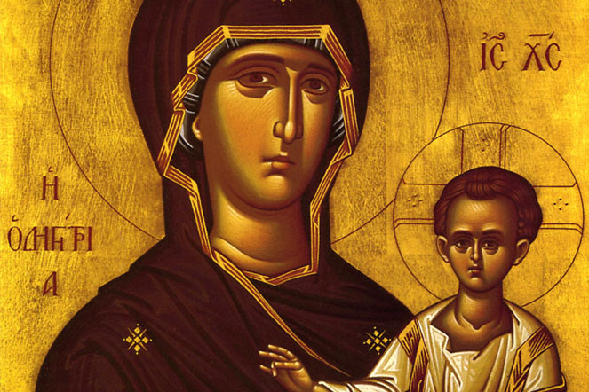
Theotokos
In Greek, Theotokos = Mother of God
Mary is the Mother of Jesus, who is God the Son.
Jesus received his human nature from Mary.

Slide 13
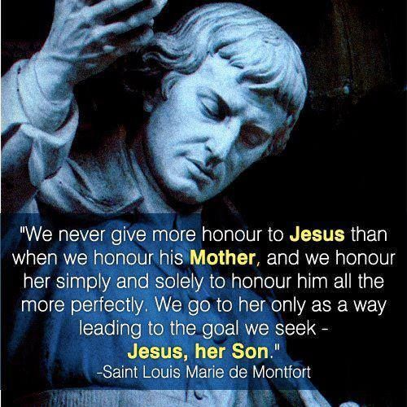
Consecration to Mary
A sign of absolute trust in the motherly, loving concern of Mary for the Church and for us individually
When we trust Mary completely, she will most certainly care for our spiritual and temporal concerns
Lessons from True Devotion to Mary, by St. Louis de Montfort
Mary loves you: “She loves them more tenderly, more tenderly than all the others in the world together. Take the love of all the mothers of the world for their children. Pour all that love into the heart of one mother for an only child…Yet Mary’s love for each of her children has more tenderness than the love of that mother for her child.”

Slide 14
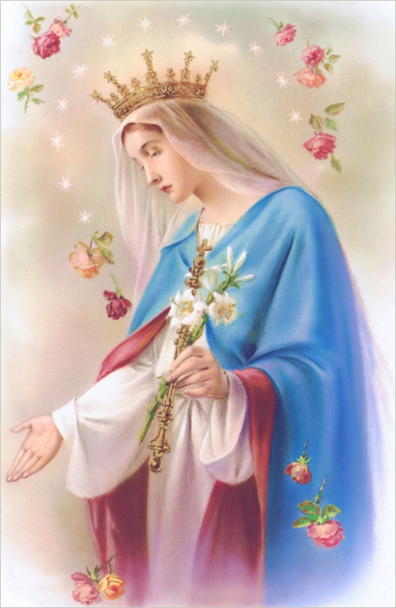
Consecration to Mary
True Devotion to Mary, St. Louis de Montfort
Mary provides for all your needs: “She provides them with everything they need for body and soul.”
Mary leads and guides you: “How could a child that follows such a mother and such an enlightened guide as Mary take the wrong path to heaven? Follow her and you cannot go wrong.”
Mary intercedes for you: “The fifth and greatest service which this loving Mother renders her faithful followers is to intercede for them with the Son. She appeases him with her prayers, brings her servants into closest union with him and maintains that union.”

Slide 15
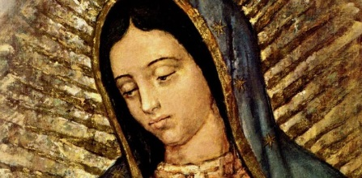
Activities
Act out Revelation 12 where Mary is chased by the dragon. Explain Mary’s power of intercession and her motherhood to us through this story.
Look up pictures of Mary together on the internet and have each student select their favorite. Talk about why they like the pictures.
Pray to the heart room prayer to Mary.

