Slide 1
Sacramentals

Slide 2
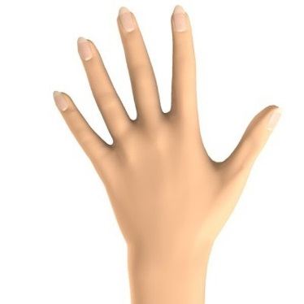
As human beings (body and soul), tangible things help increase our faith.
The matter of sacraments (physical things that we can see, touch, smell, taste, and feel) helps us to better understand what is spiritually happening in the sacrament.
Sacramentals (related to sacraments) sustain us in our faith and assist us on our journey to heaven, we have sacramentals.
Sacred signs established by the Church to give grace to people who use them with the right disposition
Prepare people to receive the sacraments

Slide 3
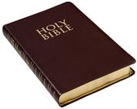
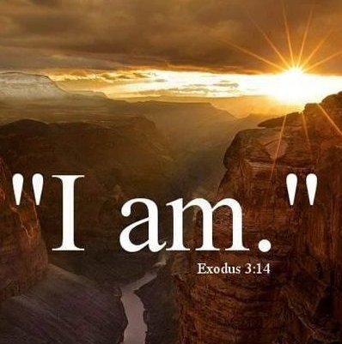
A sacramental is a help for us. When we use it well, we can attain grace and blessings.
When we look at a picture of a scene from the bible, it can help us to meditate upon those events.
The picture is a sacramental – we grow in grace through the meditation, which was helped by the image.
We may find comfort in the tangible – it can be a way to remind us of the constancy of God and his promises.

Slide 4
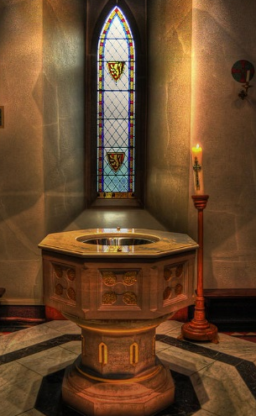
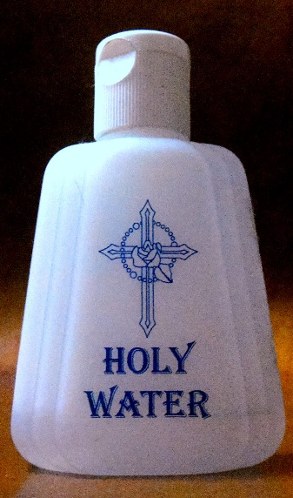
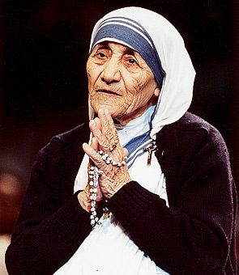
We bless ourselves with holy water to remind us of baptism and the promise of grace.
How do we use sacramentals in a way that opens us to grace?
Praying the rosary should help us to meditate upon the mysteries of our faith.
We should treat sacramentals with respect, for they are sacred signs given to us by the Church.

Slide 5
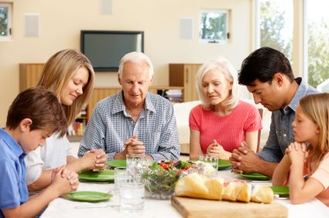
Blessings
A blessing is one example of a sacramental.
It is a ceremony and in this way it is a sign.
It helps us to grow in holiness through God's blessing.
It is not something we can touch, like a rosary or a holy medal, but it is still a sacramental.
Occasions when we receive blessings:
at the end of mass
we bless ourselves with holy water
Before and after meals
When entering a ministry or vocation

Slide 6
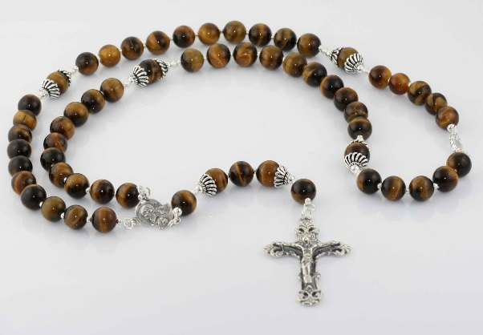
Places can also be blessed, such as a church or shrine. These places are then set apart for God that worship and devotion may occur there.
Blessed objects must be treated with reverence. If it is a time to dispose of a blessed object, it must either be burned or buried.

Slide 7
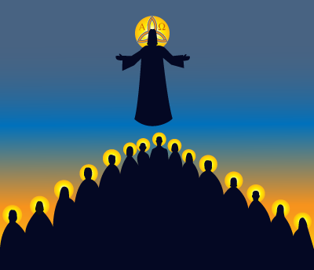
Piety: Reverence for / devotion to God or to the saints.
We do not worship the saints. We worship God alone (latria=worship).
We give devotion (dulia) to saints to honor them for their holiness.
We may ask for their intercession.
Mary, the greatest of all the saints, deserves our greatest devotion (hyperdulia).
Although we call upon the saints to intercede for us, we are not praying to them as God, but asking them to pray with us to God…
“Where two or three are gathered in my name, there am I in the midst of them.” -Matthew 18:20

Slide 8
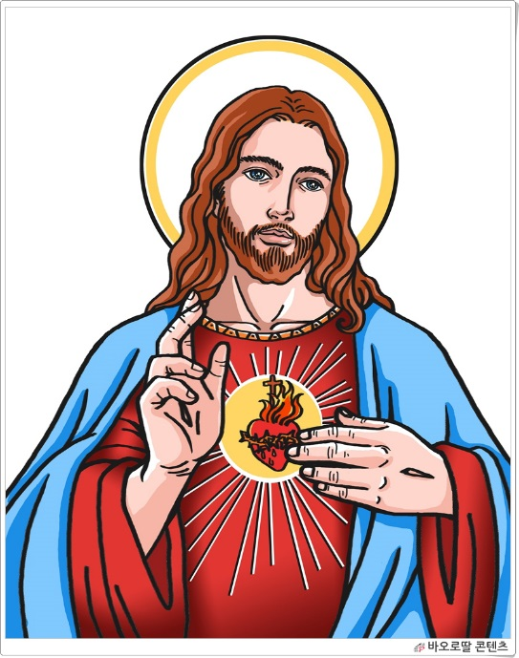
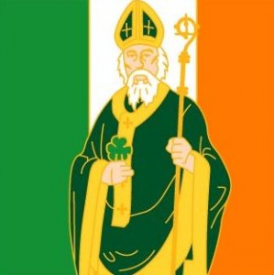
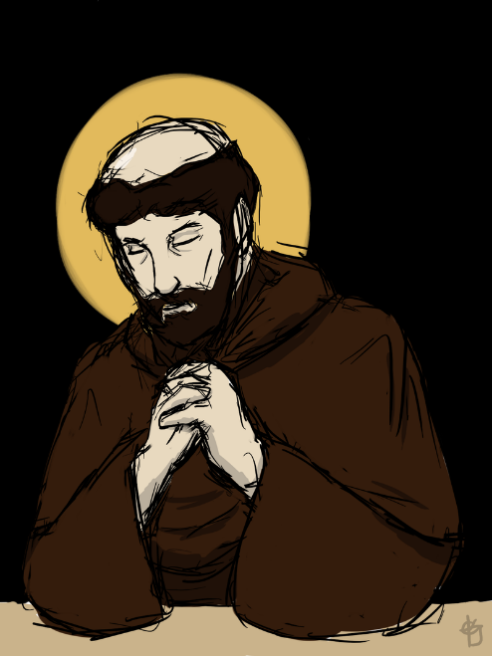
Popular piety is the way people express their personal reference for her devotion to God or to the Saints, in addition to the ceremonies of the sacred liturgy.
E.g.. Praying the Litany of the Sacred Heart is a devotion to Jesus’ sacred heart, which calls attention to his sacrificial love for us.
Saints are popular in different places and times
Different expressions of devotion as time goes on

Slide 9
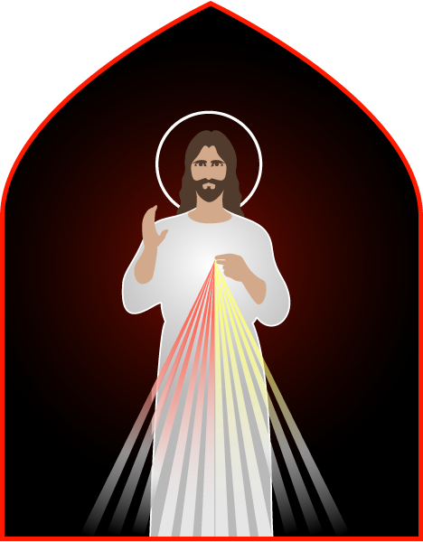
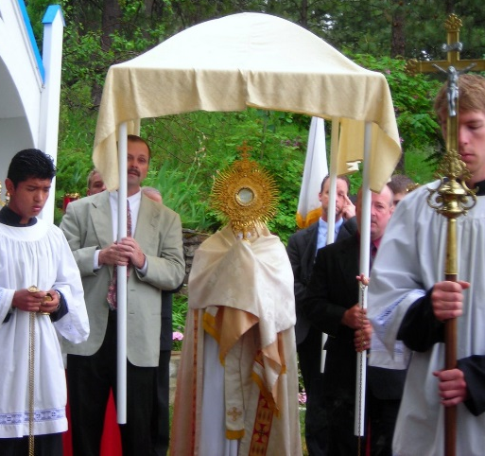
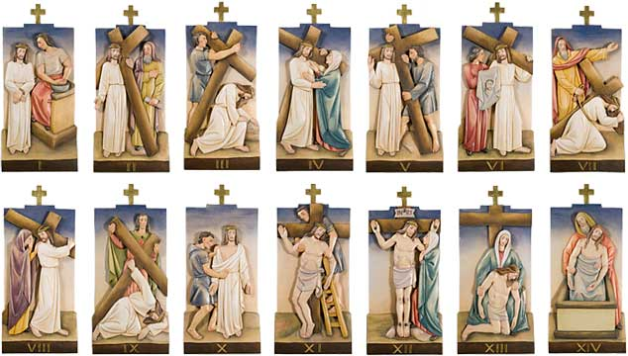
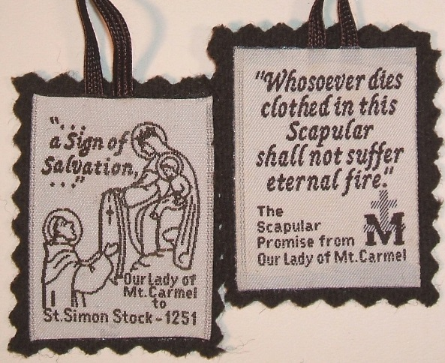
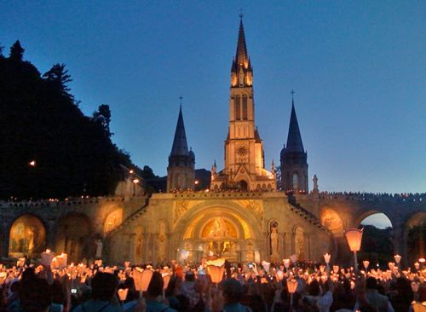
Popular pieties
Veneration of relics
Brown scapulars
Pilgrimages
Processions
Stations of the Cross
Rosary
Chaplet of Divine Mercy

Slide 10
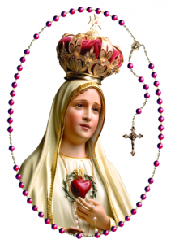
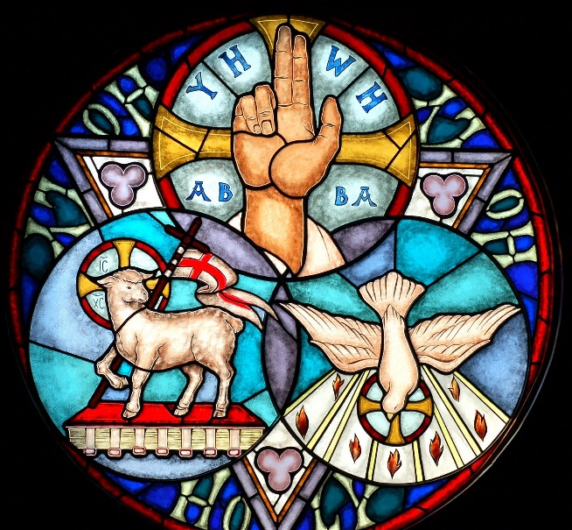
Popular pieties
Even when a popular piety is approved by the Church (e.g.. Our Lady of Fatima), the doctrines and the Sacraments are still more important.
The piety should lead us to a closer relationship with God and a sacramental life.
Even in approved apparitions, there is no new revelation because Jesus Christ has already given us the fullness of God’s revelation.

Slide 11
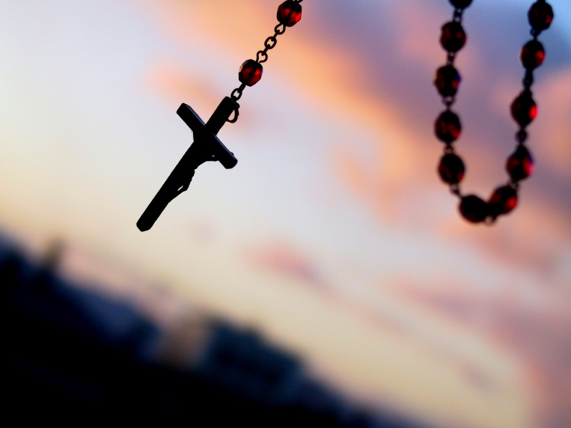
The Rosary
Review the Mysteries of the Rosary
St. John Paul II: I look to all of you, brothers and sisters of every state of life, to you, Christian families, to you, the sick and the elderly, and to you, young people: confidently take up the Rosary once again. Rediscover the Rosary in the light of Scripture, in harmony with the Liturgy, and in the context of your daily lives.

Slide 12
Activities
Have Father show the Church’s relics and explain them.
Tell a story of a time you personally felt God’s love through someone’s actions and explain how God shows His love in little ways through sacramental.

