Slide 1
The Sacrament of Matrimony
As the church is subject to Christ, so let wives also be subject in everything to their husbands. Husbands, love your wives, as Christ loved the church and gave Himself up for her.
–Ephesians 5:24:25

Slide 2
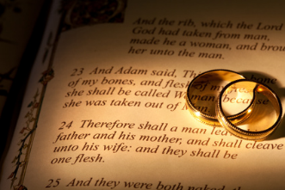
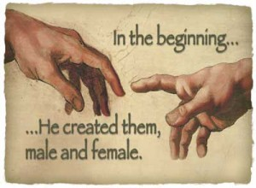
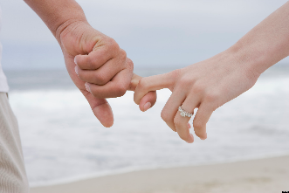
Marriage was instituted by God at the time of creation.

Slide 3
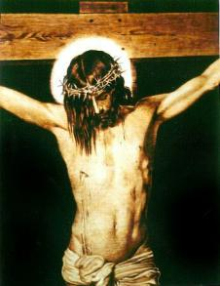
Jesus elevated marriage to the level of a sacrament by giving it his grace.
Marriage models Christ’s love for the Church, shown by his life and death.

Slide 4
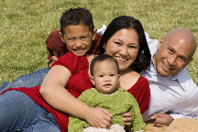
The purposes of marriage include…
mutual love between the spouses
support for one another
procreation (bearing and bringing up children in a loving family)

Slide 5
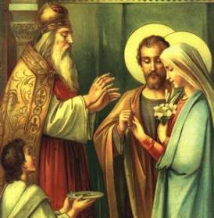
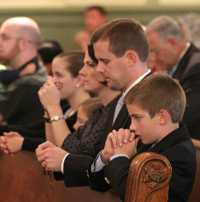
Spouses help each other to know, love and serve God and raise children according to the Faith.

Slide 6
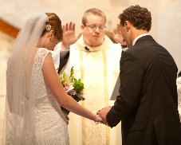
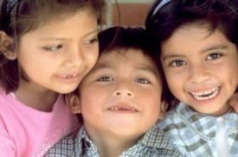
What is a Christian marriage?
Husband and wife must be baptized
Must intend to live their marriage according to God’s plan
A life-long union that is open to children
Free consent

Slide 7
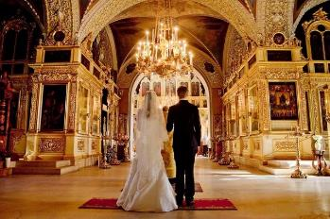
Sign of Matrimony
Minister: man and woman
Matter: man and woman and their consent
Form: the vows

Slide 8
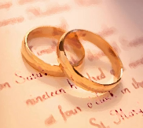
Effects of Matrimony
The marriage bond is perpetual (for the rest of this life) and exclusive (no one else).
Spouses are given grace and strength to fulfill the duties and dignity of their vocation

Slide 9
Divorce and Annulment
Annulment = in the eyes of God, the two people were never truly married to each other; it was an invalid marriage
Divorce = court of law says that the two people are no longer married

Slide 10
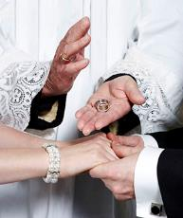
Attacks on Marriage
Marriage is attacked in our culture today.
To prepare for marriage, young people should live chastely, select good friends, and pray.

Slide 11
Activities
Option1: Compare/contrast Christ’s vision of marriage (1 Cor 13:4-8, Mk 10:6) with the world’s view (make a t-chart).
Option 2: Line up a panel of options for a student volunteer to marry and discuss why hypothetically he/she could get married/not get married to each panel option. For example, the panel could include a person of the same sex, an available person of the opposite sex, a married person, a priest, etc. All of these can be students pretending to be someone else.
Option 3: Write a letter to future spouse, Jesus, or the Church.
Option 4: Tell students a story of a normal, but faithful, marriage you know. Point out struggles to be faithful and the lasting joy that comes.
Option 5: Discuss student thoughts about marriage.

Slide 12
Blessed Teresa of Calcutta’s Prayer for Families
Heavenly Father, you have given us the model of life in the Holy Family of Nazareth. Help us, O Loving Father, to make our family another Nazareth where love, peace and joy reign. May it be deeply contemplative, intensely Eucharistic, and vibrant with joy. Help us to stay together in joy and sorrow in family prayer.

Slide 13
Videos
Chris Padgett Talks About Marriage (http://vcat.org/august-2014-chris-padgett-talks-marriage/)
Sacraments 101: Matrimony by Busted Halo (https://www.youtube.com/watch?v=uq2RDYlOLrs)

