Slide 1
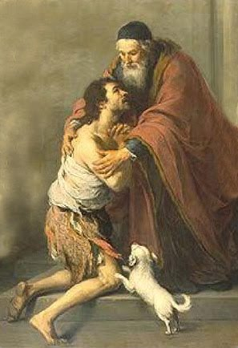
Sin and Mankind
“Those who are well have no need of a physician, but those who are sick.
Go and learn what this means, ‘I desire mercy, and not sacrifice.’
For I came not to call the righteous, but sinners.”
--Matthew 9:12-13

Slide 2
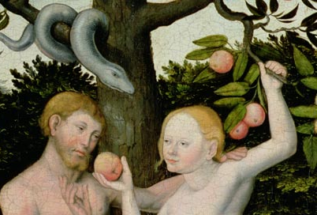
Original sin
First sin of man
Committed by Adam and Eve
Inherited by all human persons
Separates man from God
Denied entrance into Heaven

Slide 3
Temptation
Enticement to sin
Comes before sin
Tells us that the wrong will be good for us

Slide 4
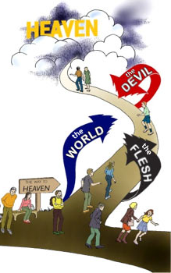
Sources of temptation
World
Persons or created things luring us away from Jesus’ teachings
Flesh
Disordered inner urges
Devil
Satan, other bad angels

Slide 5
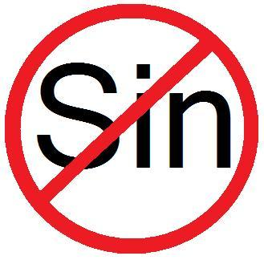
Occasion of sin
Person, place or thing that may easily cause us to sin
Overcoming sin
Know what leads us into sin
AVOID IT!

Slide 6
Sin
Offense against God
2 kinds:
Original
Actual

Slide 7
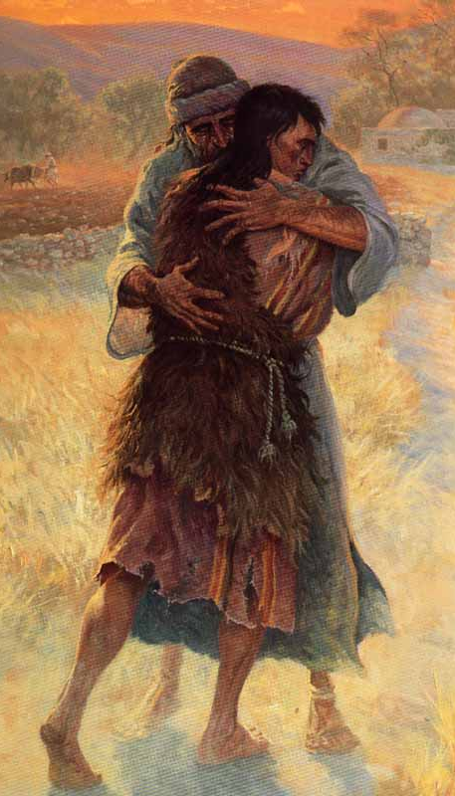
4 ways to sin
Thought
Word
Action
Omission
not doing something we should do

Slide 8
Types of actual sin
Mortal
Venial

Slide 9
Mortal sin
Worst kind of sin
Kills God’s life within us
Can’t go to Heaven
Must be forgiven in Confession
Requires: 1. serious matter, 2. full knowledge, 3. full consent

Slide 10
Venial sin
Less serious, or committed without full knowledge or consent
Weakens our relationship with God
Good to confess them
Forgiven in Holy Communion

Slide 11
Conscience
Ability to judge right from wrong according to what we have learned from faith and reason
We must have a well-formed conscience and act in accord with it

Slide 12
Activity
Students will complete the Capital Sins booklet.

Slide 13
Video
Ocean of Mercy – Chris Stefanick

