Slide 1
The Eucharist in Our Lives
And by that will we have been sanctified through the offering of the body of Jesus Christ once for all.
- Hebrews 10:10

Slide 2
Source and summit
Eucharist is source and summit of Christian life
It is Jesus Himself, who is
source of all grace
goal (summit) of our lives

Slide 3
Eucharistic devotions
Benediction
Jesus blesses us when a Host is put in the monstrance (priest covers his hands)
Perpetual Adoration
Forty Hours
Eucharistic processions
Blessed Sacrament beads
Spiritual Communion

Slide 4
Worthy reception of Holy Communion
Know whom you are about to receive. (FAITH)
Be in a state of grace.
It is a sacrilege to receive the Eucharist in a state of mortal sin.
Observe the Eucharistic fast.
One hour—only water and medicine

Slide 5
Eucharist and the Other Sacraments
The Eucharist is greater than the other sacraments, but related intimately to each one.
Baptism: welcomes us into God’s Church; necessary to receive the Eucharist
Confirmation: outpouring of the Holy Spirit’s gifts to give us a mature faith in Christ’s Real Presence
Penance: takes away our sins so we can receive the Eucharist with a pure heart and in the state of grace
Anointing of the Sick: prepares us for heaven, the glory of which is promised in the Eucharist
Holy Orders: gives us priests who consecrate the Eucharist
Matrimony: witnesses Christ’s love for the Church, which is made present in the Eucharist

Slide 6
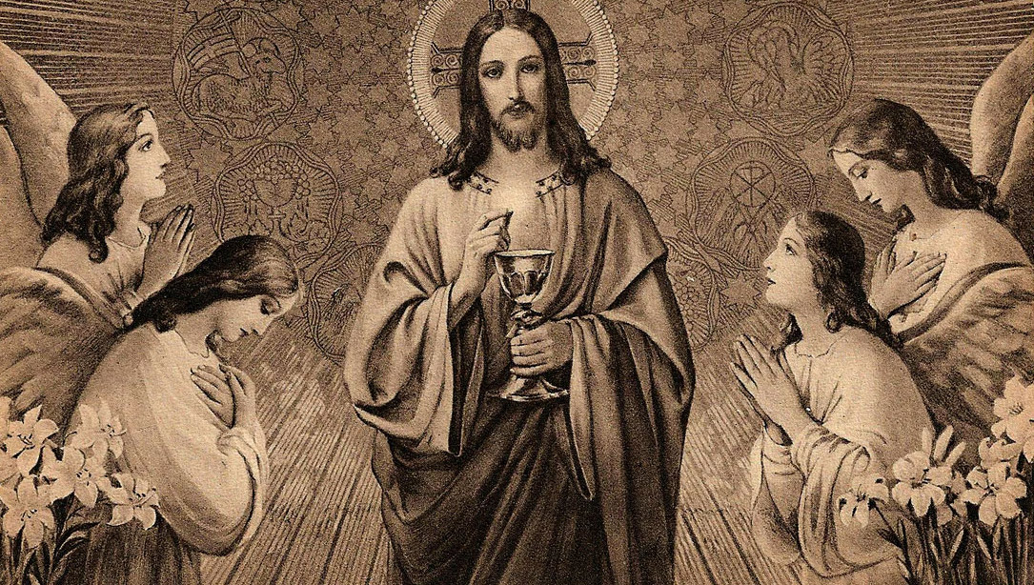
Activity
Receiving Communion Steps (fill in the blank)

Slide 7
Video
Catholic View of the Eucharist
https://www.youtube.com/watch?v=V3pQisDtqw8

