Slide 1
The Holy Prophet Moses
“When the Lord saw that he turned aside to see, God called to him out of the bush, “Moses, Moses!” And he said, “Here am I.” --Exodus 3:4

Slide 2
The Israelites in Egypt
The number of Israelites was increasing rapidly.
Pharaoh ordered the death of every newborn Israelite boy.
Moses was sent down the Nile river by his mother.
Moses was found by Pharaoh’s daughter.

Slide 3
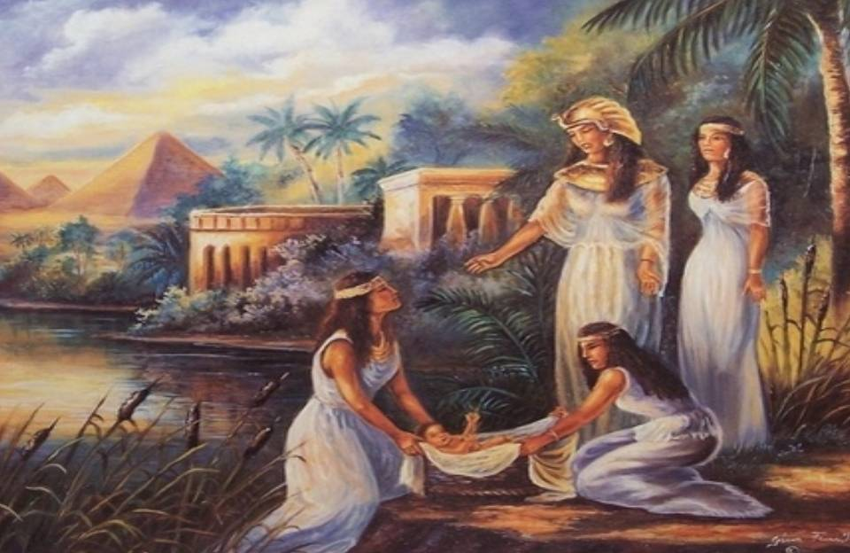
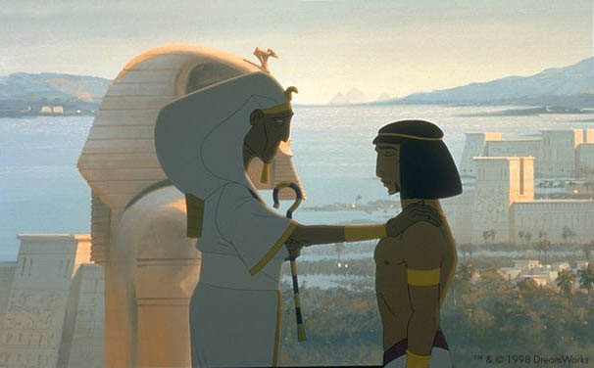

Slide 4
Moses
Moses was raised as a child in Pharaoh’s palace.
Moses witnessed an Egyptian striking an Israelite. He responded by killing the Egyptian.
Moses fled Egypt and became a shepherd.
God appeared to Moses in a burning bush and revealed Himself as “Yahweh”.

Slide 5
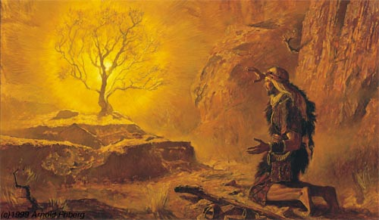
Moses and the Burning Bush Exodus 3:1-22

Slide 6
Moses Returns to Egypt
God instructs Moses to lead the Israelites out of Egypt.
Pharaoh is reluctant to release the Israelites from slavery.
The last plague persuades Pharaoh to release the Israelites.
The plagues were sent upon the Egyptians to teach them that Yahweh is the true God.

Slide 7
The Passover
The Passover was the special meal that each Israelite family celebrated.
The meal consisted of a lamb, unleavened bread, and bitter herbs.
The blood of the lamb was put on the doorposts.
The blood saved them from losing their first born child.

Slide 8
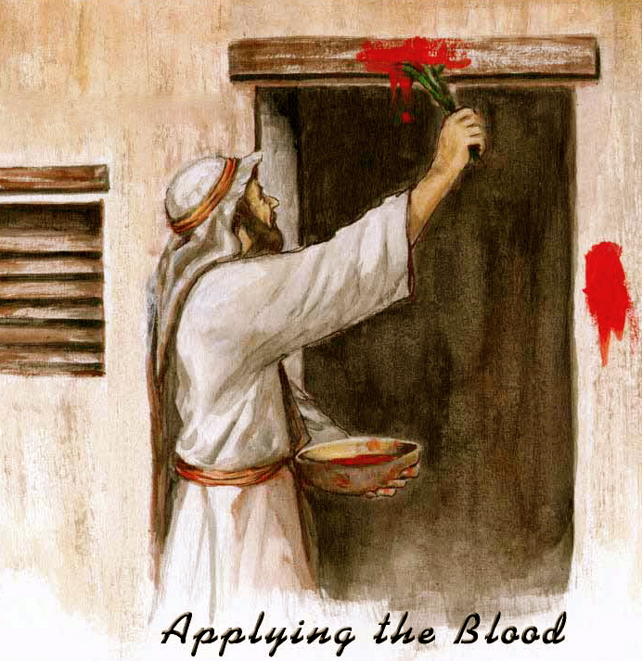

Slide 9
The Eucharist
The Eucharist is the fulfillment of the Passover.
Jesus is the new lamb that is sacrificed.
We eat His body and drink His blood each time we attend Mass.
His sacrifice saves us from eternal death in Hell and enables us to be in a relationship with Him.

Slide 10
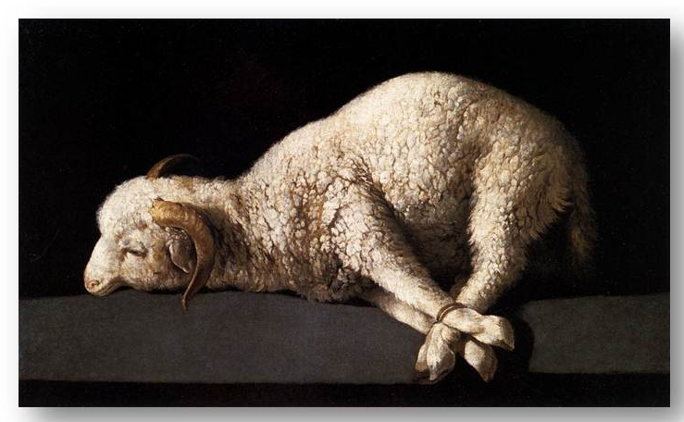
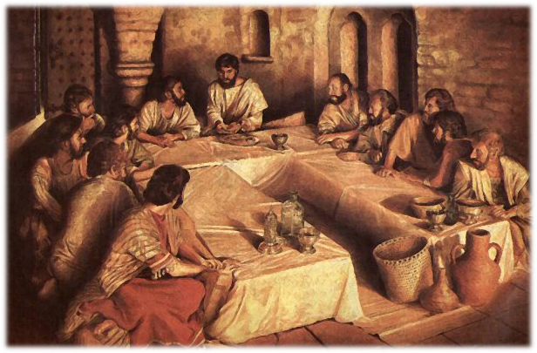
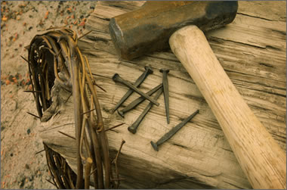
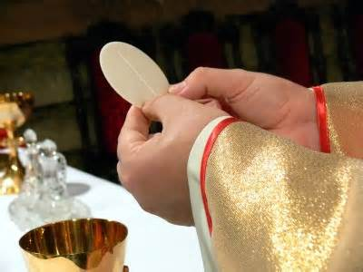

Slide 11
Flight from Egypt
After the last plague Pharaoh let the Israelites leave Egypt.
Shortly after he let them leave he changed his mind.
Pharaoh sent his army to capture them.
As the Israelites approached the Red Sea, Moses parted the Sea.
The Israelites made it to the other side.
All the Egyptians were drowned in the Sea.

Slide 12
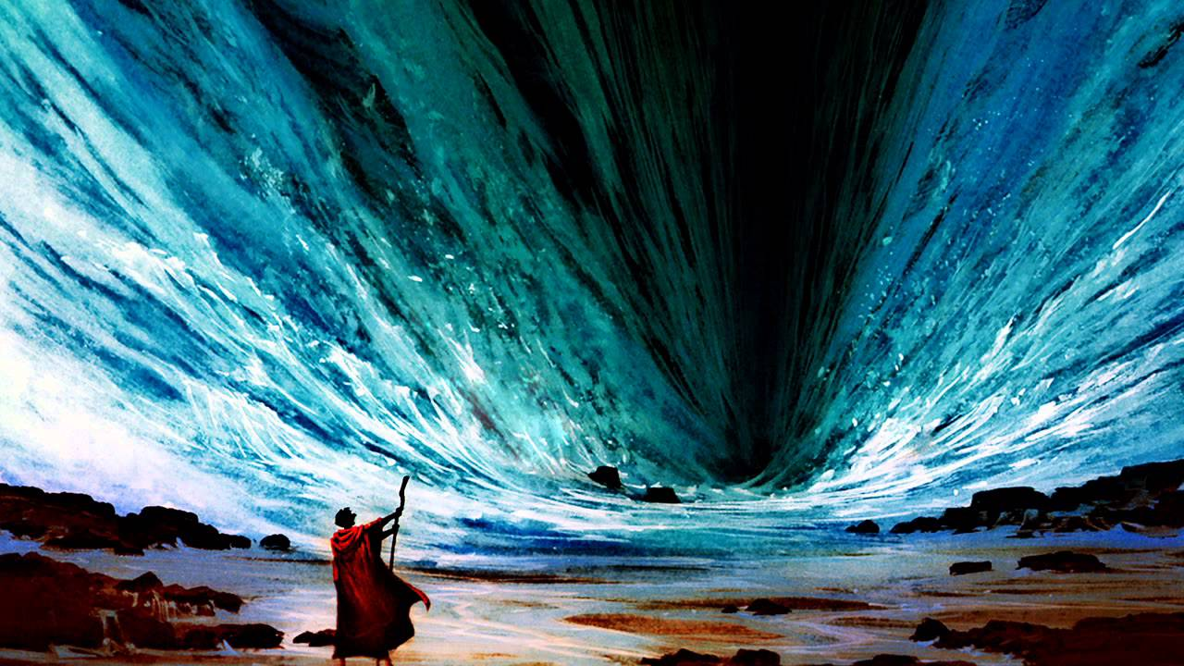

Slide 13
Role Play Activity
Have half the students pretend they are Egyptian soldiers on chariots trying to catch the Israelites.
One student is Moses parting the Sea.
Once the Israelites all pass through the Sea they celebrate on the banks of the Red Sea.

Slide 14
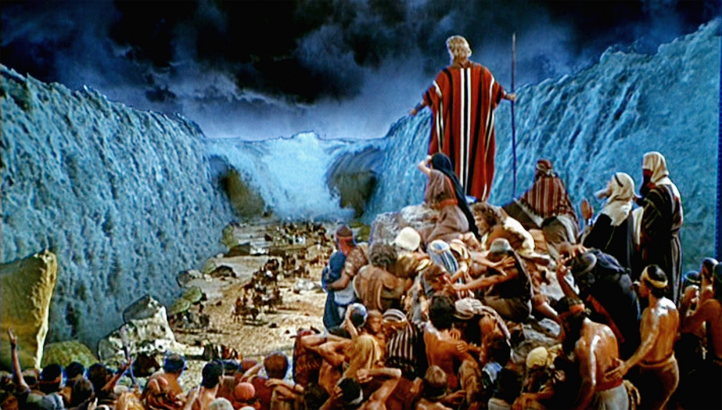
Video
Pillar of Fire and the Parting of the Red Sea
https://www.youtube.com/watch?v=Jo0JMs-evQU

Slide 15
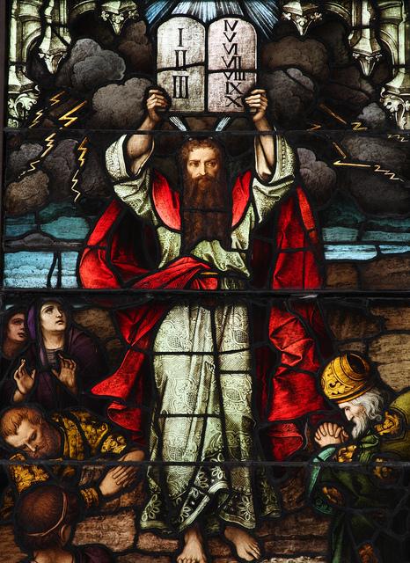
Israelites in the Wilderness
At Mt. Sinai God established a covenant with the Israelites.
God gave the Israelites the Ten Commandments to the people to follow.
The Ten Commandments are binding for all people.

