Slide 1
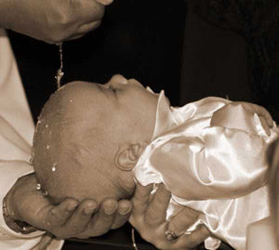
Chapter 18: The Rite of Baptism
“I baptize you
in the Name of
the Father,
and of the Son
and of the
Holy Spirit.”

Slide 2
Brainstorm and discuss:
What words come to mind when I say “water”?
What are some of the functions of water?
Why does the Church use water in Baptism?

Slide 3
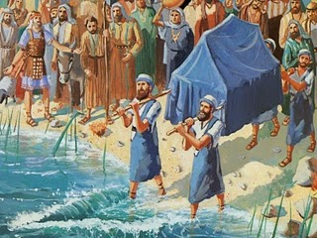
Water in the Old Testament
Noah and the flood
      Genesis 6-7
Parting of the Red Sea
      Exodus 14:14 - 15:3
Crossing of the Jordan River
              Joshua 1:1-15

Slide 4

Significance of water in each story
Noah and the flood
      All sin will be washed away.
Parting of the Red Sea
      We will no longer be slaves to sin.
      We will enter a covenant with God.
Crossing of the Jordan River
              We will inherit the Promised Land of heaven.

Slide 5
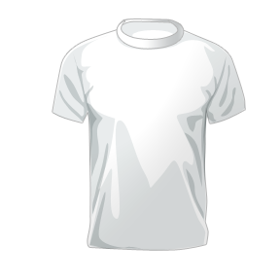
Symbols in the Rite of Baptism
Water Chrism Oil Candle White Garment

Slide 6
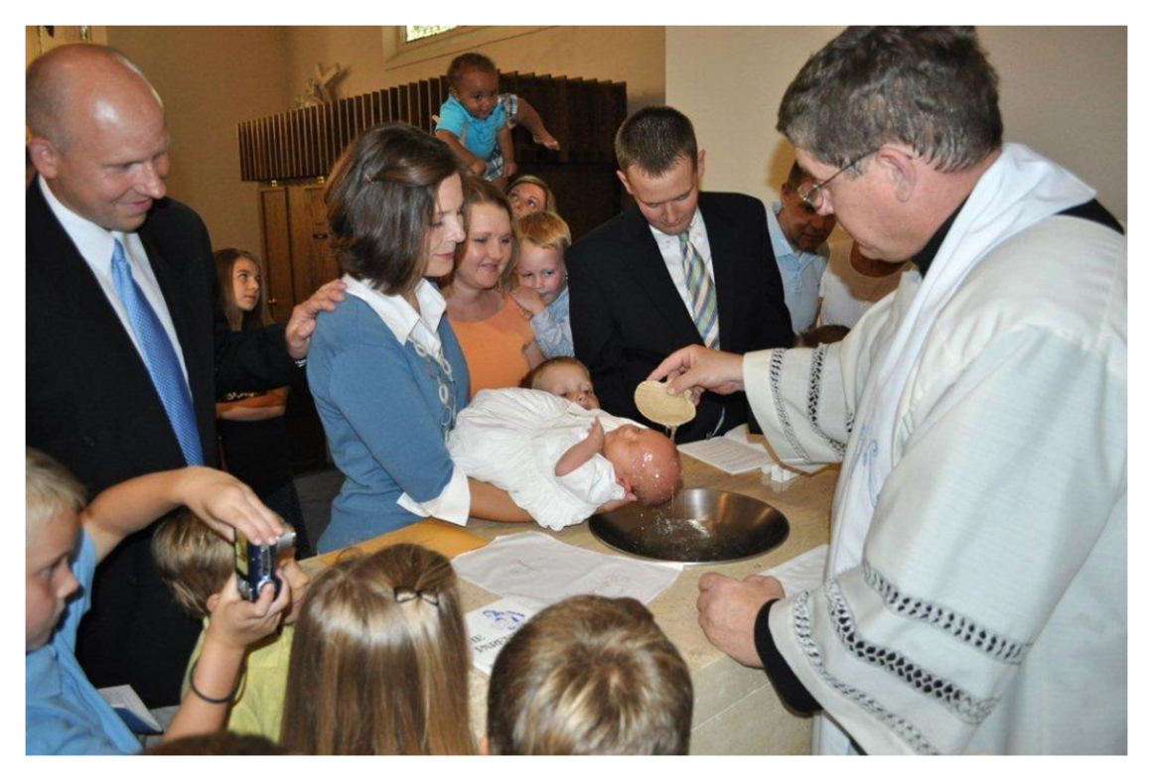
Symbols in the Rite of Baptism
Water
  Poured over the child’s head or the child is immersed.
  Signifies that we have been cleansed from sin.
  All sin (including original sin) is washed away!

Slide 7
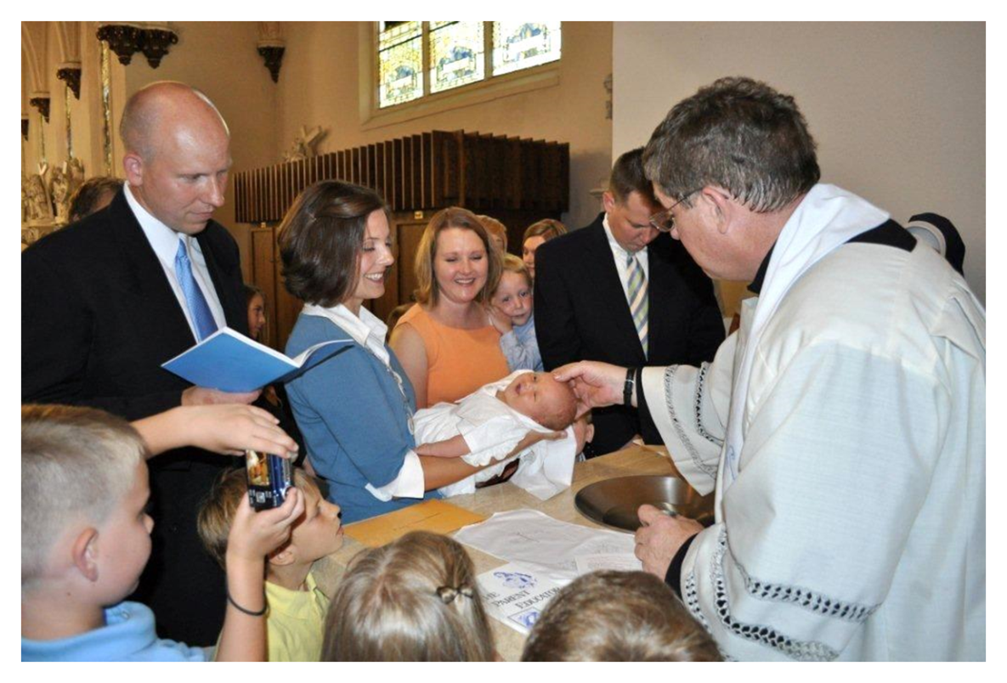
Symbols in the Rite of Baptism
Chrism Oil
  Child is anointed with chrism, which is consecrated by the Bishop.
  Signifies that we share in Christ’s threefold ministry as priests, prophets and kings.

Slide 8
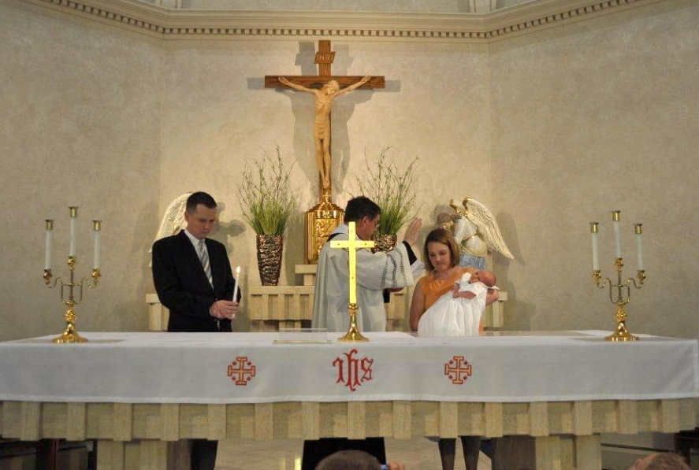
Symbols in the Rite of Baptism
Candle
  Candle is lit and given.
  Signifies that we have received Christ who is the light of the world.

Slide 9
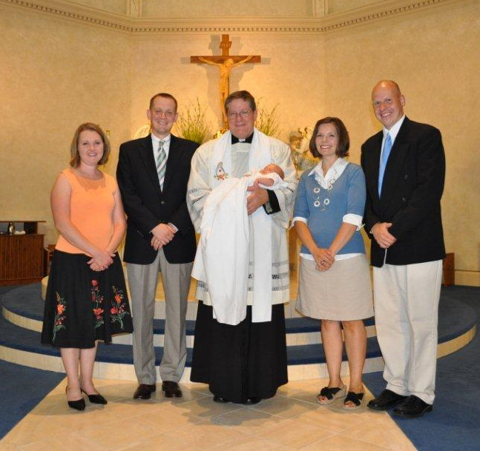
Symbols in the Rite of Baptism
White Garment
  Child is clothed with a white garment.
  Signifies that we are pure and clothed in Christ.

Slide 10
Exorcism
Exorcism occurs after the homily and litany of the Saints.
  Special and powerful ceremony of the Church.
  We are born with original sin, which puts us under the evil influence of the devil.
  Drives away the devil.
  Destroys his influence.

Slide 11
Prayer of Exorcism (from Rite of Baptism)
Almighty and ever-living God, you sent your only son into the world to cast out the power of Satan, spirit of evil, to rescue man from the kingdom of darkness, and bring him into the splendor of your Kingdom of light. We pray for this child: set him free from original sin, make him a temple of your glory, and send your Holy Spirit to dwell within him. We ask this through Christ our Lord. Amen.

Slide 12
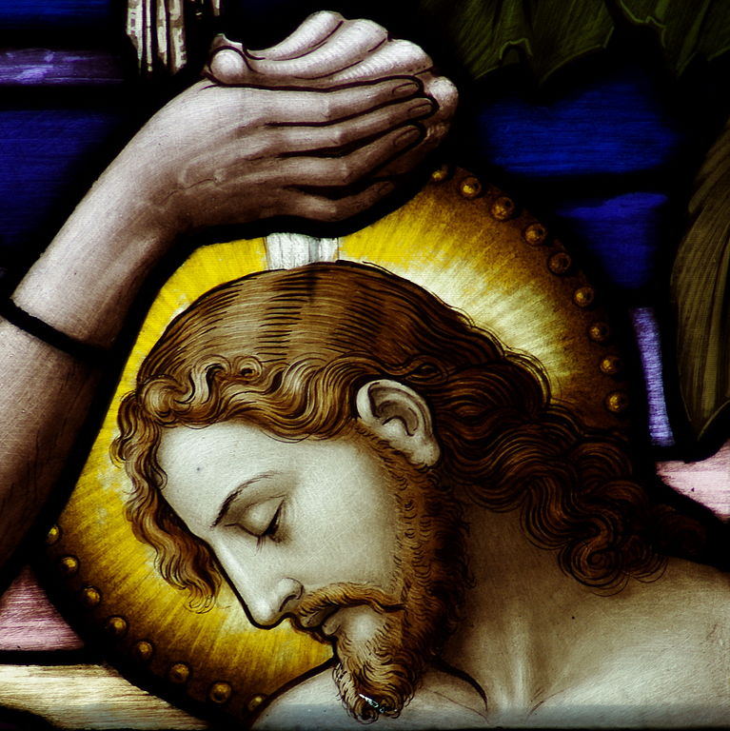
Godparents
  Help parents raise the child in the Catholic faith.
  They are responsible for educating the child in the Faith if the parents are not doing so.

