Slide 1
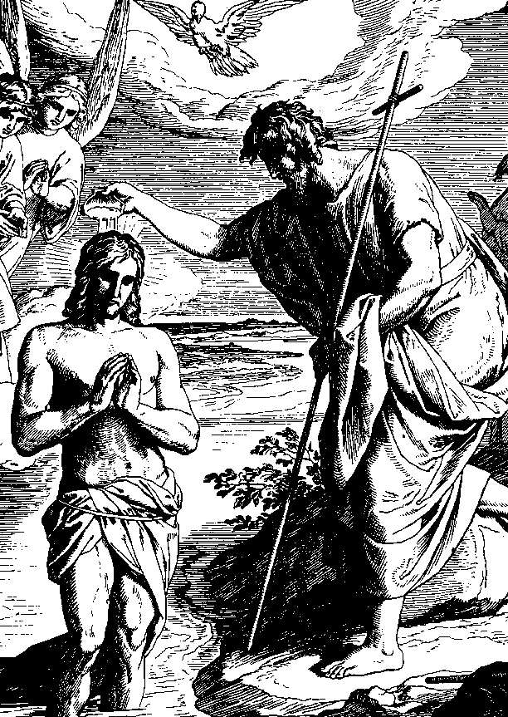
Ch. 17 God calls us to reconciliation
“Truly, truly, I say to you, unless one is born of water and the Spirit, he cannot enter the kingdom of God.”
--John 3:5

Slide 2
“You are free to eat from any of the trees in the garden, except the tree of knowledge of good and evil.” Gen. 2:16-17

Slide 4
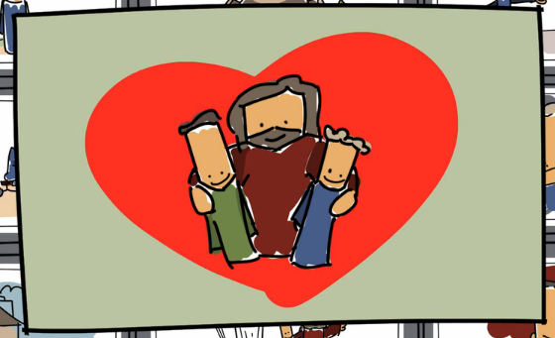
God wants us to be Reconciled with Him!
Reconciliation: the act of re-establishing friendship between two or more persons

Slide 5
God wants us to be Reconciled with Him!
“Good News” = Jesus reconciles us to God
John 3:16 – “For God so loved the world that he gave his only son, so that everyone who believes in him might not perish but might have eternal life.”
Jesus established Baptism to justify us and reconcile us with God.
Do you remember where in the Bible Jesus instituted Baptism? __________________
Matthew 28:19

Slide 7
Effects of Baptism
Justification
Reconciliation
Divine Filiation – makes us sons and daughters of God.
Gives us new life through grace in our soul.
Makes us members of the Church.

Slide 8
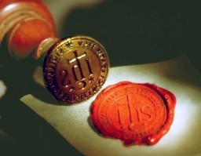
At Baptism we also receive …
An indelible mark on our soul.
A permanent mark that we are a Christian.
We are sealed with Christ.

Slide 9
Free choice
Jesus won grace for everyone, but we must choose to receive it.
God never forces us.
He gives us free will to choose.
We receive this grace in Baptism.

Slide 10
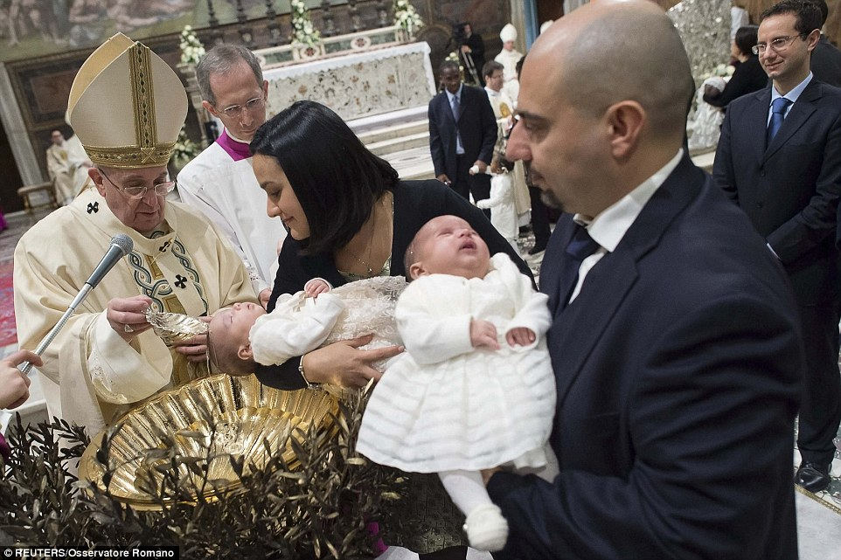
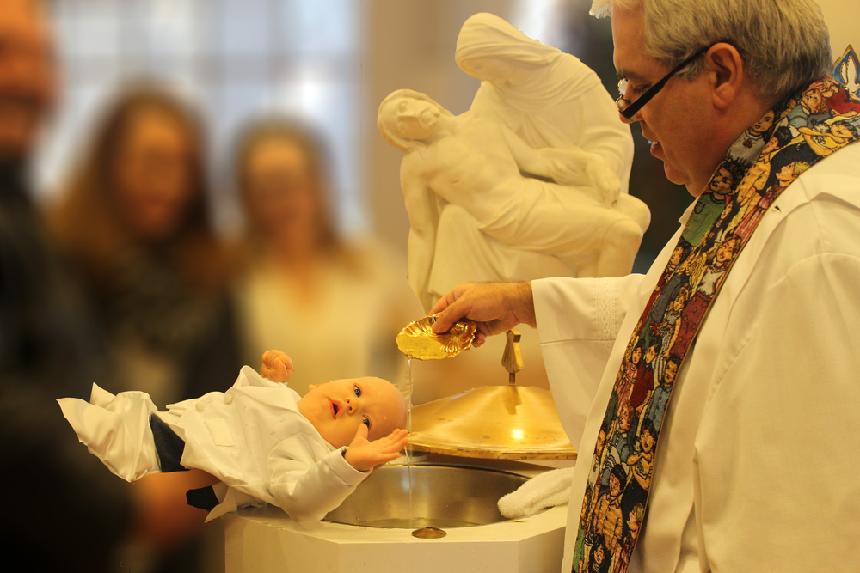
Parents
As infants, our parents act on our behalf, and ask for Baptism for us.
They help us live out and understand this gift of Baptism.

Slide 11
Baptism is Necessary
Baptism gives us grace.
Grace is necessary for our salvation.
Therefore, baptism is necessary for salvation!

Slide 12
What about those who don’t know about Baptism? Can they be saved?
Baptism of desire
the possibility of salvation for those, who through no fault of their own, do not know about the necessity of Baptism in order to enter heaven.
Baptism of blood
The possibility of salvation for those who have not received the Sacrament of Baptism, but who have died as martyrs for Christ.

Slide 13
God gives us much in baptism
“Much will be required of the person entrusted with much, and still more will be demanded of the person entrusted with more.” Luke 12:48
We have been given much and much is expected of us.
By our Baptism, we have certain duties/ responsibilities.

Slide 14
Duties of Baptism
1. Live sacramental lives
Prepare for and receive the sacraments.
Receive Sacrament of Penance and the Eucharist according to our Easter duty.
Get married in the Church.
2. Obey Church teachings
Learn them first!
If we don’t know what the Church teaches about something, find out.

Slide 15
Duties of Baptism
3. Read Scripture.
God communicates to us in the Bible.
4. Attend Mass on Sundays and Holy Days of Obligation.
5. Pray.
6. Do good works.
Is God asking
too much?

Slide 16
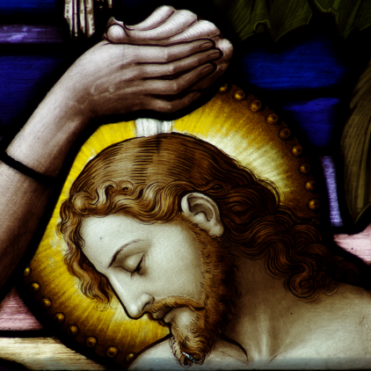
Closing Prayer
Matthew 3:13-17
Then Jesus came from Galilee to John at the Jordan to be baptized by him. John tried to prevent him, saying, “I need to be baptized by you, and yet you are coming to me?” Jesus said to him in reply, “Allow it now, for thus it is fitting for us to fulfill all righteousness.” Then he allowed him. After Jesus was baptized, he came up from the water and behold, the heavens were opened, and he saw the Spirit of God descending like a dove [and] coming upon him. And a voice came from the heavens, saying, “This is my beloved Son, with whom I am well pleased.”

