Slide 1
The Cardinal Virtues Chapter 15
“For this very reason make every effort to supplement your faith with virtue, and virtue with knowledge.”
--2 Peter 1:5

Slide 2
Cardinal Virtues
Once we have received sanctifying grace in Baptism, we don’t just “sit back” and believe that we are saved.
God calls each one of us to prove our
love for Him by:
- prayer.
- good works.

Slide 3
Cardinal Virtues
Supernatural habits.
Help us achieve heaven.
Cardinal = “hinge”
All our good actions depend on or “hinge” upon these virtues.
Practicing these virtues makes us virtuous.

Slide 4
Prudence
Gives us power to:
make right decisions.
judge what is good.
choose the right means of attaining the good.

Slide 5
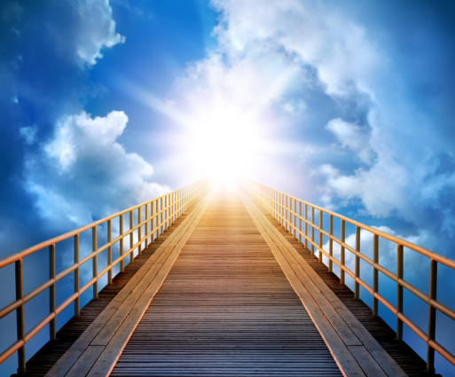
Prudence
Natural prudence: might indicate the best way to earn money.
Supernatural prudence: indicates the best way to get to heaven and help others get there.

Slide 6
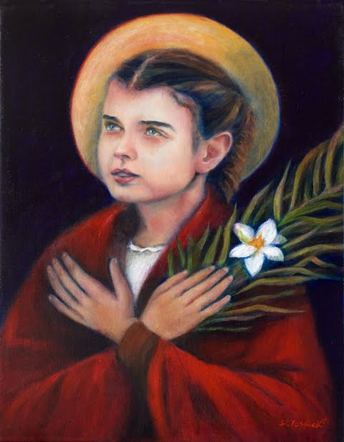
Model of Prudence
St. Maria Goretti
True good: heaven
The right way to get there: avoid mortal sin

Slide 7
Justice
Gives us power to:
respect the rights of others.
give others what is due to them.
Since we owe God sincere worship, we offer Him true worship, from the heart.
We owe our parents obedience and respect, so that is what we give them.

Slide 8
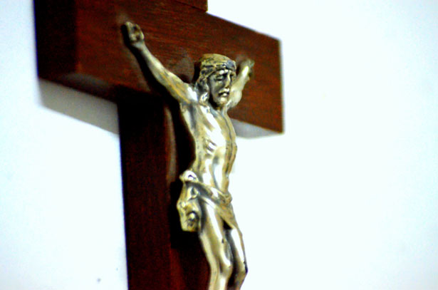
Justice
Natural: the work of a
civil court.
Supernatural: attending Sunday Mass, worshipping God who saved us from our sins.

Slide 9
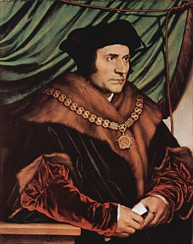
Model of Justice
St. Thomas More
“I am the king’s good servant, but God’s first.”

Slide 10
Temperance
Gives us power to:
control ourselves.
Direct our desires.
Each sense has an attraction (watch exciting TV shows, listen to music…).
Our senses are good and creation is good, but we must order them according to God’s will.

Slide 11
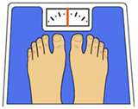
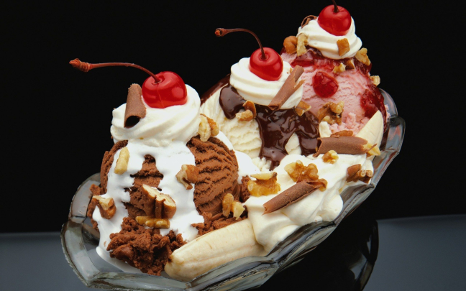
Temperance
Natural: might include dieting to lose weight.
Supernatural: offering up food as a penance.

Slide 12
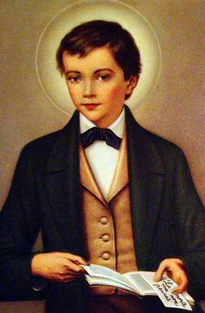
Model of Temperance
St. Dominic Savio
Promised God that he would never commit mortal sin.
Kept this promise because he consistently practiced temperance.

Slide 13
Fortitude
Gives us power to:
pursue the good.
face difficulty and danger with peace and courage.
Courage to do the right thing when it is hard.
Strength to do the right thing in everyday circumstances.

Slide 14
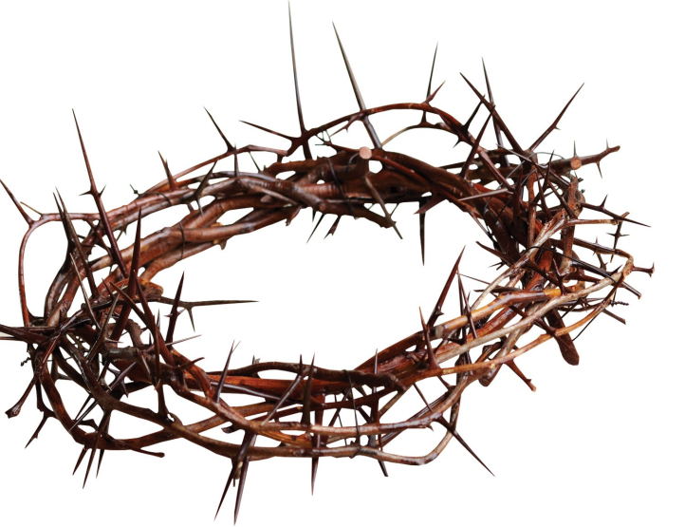
Fortitude
Natural: athletic training
Supernatural: suffering martyrdom

Slide 15
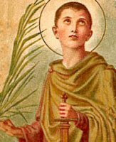
Model of Fortitude
St. Pancras
Like all martyrs, he practiced fortitude.
Refused to deny Jesus, even though he was afraid of being killed.

Slide 16
Virtue and Vice
Virtue is a habit of doing good.
Vice is a habit of doing wrong.
To oppose vice, we must practice virtue.
There are 7 capital vices (sins) and 7 corresponding virtues.

Slide 17
Capital Sins and Corresponding Virtues
Pride
One places himself or herself before God and neighbor.
Humility
Seeing ourselves as we truly are, as God’s children.
Models: St. John the Baptist and St. Catherine of Siena

Slide 18
Capital Sins and Corresponding Virtues
Avarice
Covetousness.
Wanting things which we do not have a right to.
Liberality
Generosity with our goods and talents.
Models: St. Katherine Drexel and St. Anthony of Egypt

Slide 19
Capital Sins and Corresponding Virtues
Lust
An inordinate desire for something.
Examples: money, sexual pleasure
Chastity
Temperance with our desires.
Models: St. Agnes and St. Aloysius Gonzaga

Slide 20
Capital Sins and Corresponding Virtues
Anger
Harboring dislike and aversion toward someone.
Patience
Putting God and others before ourselves.
Acting with gentleness and meekness.
Models: Bl. Pier Giorgio Frassati and St. Therese of Lisieux

Slide 21
Capital Sins and Corresponding Virtues
Gluttony
Having too much of something.
Food, drink, shopping …
Sobriety
Using created goods well, with proper limits.
Model: St. Francis of Assisi

Slide 22
Capital Sins and Corresponding Virtues
Envy
Serious jealousy.
If we can’t have what another has, then we do not want them to have it, either.
Brotherliness
Wanting the best for others.
Happy for others’ goods and successes.
Model: St. Bernard of Clairvaux

Slide 23
Capital Sins and Corresponding Virtues
Sloth (pronounced with a long o)
Spiritual laziness.
Diligence in the service of God
To persevere in our spiritual life.
Models: St. Teresa of Avila and Bl. Teresa of Calcutta

