Slide 1
Chapter 14 Faith, Hope and Charity
“So faith, hope, love remain, these three; but the greatest of these is love.” –1 Corinthians 13:13

Slide 2
By the end of class …
you will know the definition of virtue.
you will distinguish between natural and supernatural virtues.
you will identify the three Theological virtues.

Slide 3
Virtue
Virtue is a habit of doing good.
Practice and prayer help us to grow in virtue.
With practice, our good acts become habits and it becomes easier for us to act rightly.

Slide 4
What the Catechism says …
“A virtue is an habitual and firm disposition to do the good. It allows the person not only to perform good acts, but to give the best of himself.” --CCC #1803

Slide 5
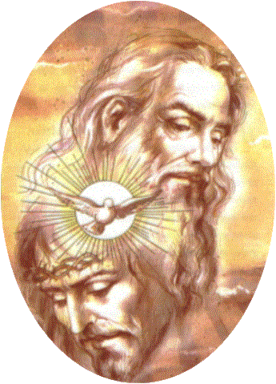
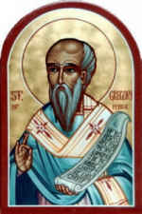
What the Saints say …
“The goal of a virtuous life is to become like God.”
--St. Gregory of Nyssa

Slide 6
2 Kinds of Virtue
Natural Virtue
Things we work for.
Acquired by practice, repeating good acts.
Example: power to be honest
Supernatural Virtue
Given directly by God.
Infused into our souls.
Examples: faith, hope, love

Slide 7
What’s the difference?
Natural Virtue
Deny oneself food to be attractive.
Help others because we owe them a favor.
Controlling what we say to stay out of trouble.
Supernatural Virtue
Deny oneself food as penance.
Help others to imitate Jesus’ love.
Controlling what we say to be meek and humble like Jesus.

Slide 8
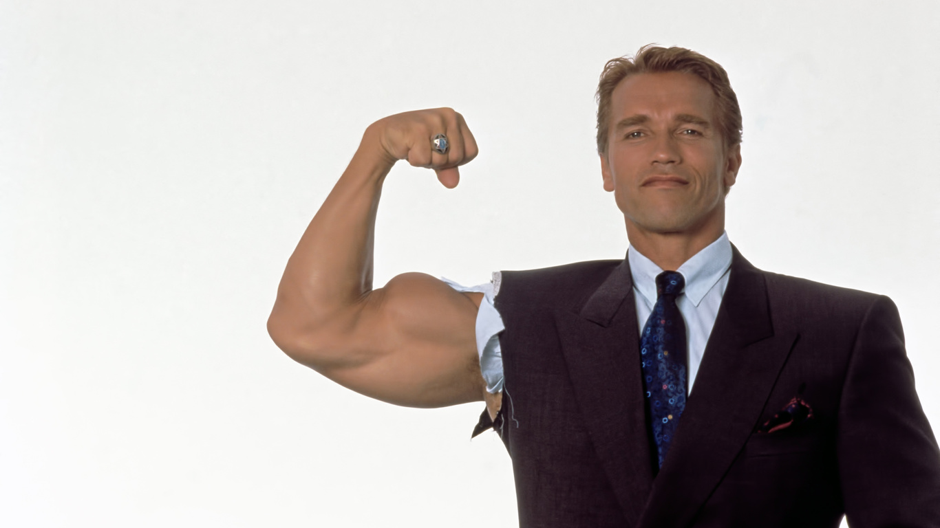
Virtues are like muscles for the soul.
We must exercise them to make them strong.
The more we exercise these virtues, the easier it is to use them.
As we become strong in virtue, we become strong in our spiritual life.

Slide 9
3 Theological Virtues
Faith, hope and charity.
Theos = God (Greek word).
Gifts from God received through the Sacraments.
Direct us toward God.

Slide 10
The Virtue of Faith
Virtue that gives us power to believe in God and in all that He has revealed through Christ and the Church.
Necessary for salvation.
We may never understand all the mysteries of our Catholic faith, but we still believe they are true.
To accept something in faith means to believe it’s true because we trust the one who reveals it, not because it can be proven.

Slide 11
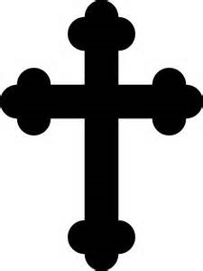
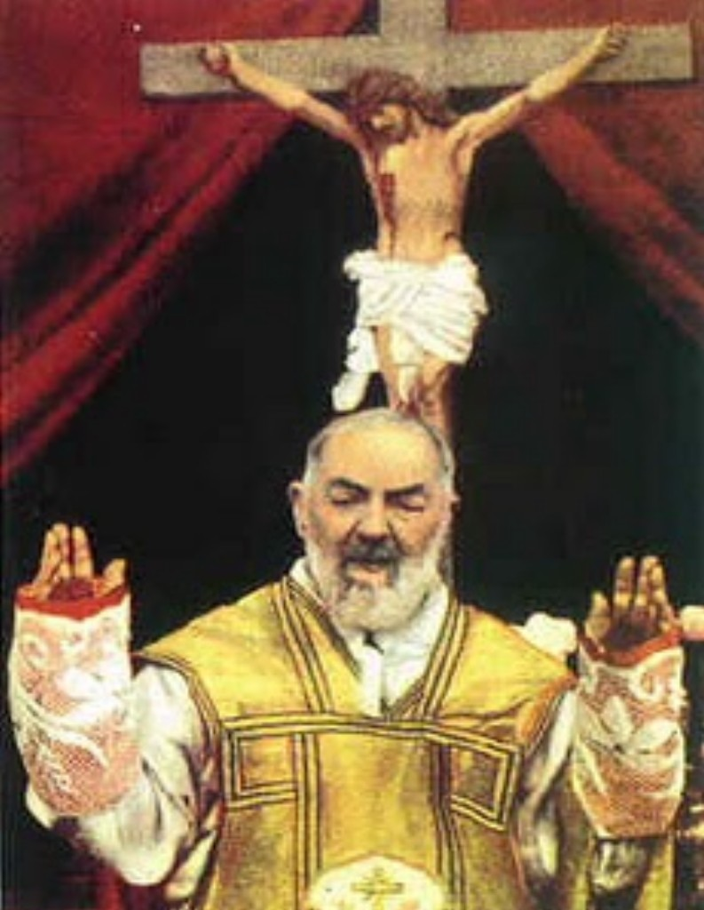
The Virtue of Faith
Symbol: Cross
Why?
Saint Padre Pio:
a model of faith

Slide 12
The Virtue of Hope
The power to trust in God and His promises.
Keeps us from getting discouraged by problems and struggles.
Different from a worldly “want” or “desire.”
Inspires us to pray for those who have died because we hope they will be in heaven.
Encourages us to be faithful to God’s teachings knowing that He will give us help and reward.
We order our lives according to what we hope for.

Slide 13
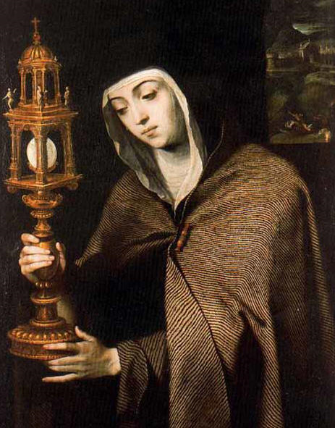
The Virtue of Hope
Symbol: Anchor
Why?
Saint Clare:
a model of hope

Slide 14
The Virtue of Charity
The power to love God above all things and to love our neighbors for love of God.
Every time we sin, we are lacking in charity.
To love God is to please Him by doing good.
To love our neighbor is to want good for them.
Charity is not just a feeling!
It is an act of the will, a decision and self-gift for another.
If we truly love God, we will love our neighbor too.

Slide 15
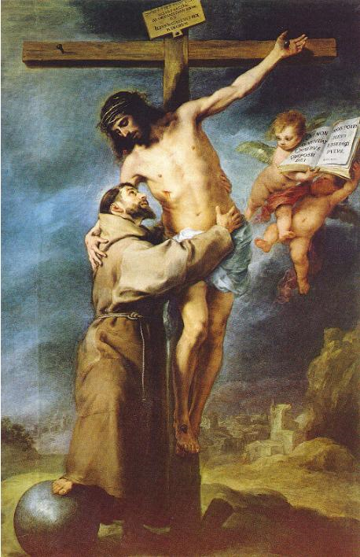
The Virtue of Hope
Symbol: Heart
Why?
Saint Francis of Assisi:
a model of charity

Slide 16
Acts of Faith, Hope and Love
Act of Faith
O my God, I firmly believe that You are one God in three divine Persons: Father, Son, and Holy Spirit. I believe that Your divine Son became man and died for our sins, and that He will come to judge the living and the dead. I believe these and all the truths that the Holy Catholic Church teaches because You have revealed them, Who can neither deceive nor be deceived. Amen.

Slide 17
Acts of Faith, Hope and Love
Act of Hope
O my God, relying of Your infinite goodness and promises, I hope to obtain pardon of my sins, the help of Your grace, and life everlasting, through the merits of Jesus Christ, my Lord and Redeemer. Amen.
Act of Love
O my God, I love You above all things, with my whole heart and soul because You are all-good and deserving of all my love. I love my neighbor as myself for love of You. I forgive all who have injured me and ask pardon of all whom I have injured. Amen.

