Slide 1
Chapter 13: Grace
We need grace to get to heaven.
Grace is like a football.
You have to have the football to score a touchdown!
Grace is necessary for Salvation.
Sanctifying Grace=Sacraments
Actual grace = Inspired opportunities to do good and grow in holiness

Slide 2
What you will know by the end of class:
The two kinds of grace
sanctifying grace
actual grace
What the purpose of our life is.

Slide 3
The definition of grace
Grace is the free gift God gives us
by which we reach heaven.
Two kinds of grace
Sanctifying Grace
Gives us a share in God’s own life, making us His adopted children and making it possible for us to be with Him in heaven.
Actual Grace
The day-to-day help that enlightens our mind and strengthens our will so that we may do good and avoid evil.

Slide 4
Sanctifying Grace
Jesus and Mary were/are always full of sanctifying grace.
We receive sanctifying grace at Baptism.
Share in God’s life
Makes us holy, children of God
Gives us supernatural powers of faith, hope and charity
Allows us to get to heaven - to be saved
Received in all 7 Sacraments
Only lost by mortal sin

Slide 5
Actual Grace
Actual Grace
day-to-day help that enlightens our mind and strengthens our will so that we may do good and avoid evil.
Enlightens our mind
Helps strengthen our will
Allows us to do good works and avoid sin.
What are some examples of actual grace in your life?

Slide 6
The Purpose of Our Lives
To know, love and serve God in this life so we can be happy with him in heaven.
We can only do this with God’s gift of grace.
We have free will:
We must chose to receive grace, to receive the sacraments, to grow in grace.
We can chose to lose grace through mortal sin.
Our thoughts, words, deeds and omissions determine our ability to receive, sustain and reject grace
Ask ourselves, “What is Jesus asking of me?”

Slide 7
Saints
We are all called to be Saints!
We are all given the grace necessary, we just have to listen and receive the grace offered to us.
God knows what we need and gives us the ability to succeed and gives us enough grace to be a saint and be happy forever in heaven.

Slide 8
Let’s go back to the football analogy …
Your life is like a football game:
Grace is the football. You want to keep possession of the ball.
The goal of the game is to get the ball (grace) and get to the end zone (heaven).
Notes:
Life is like a football game. In the game you try and get the ball and get to the end zone and make a touchdown, but you can’t do this without the football. You can fumble the ball (sin) and intercept the ball (Confession/doing penance). Every Eucharist is a first down. But you can’t make a touchdown without the football=grace.

Slide 9
Let’s go back to the football analogy …
You may fumble the ball (fumbling the ball = sin).
You may intercept the ball (intercepting the ball = Confession/doing penance).
Receiving Communion is like getting a first down.
Notes:
Life is like a football game. In the game you try and get the ball and get to the end zone and make a touchdown, but you can’t do this without the football. You can fumble the ball (sin) and intercept the ball (Confession/doing penance). Every Eucharist is a first down. But you can’t make a touchdown without the football=grace.

Slide 10
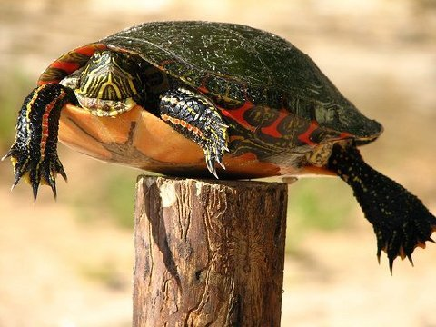
God’s gift to us: another way to look at grace
This turtle wasn’t able to get to the top of the
post on his own; someone put him there.
We can’t get to heaven on our own;
we need God’s grace to get there!

